Slide 1
Keeping your Azure Apps Healthy & Happy
Puneet Gupta & Khaled Zayed
puneetg@microsoft.com & khzayed@microsoft.com

Slide 2



Introduction
Agenda
App Service & Function App Diagnostics Experience
Troubleshooting Scenarios:
Web App - Performance Scenario
Web App for Containers - Configuration Scenario
Function App - Application Code Scenario

Slide 3

Under the App Service Umbrella
Web Apps: our PaaS platform where you can quickly deploy and scale fully-managed web apps
Web App for Containers: bring your own Docker container to the App Service on Linux platform
App Service Environment: provides a dedicated and isolated environment to run your apps securely and at a very high scale
Platform-as-a-Service
Azure Functions: our serverless platform for executing code based on event-driven scale
Serverless

Slide 4
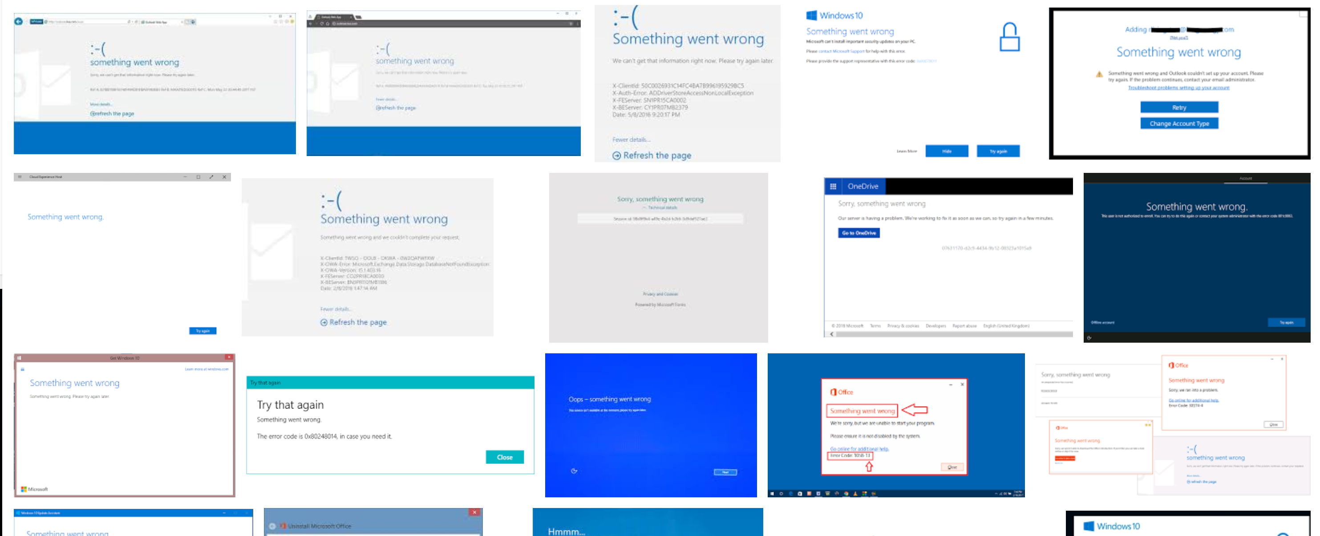
When things go wrong…

Slide 5

What can happen when things go wrong?
Symptom
Under the hood
Application Code
“My app is down!”
“My app is running slow.”
“My container isn’t starting.”
“My Function is
throwing errors!”
Deployment
Configuration
Management
Certificates and Domains
Availability and Performance

Slide 6
What can happen when things go wrong?
Symptom
Under the hood
Application Code
“My app is down!”
“My app is running slow.”
Deployment
Configuration
Management
Certificates and Domains
Availability and Performance

Slide 7
Demo: App Service Diagnostics Experience & Performance Scenario

Slide 8


Key Takeaways
Rich diagnostics in App Service Diagnostics
One-click solutions
Proactive & reactive diagnostic tools
App Service Plan Density
Apps running in the same App Service Plan share the same underlying resources
Resource intensive apps, can have a negative effect on neighboring apps
Distribute apps in different App Service Plans to distribute the load
RedmondBakery
VegasBakery
VancouverBakery
NewYorkBakery
….
….
….
ChicagoBakery
RedmondBakery
VegasBakery
VancouverBakery
NewYorkBakery
….
….
….
ChicagoBakery
Instance 1
Instance 2
App Service Plan

Slide 9
What can happen when things go wrong?
Symptom
Under the hood
Application Code
“My app is down!”
“My app is running slow.”
Deployment
Configuration
Management
Certificates and Domains
Availability and Performance

Slide 10
What can happen when things go wrong?
Symptom
Under the hood
Application Code
“My containers isn’t starting”
Deployment
Configuration
Management
Certificates and Domains
Availability and Performance

Slide 11
Demo: Web App for Containers - Configuration Scenario

Slide 12
What can happen when things go wrong?
Symptom
Under the hood
Application Code
“My containers isn’t starting”
Deployment
Configuration
Management
Certificates and Domains
Availability and Performance

Slide 13
What can happen when things go wrong?
Symptom
Under the hood
Application Code
“My Function is throwing errors!”
Deployment
Configuration
Management
Certificates and Domains
Availability and Performance

Slide 14
Demo: Function App - Application Code Scenario

Slide 15

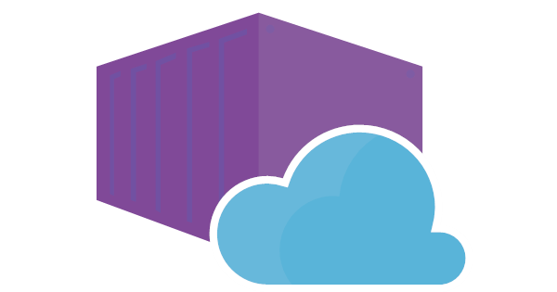

Key Takeaway: Try App Service & Function App Diagnostics
Use App Service Diagnostics as a starting point to guide you in your troubleshooting process.
If you don’t know where to start, select the problem category that best fits your issue to launch Genie.
If you know your specific problem, feel free to search App Service Diagnostics.
Try out the “Best Practice” suggestions to prepare your app for production workloads.
Select Availability and Performance to run a health checkup
Select a category such as “Web App Down” to run multiple checks on your App
One-click solutions to mitigate your apps
Web App Down can be attributed to container issues or app issues
Turn on Docker logs to start troubleshooting
Use Application Logs for analysis
Many Functions issues are code issues related to availability and performance
Check Function Execution and Errors for failure rate and top exceptions
You can find the exact line of code where the function failed

Slide 16
Helpful Links
Try App Service or Functions – aka.ms/TryAppService
Diagnostics Documentation – aka.ms/Diagnostics
App Service Blog - aka.ms/AppServiceBlog
Take our survey: aka.ms/DiagnosticsFeedback
Twitter: @PuneetGuptaMS - @PepperLandian
Email us: diagnostics@microsoft.com

Slide 17
Please use EventsXD to fill out a session evaluation.
Thank you!

