Slide 1
Beginner’s Guide to Microsoft AI
Chris Givens
Solliance.net
@givenscj

Slide 2
Agenda
Overview
Top Tools
Data Wrangling
Training, Testing and Scoring
Publishing your models
Quickstarts / Samples
Training

Slide 3
What is AI?

Slide 4
Artificial Intelligence Introduction
Artificial Intelligence can be confusing given all the terms in the wild,
Simply put
“The science and engineering of making intelligent machines.” - John McCarthy, Father of AI

Slide 5
AI vs Machine Learning Differences
AI
A computer system able to perform tasks that normally require human intelligence
Visual perception, speech recognition, decision-making, and translation between languages.
Machine Learning
A subset of AI, but separated from the knowledge graphs and expert systems in its ability to modify itself when exposed to more data
It is dynamic and does not require human intervention to make certain changes

Slide 6
Learning Styles What am I solving?
Supervised
Data is labeled, known result based on training data
Unsupervised
No known result, no labeled data
Hybid / Semi-supervised
Data should be labeled (up to learning to do it), known result

Slide 7
Types of Algorithms Grouped by function
Regression
Instance-based
Regularization
Decision Trees
Bayesian
Clustering
Association
Neural Networks
Deep Learning

Slide 8
Neural Networks Its full of stars…
Neural networks can be made up of many nodes defined by activation functions
Nodes tend to be in “layers”
Functions can be very simple or very complex
Nodes can be called any number of times and with any number of different patterns

Slide 9
Neural Networks Types
Perceptron
Multilayer Perceptrons (MLP)
Back-Propagation
Stochastic Gradient Descent
Hopfield Network
Radial Basis Function Network (RBFN)

Slide 10
Deep Learning What?
Deep learning is a subset of Neural Networks
Referrers to deep artificial neural networks and deep reinforcement learning
Deep vs Shallow
Defined by number of layers in neural network
Shallow = one hidden layer
Deep = more than one hidden layer
More layers create a feature hierarchy
Example: Two pixels, Four pixels…up to a full-blown image
Lower levels tend to be “problem independent”
High levels are “problem dependent”

Slide 11
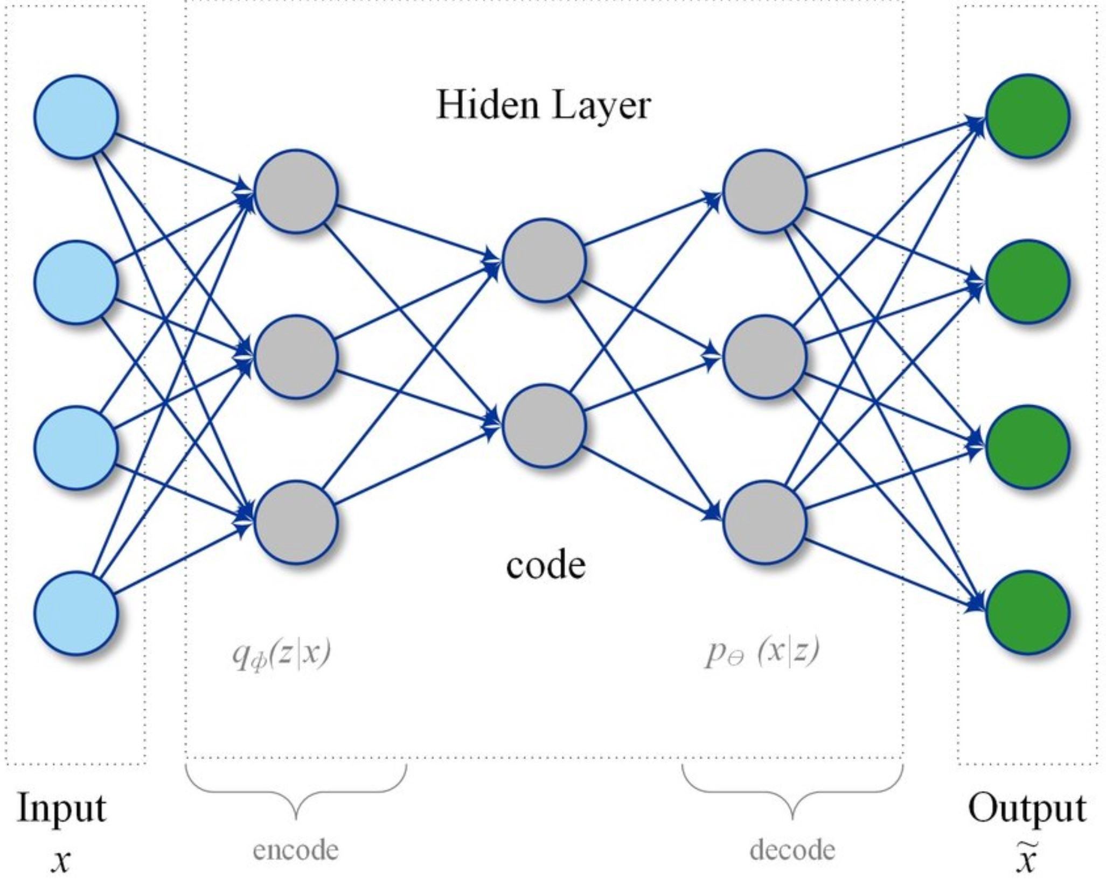
Hidden Layers What is it?
Notes:
A multi-layer perceptron (MLP) with same input and output nodes.

Slide 12
Deep Learning Types
Convolutional Neural Network (CNN)
Recurrent Neural Networks (RNNs)
Long Short-Term Memory Networks (LSTMs)
Stacked Auto-Encoders
Deep Boltzmann Machine (DBM)
Deep Belief Networks (DBN)

Slide 13
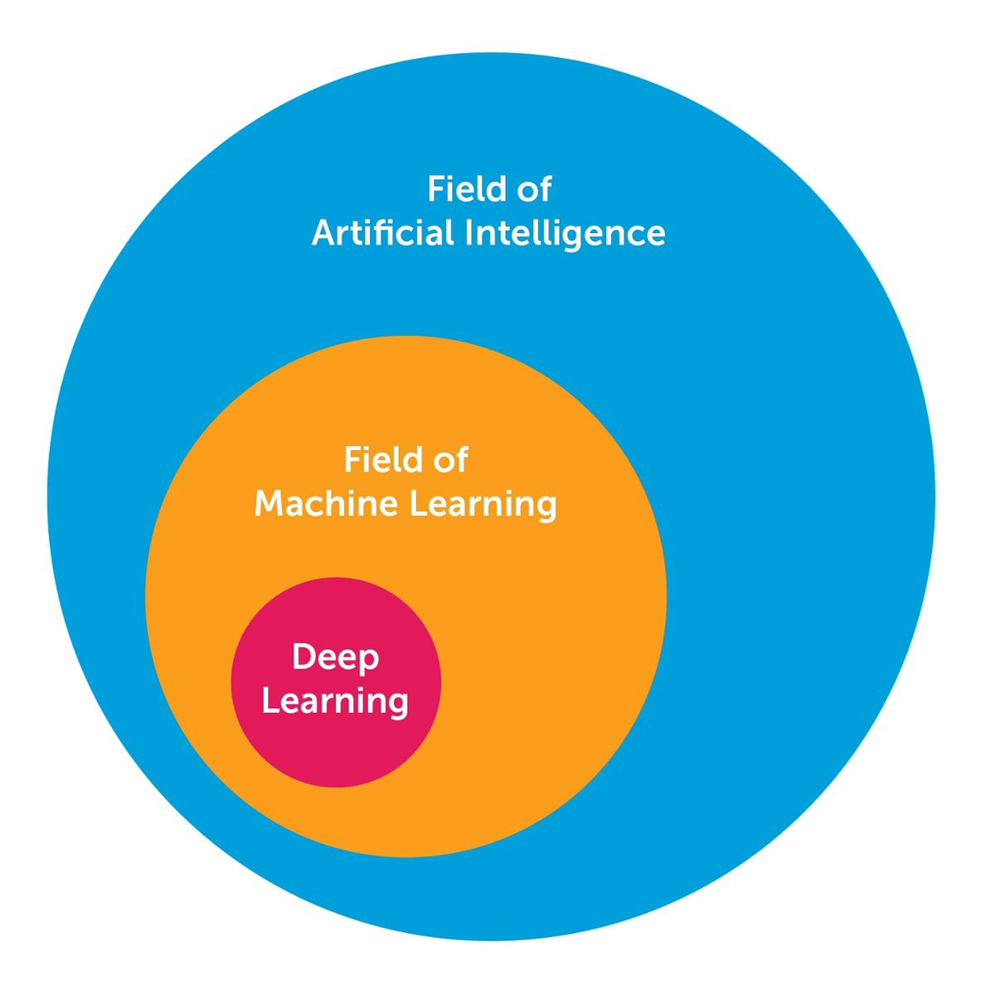
What is AI?

Slide 14
The Pre-Built and Custom AI Spectrum
Pre-Built AI
Custom AI
Azure Cognitive Services
Azure Machine Learning
Pre-built models
Custom models
Models are pre-trained using Microsoft supplied data
Models “customized” with your data
Models tailored to your scenario and your data

Slide 15
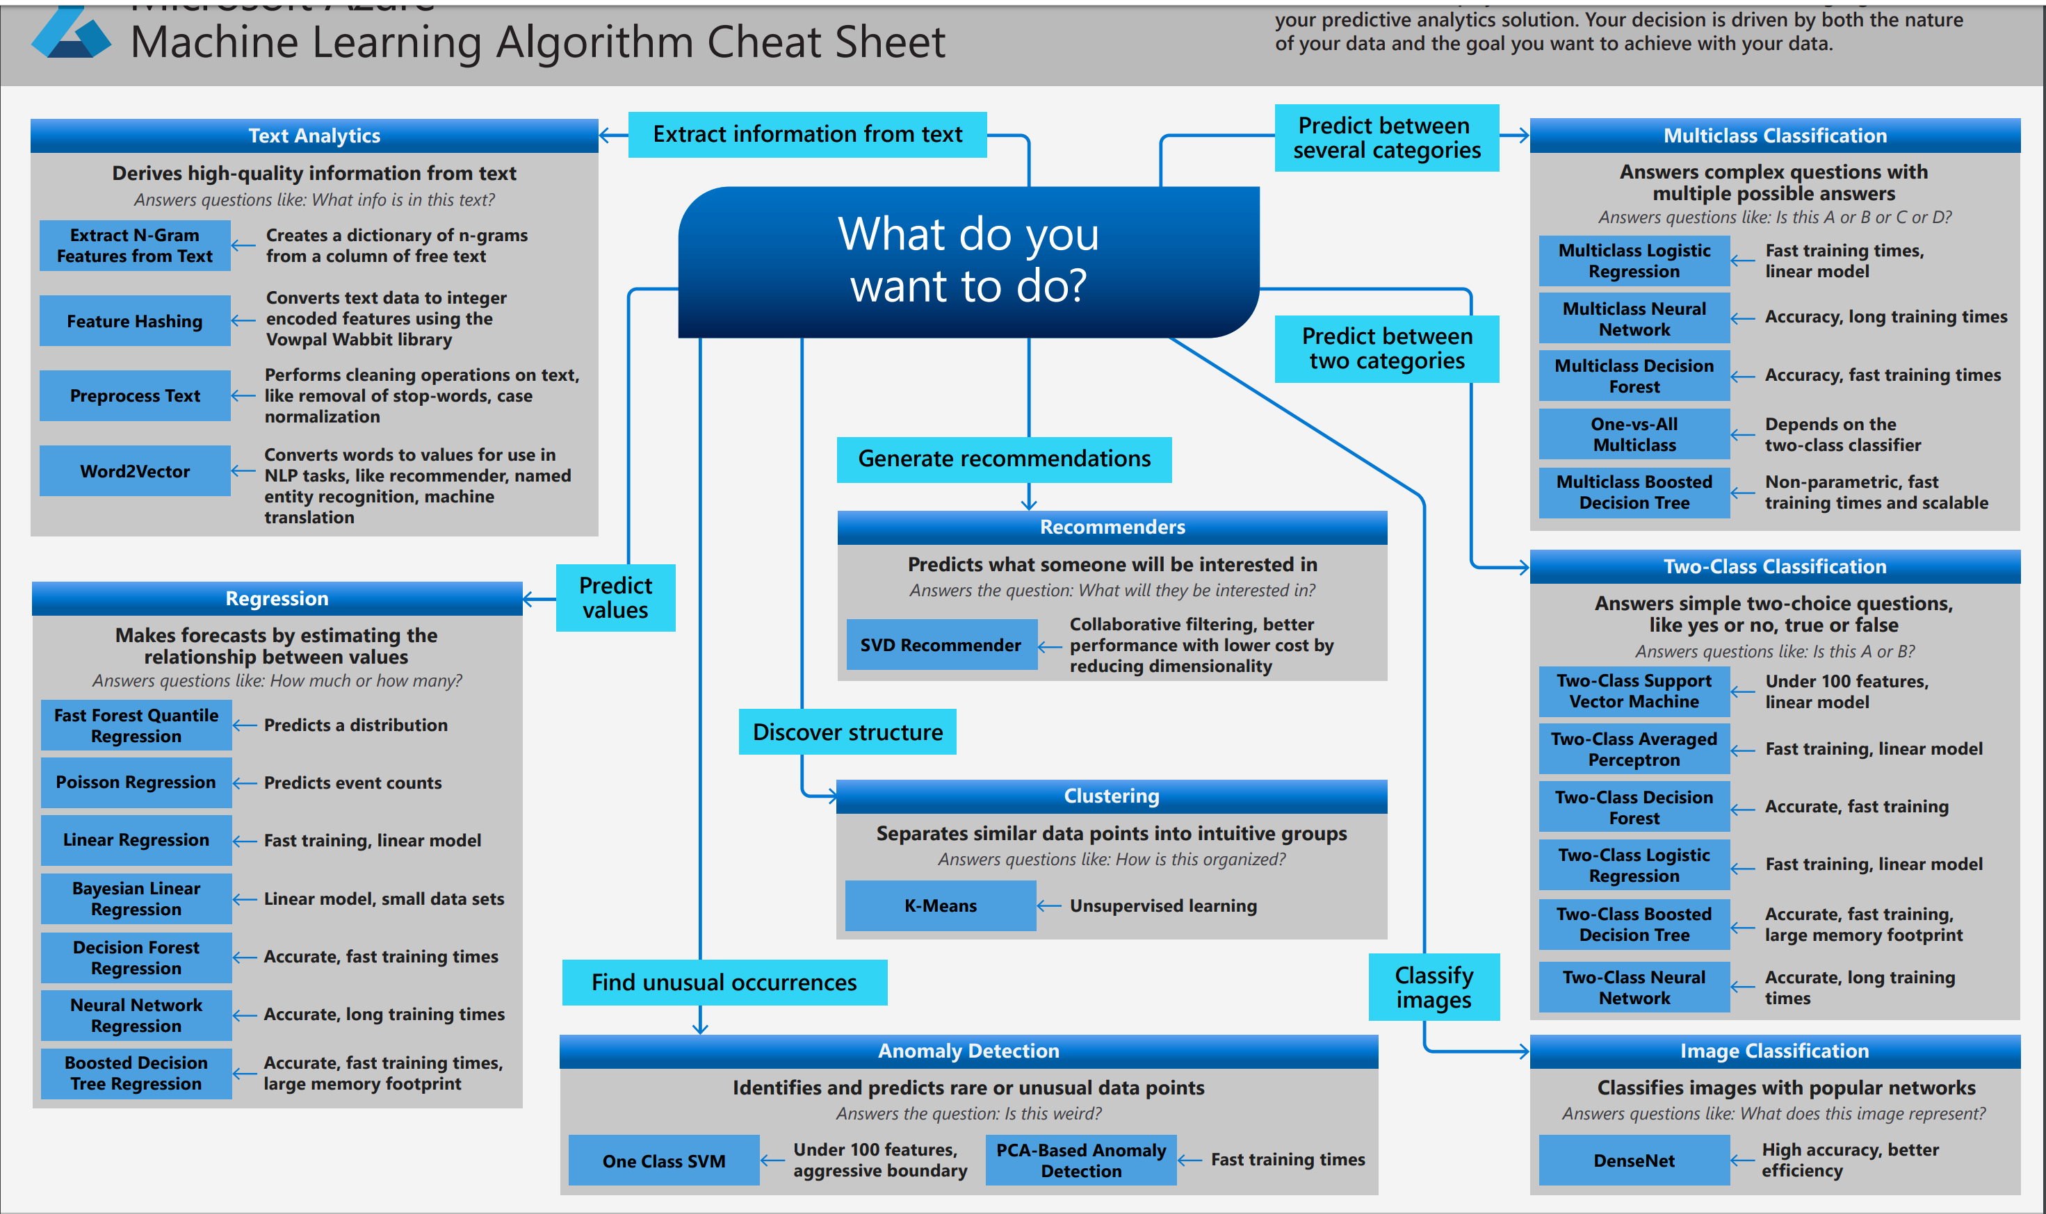
AI Cheat Sheet

Slide 16
Top Tools

Slide 17
Microsoft AI Tools
Cognitive Services
Azure ML Studio
Azure Databricks / Azure Notebooks
Visual Studio
Visual Studio Code
Cognitive Toolkit

Slide 18
Microsoft AI Cognitive Services
Prepackaged set of “basic” AI services
Yes, it is AI and its serious business - https://scale.com/blog/series-c
Types:
Decision, Vision, Speech, Search, Language, Forms Recognizer, Content Moderator
Accessible via
Nuget packages for .NET
REST APIs

Slide 19
Microsoft AI Azure ML Studio
Visual (no-code) ML Designer
Microsoft Azure Machine Learning Studio (classic)
https://studio.azureml.net
Basic/Free version
Full API
ML Studio
https://ml.azure.com
Enterprise version
Full API

Slide 20
Microsoft AI Azure Databricks / Azure Notebooks
Designed to work with Apache Spark and similar frameworks
A specific focus on data science
Preconfigured environment of Spark / Hadoop cluster(s)
Outstanding API support
Azure Notebooks
A general purpose Jupyter notebook editor
Simply an interpreter for code

Slide 21
Microsoft AI Visual Studio Code
Azure Machine Learning extension
https://marketplace.visualstudio.com/items?itemName=ms-toolsai.vscode-ai
Support for various DataSci packages
TensorFlow, PyTorch, Jupyter, etc
Supports Python packages
PIP download modules (Azure SDK, Keras, etc)
Notebooks run on port 8888 ☹
Think Fiddler…

Slide 22
Microsoft AI Visual Studio
ML.NET Model Builder extensions
Allows you to build a machine learning model through wizards
Provides a .NET namespace for programmatic model generation
using Microsoft.ML
.NET Standard compliant
https://dotnet.microsoft.com/apps/machinelearning-ai/ml-dotnet/model-builder
VSIS package for VS2017 and VS2019

Slide 23
Microsoft AI Cognitive Toolkit (CNTK)
Open-source toolkit for distributed deep learning
https://docs.microsoft.com/en-us/cognitive-toolkit/
Features
Describes neural networks as a series of computational steps via a directed graph
Easily realize and combine popular model types such as feed-forward DNNs, convolutional neural networks (CNNs) and recurrent neural networks (RNNs/LSTMs)
Implements stochastic gradient descent (SGD, error backpropagation) learning with automatic differentiation and parallelization across multiple GPUs and servers

Slide 24
Data Wrangling

Slide 25
AI / ML requires data Not All Data Is Appropriate
AI needs data
Data needs features
Features are important
Features are the attributes of an entity
Entity = Database table
Features = Column in table
Selecting Features
Some features are better for predicting the target than others
Some features have a strong correlation with other features and can be removed

Slide 26
Data Wrangling Most Data is Dirty
What can go wrong?
Missing data
Outliers
Completely invalid data
Extra data that holds no value

Slide 27
Models Need Data Top Testing Data Sets
Imagenet
Dataset with 1000 layers
Used to train image processing models
Lots of dogs (120 categories) and birds
Places & Places2
Architecture and landscapes (2.5 million with category label)
Open Images V5
https://storage.googleapis.com/openimages/web/index.html
MAESTRO
200 hours of virtuosic piano
https://magenta.tensorflow.org/datasets/maestro
MNIST
Hand-written digits
http://yann.lecun.com/exdb/mnist/

Slide 28
Data Sets Trust
Many datasets were generated by universities
Undergrad, grad students
Do you trust that the data is sufficient to support a pretrained model based on your analysis needs?
Do you trust your own data?

Slide 29
Training, Testing, Scoring

Slide 30
Training & Testing Munge it time!
An algorithm is needed
A DataSet is needed
Training Set vs Test Set (“split”)

Slide 31
Selecting an Algorithm Choose, but choose wisely
Different types of algorithms
Suited for specific purposes
Anomaly Detection
The identification of rare items, events or observations which raise suspicions by differing significantly from the majority of the data.
Classification
Predict the categorical response value where the labeled data can be separated into specific “classes”. Supervised.
Clustering
Similar to classification, but data is not labeled. Unsupervised.
Regression
Rather than sperate the data, the data is “fitted”
Notes:
https://docs.microsoft.com/en-us/azure/active-directory/develop/active-directory-signing-key-rollover
https://docs.microsoft.com/en-us/azure/active-directory/develop/active-directory-token-and-claims

Slide 32
Scoring Did it work?
How do you know it worked?
Measure it!
Mean Absolute Error
Root Mean Squared Error
Relative Absolute Error
Relative Squared Error
Coefficient of Determination
Notes:
https://docs.microsoft.com/en-us/azure/active-directory/develop/active-directory-signing-key-rollover
https://docs.microsoft.com/en-us/azure/active-directory/develop/active-directory-token-and-claims

Slide 33
Publishing Your Models

Slide 34
Publish Your Model Sharing is Caring
Why not share that awesome design?
Share the entire Python/Notebook
Several model formats (Pickle, ONNX, PMML, iLearner)
Publish the web services as a model (free or paid)
*Wrap API Management around it
Session: Top 10 Models you can use now
Check out my other session on the top 10 models available for you to use today!

Slide 35
DevOps / MLOps Automating Deployment
Automate the entire process
Train
Score
Deploy
Repeat
Azure DevOps can be used to push your models
AKS
ACI
Docker / IoT

Slide 36
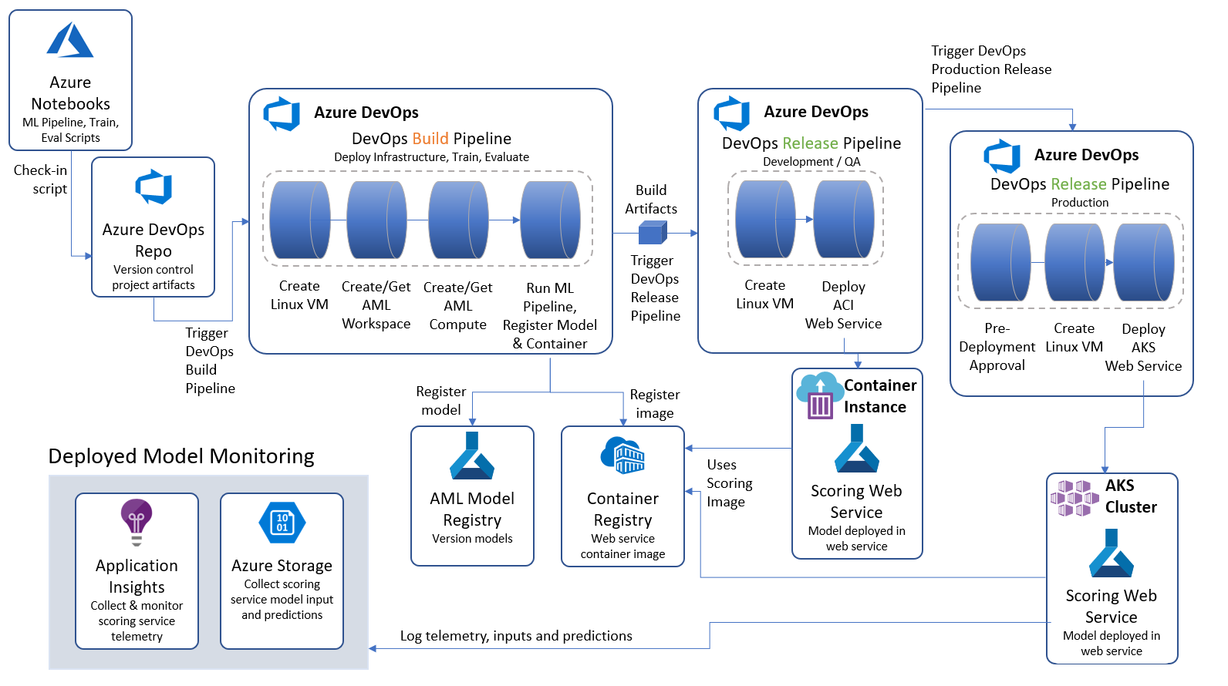
Detailed view of MLOps with AML
Notes:
The overall approach is to orchestrate continuous integration and continuous delivery Azure Pipelines from Azure DevOps. These pipelines are triggered by changes to artifacts that describe a machine learning pipeline, that is created with the Azure Machine Learning SDK. For example, checking in a change to the model training script executes the Azure Pipelines Build Pipeline, which trains the model and creates the container image. Then this triggers an Azure Pipelines Release pipeline that deploys the model as a web service, by using the Docker image that was created in the Build pipeline. Once in production, the scoring web service is monitored using a combination of Application Insights and Azure Storage.

Slide 37
QuickStarts / Samples

Slide 38
Quickstarts and Samples Let’s get started
Azure ML Studio
https://docs.microsoft.com/en-us/azure/machine-learning/studio/create-experiment

Slide 39
Learning

Slide 40
Learning AI (Basic) Let’s get started
Microsoft AI School
https://aischool.microsoft.com/en-us/home
Microsoft Learning - AI-100
https://github.com/MicrosoftLearning/AI-100-Design-Implement-Azure-AISol
Focus on Cognitive Services
Learn AI – Knowledge Mining Bootcamp
Integration of CogSvcs with Azure Cognitive Search
https://github.com/Azure/LearnAI-KnowledgeMiningBootcamp

Slide 41
Learn from others Review existing models
Caffe wiki
https://github.com/BVLC/caffe/wiki/Model-Zoo
TensorFlow
https://github.com/tensorflow/models/tree/master/research
ModelDepot.io
https://modeldepot.io/
Kaggle
https://Kaggle.com
19K datasets, 200K notebooks

Slide 42
Artificial Intelligence Demo

Slide 43
Summary

Slide 44
Microsoft AI Summary
Many different ways to create and run your models
Support for all standard python libraries
Azure ML Studio is visually easy and simple

Slide 45
Microsoft AI Questions\Comments?
What’s on your mind?
Need help?

Slide 46
Microsoft AI Contact
Chris Givens
chris@solliance.net
@givenscj

