Slide 1
Top 10 AI Models
Chris Givens
Solliance.net
@givenscj

Slide 2
Agenda
Overview
Top Datasets
Top 10 AI Models
AI Model Registries
AI Model Tools
Publishing your Models

Slide 3
Overview

Slide 4
Introduction
What is an AI Model?
A set of weightings generated from an input data set and algorithm(s)
Why use pre-trained models?
  Training can be very time and energy intensive
  Starting with a pre-trained model can speed up your dev/test/production

Slide 5
Reusing Models
Plug and Play
Don’t reinvent the wheel
  Training the model on your dataset is the same as running the entire model from scratch
  Model could have taken days/weeks/months to train

Slide 6
Reusing Models
Flexibility
Be flexible, train some layers, leave others frozen
  Aka remove the original classifier, insert yours
  Lower levels tend to be “problem independent”
  High levels are “problem dependent”

Slide 7
Reusing Models
Overfitting
Try to avoid
  Overfitting is a modeling error which occurs when a function is too closely fit to a limited set of data points
  Small datasets are prone to overfitting
  Keep more layers frozen
Example, one game vs entire season of games

Slide 8
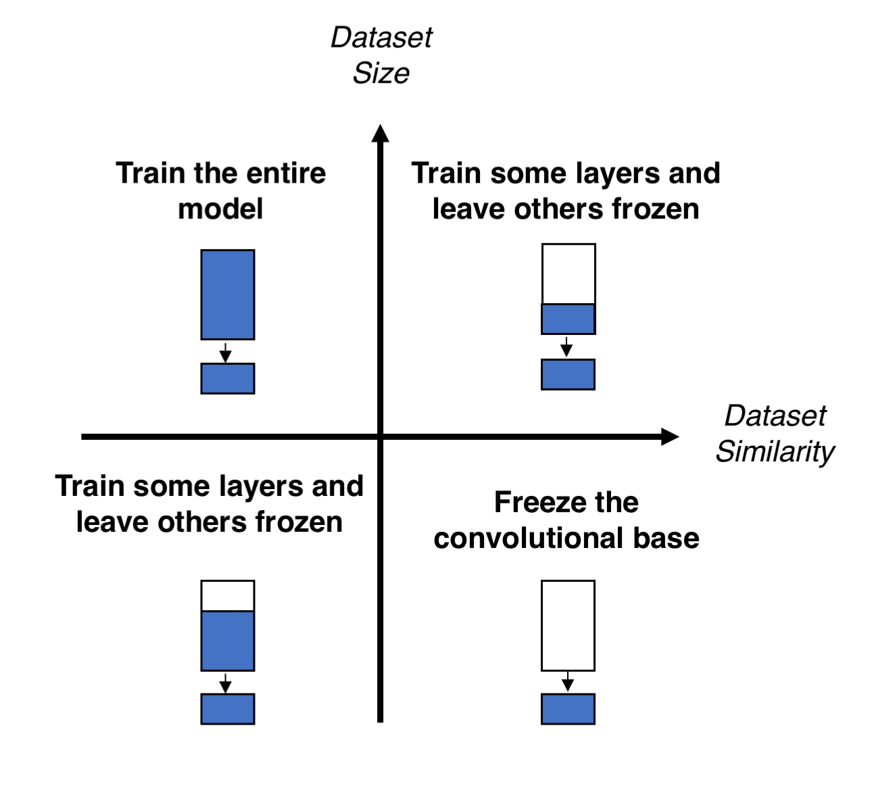
Size vs Similarity
What should you change?

Slide 9
Top Datasets

Slide 10
Consuming Models
Models need data
Generate or select a data set
  This alone is a very involved process
  Many data set repos available on the internet
Other steps
  Freeze unnecessary layers
  Add/substitute your own layers (ex: classification)
  Call the model with the pre-trained weightings

Slide 11
Models Need Data
Top Testing Data Sets
Imagenet
  Dataset with 1000 layers
  Used to train image processing models
  Lots of dogs (120 categories) and birds
Places & Places2
  Architecture and landscapes (2.5 million with category label)
Open Images V5
  https://storage.googleapis.com/openimages/web/index.html
MAESTRO
  200 hours of virtuosic piano
  https://magenta.tensorflow.org/datasets/maestro
MNIST
  Hand-written digits
  http://yann.lecun.com/exdb/mnist/

Slide 12
Data Sets
Trust
Many datasets were generated by universities
  Undergrad, grad students
Do you trust that the data is sufficient to support a pretrained model based on your analysis needs?
Do you trust your own data?

Slide 13
Top 10 AI Models

Slide 14
Top 10 Huh
Why?
Expand your knowledge of the breadth of models available
  I will not run every model ($$$ - $TIME)
Show you where you can find/search for models
Have some fun
So…AI Model #10 is…

Slide 15
AI Model #10
Everything already in Keras
Keras includes pre-trained weights on ImageNet for
  Xception
  VGG(16,19)
  ResNet, ResNetV2
  Inception V3
  InceptionResNetV2
  MobileNet, MobilenetV2
  DenseNet
  NASNet
https://keras.io/applications/

Slide 16
AI Model #9
Attention-OCR
A Tensorflow model for text recognition (CNN + seq2seq with visual attention)
  https://github.com/da03/Attention-OCR
New/updated spin on tesseract
  Think Computer Vision of cognitive services

Slide 17
AI Model #8
Reaction RNN
Recurrent Neural Network (RNN) Model trained on Facebook reactions
  https://github.com/minimaxir/reactionrnn
Will pick the appropriate “like” response for a post
  Does not use word2vec/doc2vec
  Network is trained on modern (2016-2017) language (posts)
    What does this mean?

Slide 18
AI Model #7
Neural Collaborative Filtering (NCF)
A generic classification algo used for implicit ranking of items
  https://arxiv.org/abs/1708.05031
NCF, short for Neural network-based Collaborative Filtering
  NCF is generic and can express and generalize matrix factorization under its framework
Microsoft example of collaborative filtering with CosmosDB
  https://github.com/AzureCosmosDB/scenario-based-labs

Slide 19
AI Model #6
Deep Dreaming (Google)
Deep “Dreaming”
  https://research.google.com/seedbank/seed/deepdream
  https://deepdreamgenerator.com/
Combine two images into “AI art”

Slide 20
AI Model #5
GloVe on Tweets
Uses Stanford’s GloVe to scan twitter posts
  Allows you to find words that are similar in meaning
  Trained on 2 billion Twitter posts, with 1.2 million unique words
  https://modeldepot.io/nisikk42/glove-on-tweets

Slide 21
AI Model #4
Sentiment Neuron
A sentiment model trained on 82M Amazon product reviews
  Utilized by Elon Musk Open AI
  https://modeldepot.io/afowler/sentiment-neuron
  https://github.com/openai/generating-reviews-discovering-sentiment
Training took one month across four NVIDIA Pascal GPUs, processing 12,500 characters per second.
Original model by Cornell University research
  https://arxiv.org/abs/1704.01444
  Trained on Stanford Sentiment Treebank
    https://nlp.stanford.edu/sentiment/treebank.html

Slide 22
AI Model #3
Dual-Objective Piano Transcription
Dual-Objective Piano Transcription
  Takes a piano sound file and converts to transcript
Links
  https://colab.research.google.com/notebooks/magenta/onsets_frames_transcription/onsets_frames_transcription.ipynb#scrollTo=IiIFvcvy7dH5
  https://storage.googleapis.com/magentadata/papers/onsets-frames/index.html
  https://github.com/tensorflow/magenta/tree/master/magenta/models/onsets_frames_transcription

Slide 23
AI Model #2
DeepMind - WaveNet
WaveNet
  https://deepmind.com/blog/article/wavenet-generative-model-raw-audio
  Text to Speech
  Concatenative vs Parametric
A deep generative model of raw audio waveforms
  WaveNets are able to generate speech which mimics any human voice
  Sounds more natural than the best existing Text-to-Speech systems
  Reduces the gap with human performance by over 50%
Ciprian’s talk – a 30 minute clip of you talking can be used to create an almost perfect likeness of you

Slide 24
AI Model #1
Dopamine
A game learning model based on reinforcement learning and deep learning
  https://github.com/google/dopamine
  Provide an implementation of Deep Q Network (DQN)
  https://storage.googleapis.com/deepmind-media/dqn/DQNNaturePaper.pdf

Slide 25
AI Models
Notable Mentions
SqueezeNet
  https://arxiv.org/abs/1602.07360
  AlexNet-level accuracy with 50x fewer parameters (imaging)
Lucid
  https://github.com/tensorflow/lucid
  a network for visualizing neural networks (similar to DeepDream)
Mathworks
  Anything in this package
  https://www.mathworks.com/help/deeplearning/ug/pretrained-convolutional-neural-networks.html
Notes:
https://keras.io/applications/

Slide 26
AI Model Registries

Slide 27
Find your own AI Models
There can be, more than one
Caffe wiki
  https://github.com/BVLC/caffe/wiki/Model-Zoo
TensorFlow
  https://github.com/tensorflow/models/tree/master/research
ModelDepot.io
  https://modeldepot.io/
Kaggle
  https://Kaggle.com
  19K datasets, 200K notebooks
Azure ML Studio gallery

Slide 28
AI Model Tools

Slide 29
TensorFlow
Popular open source tool
TensorFlow’s high-level APIs are based on the Keras API standard for defining and training neural networks.
  Keras enables fast prototyping, state-of-the-art research, and production—all with user-friendly APIs.
  Created by Google Brain team within Google's Machine Intelligence Research organization for the purposes of conducting machine learning and deep neural networks research
  Multi-platform (mobile, browser, iot/edge, etc)

Slide 30
Keras
Common Building Blocks
A higher-level abstraction layer
  2017: Added to TensorFlow’s core library
Contains common Neural Net items:
  Layers, Objectives, Activation Functions, Optimizers
Deep model platform support includes:
  OS: iOS, Android, Web, JavaVM
  Chips: GPUs and TPUs

Slide 31
Pytorch Tools
GPU Optimizer
Tensors and Dynamic neural networks in Python with strong GPU acceleration
  TensorFlow, Theano, Caffe and CNTK have a static view of the world.
  One has to build a neural network, and reuse the same structure again and again. Changing the way the network behaves means that one has to start from scratch.
Pre-trained models include:
  ResNet, SqueezeNet, Alexnet, Inception, Densenet, Vgg

Slide 32
Pytorch
Tools
Glow
  Compiler for Neural Network hardware accelerators
  Designed to allow state of the art compiler optimizations and code generation of neural network graphs
Pytorch Geometric
  Geometric Deep Learning Extension Library for PyTorch
  Working with geometric data structures (graphs, point clouds, manifolds)
Captum
  Model interpretability – explain to your users “why”
Torchbearer
  A model fitting library for PyTorch
Others
  skorch, model wrapper that enables use with scikit-learn - crossval etc. can be very useful
  PyToune, simple Keras style API
  ignite, advanced model training from the makers of PyTorch, can need a lot of code for advanced functions (e.g. Tensorboard)
  TorchNetTwo (TNT), can be complex to use but well established, somewhat replaced by ignite
  Inferno, training utilities and convenience classes for PyTorch
  Pytorch Lightning, lightweight wrapper on top of PyTorch with advanced multi-gpu and cluster support
  Pywick, high-level training framework, based on torchsample, support for various segmentation models

Slide 33
Cadene
Another tool for Pytorch
Pretrained ConvNets for pytorch
  NASNet, ResNeXt, ResNet, InceptionV4, InceptionResnetV2, Xception, DPN, and many more!
https://github.com/Cadene/pretrained-models.pytorch

Slide 34
Publishing Your Models

Slide 35
Publish Your Model
Sharing is Caring
Why not share that awesome design and time intensive number crunching work?
Share the entire Python/Notebook
Share a model in a common file format

Slide 36
Standard Formats
Sharing models
Pickle
  Python serialization technique, only works with Python
Open Neural Network Exchange (ONNX)
  Supports storing and porting models across libraries
  Sklearn extension
Predictive model markup language (PMML)
  Limited support for prediction models
  Sklearn extension
.Ilearner
  Microsoft Azure ML Studio (.NET Model object serialized)

Slide 37
Publishing Models
Using Models
Database Integration
  Python code is run in-context
Pub/Sub
  Applications that can’t handle in-context
  Queueing/Event Hubs/Function Apps
Webservice
  Make a call to standard web service
  Azure ML Service
  Wrap API Management around it (free or paid)
In-App
  Data must remain in app
  Tensorflow.js, ONNXJS, Caffe2, Android-ML
  Containers (AKS, ACI, IoT)

Slide 38
Summary

Slide 39
Top 10 AI Models
Summary
Try to leverage the planet’s intelligence
Take advantage of the energy and time others have put into training models
Sharing is caring

Slide 40
Top 10 AI Models
Questions\Comments?
What’s on your mind?
Need help?

Slide 41
Top 10 AI Models
Contact
Chris Givens
  chris@solliance.net
  @givenscj
Other Sessions:
  Thursday 10am - Microsoft AI for Beginners
  Thursday 1:30pm – Predicting Sporting outcomes using AI and ML

