Slide 1
App Service Overview
Yutang Lin & Yun Jung Choi
Yutang.Lin@Microsoft.com & YunJung.Choi@Microsoft.com

Slide 2
Agenda
What is App Service?
Day 0/1
GitHub actions
VNet Integration
API Management (APIM) Integration
Day 2
Stay Resilient to Downtimes with Best Practices
Navigator
App Service Integration with Azure Monitor (preview)

Slide 3
What is App Service?

Slide 4

Azure App Service
Create powerful web apps
using a fully-managed cloud platform

Slide 5
Cloud application hosting continuum
IaaS
Infrastructure Platform
CaaS
Container Platform
PaaS
Application Platform
FaaS
Serverless Platform
Challenges
Patching, Management, Deployment
Management (Container & Pod)
Limitations of Execution environment
Cold start, long running process
What you get
Curated VM Hosting
Curated Orchestration
Curated Execution Environment
Scale to ‘zero’
Technology decisions
IT/Infra focused Value Prop
Dev/App Admin focused Value Prop
More Control of execution environment
Less Control of execution environment
Less Agile development & deployment
More Agile development & deployment

Slide 6
Azure App Service benefits
High-productivity for devs & ops
Fully-managed
Enterprise-grade
.NET, Node, Java, Docker, PHP, Ruby, Python
Auto scale & load balancing
Global data center footprint
Deploy containers on Windows & Linux
High availability w/auto patching
Hybrid support
Staging & deployment
Reduced operations costs
Azure Active Directory integration
Testing in production
Backup & recovery
Secure & compliance

Slide 7
DAY 0/1
GitHub Actions
VNet Integration
API Management Integration

Slide 8


Azure App Service: Build and Deploy Options Deploying source code
az webapp up
Local Git
Built-in build capabilities on Azure App Service
GitHub
Azure Repos
Runnable web app
in Azure App Service
Bitbucket
Mercurial*
Git compatible external repos*
*Only on Azure App Service for Windows

Slide 9
Azure App Service: Build and Deploy Options Deploying compiled/packaged artifacts
Visual Studio
Webdeploy
/msdeploy
Azure Pipelines
.zip file
/api/zipdeploy
GitHub Actions
Runnable web app
in Azure App Service
Jenkins
/api/wardeploy
WAR file
Maven plugin
for App Service
/api/zipdeploy
JAR file
OneDrive, Dropbox and FTP available for content sync/regular file copying

Slide 10






Azure App Service: Build and Deploy Options Deploying containers
Azure Pipelines
Private container registry
Docker push
Pulls container image
GitHub Action:
docker build
Azure Container Registry
Runnable web app
in Azure App Service
Docker build:
Docker Hub build
Docker build on dev machine
Etc…
Docker Hub

Slide 11

App Service and App Service Environment
The App Service is a multi-tenant service. Thousands of customers that share the same system safely and securely.
An App Service Environment (ASE) is a single tenant instance of the App Service that deploys into the customer’s Azure Virtual Network (VNet)

Slide 12

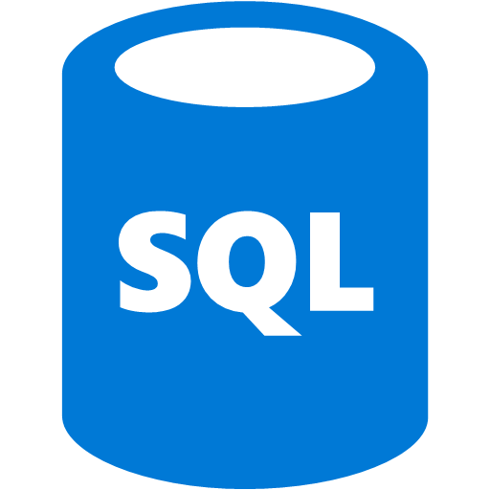


Regional VNet Integration
Scenario: App access to resources in your VNet, across Service Endpoints and across ExpressRoute Multi-tier web applications – when combined with service endpoints
Enables the backend of your app to be directly in your VNet.
Outbound calls from your app can reach
Endpoints in your VNet
Across ExpressRoute
Service Endpoint secured services, including other web apps
Available for Windows web apps, Linux web apps and Premium Functions
Only works with Resource Manager VNets in the same region
Regional
VNet Int
On-premises
Service Endpoints
ExpressRoute
Azure VNet

Slide 13





Azure API Management
Cloud hosted, turnkey solution
Works with any host, API, and scale
Promotes and supports developer engagement
Secures and optimizes APIs
Provides API insights and analytics

Slide 14
App Service Integration with API Management
Import APIs
Abstract API from Backend
Define routing patterns
No coding required

Slide 15
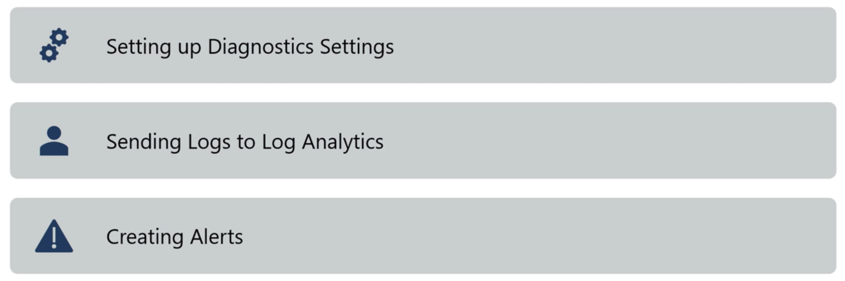

Demo
Import API from App Service
Define routing patterns
Test API

Slide 16
DAY 2
Stay Resilient to Downtimes with Best Practices
Navigator
App Service Integration with Azure Monitor (preview)

Slide 17
Stay Resilient to Downtimes with Best Practices
Availability and Performance
Configuration

Slide 18


Demo
Navigate to App Service Diagnostics
Check best practices for availability and performance
Check best practices for configuration

Slide 19




Navigator
Dependency Detection
Change Tracking
Diff View
Supplement your troubleshooting

Slide 20



Change Analysis is supported on…
Web App (Windows)
SQL Server
Storage Accounts

Slide 21


Demo
Investigate changes on the web app
Investigate changes on SQL
Troubleshoot!

Slide 22
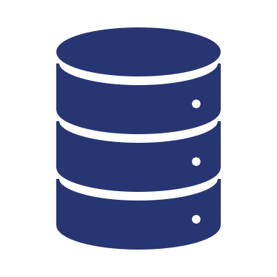



App Service Azure Monitor Integration (preview)
OS Availability
Different Endpoints
Extra Monitoring
Windows
Storage Account
Create rule-based alerts
Linux
Event Hub
Create Dashboards
Export to third-party services with Event Hubs
Log Analytics
Archive logs and metrics

Slide 23
Different Log Types
Console Logs
HTTP Logs
Application Logs
Audit Logs
File Audit Logs
App Service Environment (ASE) Logs

Slide 24
Demo
Setting up Diagnostic Settings
Sending Logs to Log Analytics
Creating Alerts

Slide 25
Key Takeaways
Day 0/1 Scenarios
GitHub Actions
Set up CI/CD with GitHub
Regional Vnet Integration
Access resources in your Vnet from your web app
Learn more about APIM
Address common URL routing patterns without any coding
Day 2 Scenarios
Stay Resilient to Downtimes with Best Practices
Learn about best practices and current state of your web app using App Service Diagnostics.
Navigator
Understand the call chain and investigate changes made on your web app.
App Service Azure Monitor Integration (preview)
Send logs from your app to different endpoints

Slide 26
Next Steps
Follow App Service Blog
https://aka.ms/AppServiceBlog
Check out GitHub Actions
https://github.com/features/actions
Learn more about APIM
https://aka.ms/apimlove
Learn more about App Service Diagnostics
https://aka.ms/diagnostics
Learn more about Navigator
https://aka.ms/navigator

Slide 27
Please use EventsXD to fill out a session evaluation.
Thank you!

