Slide 1

Building Secure IoT Solutions using Azure Sphere
Chris Pietschmann
cpietschmann@solliance.net
Notes:
Good morning! {Intro myself}
{ask questions}
Did they see Carey Payette's talk before mine?
Do they know what Azure Sphere is?

Slide 2
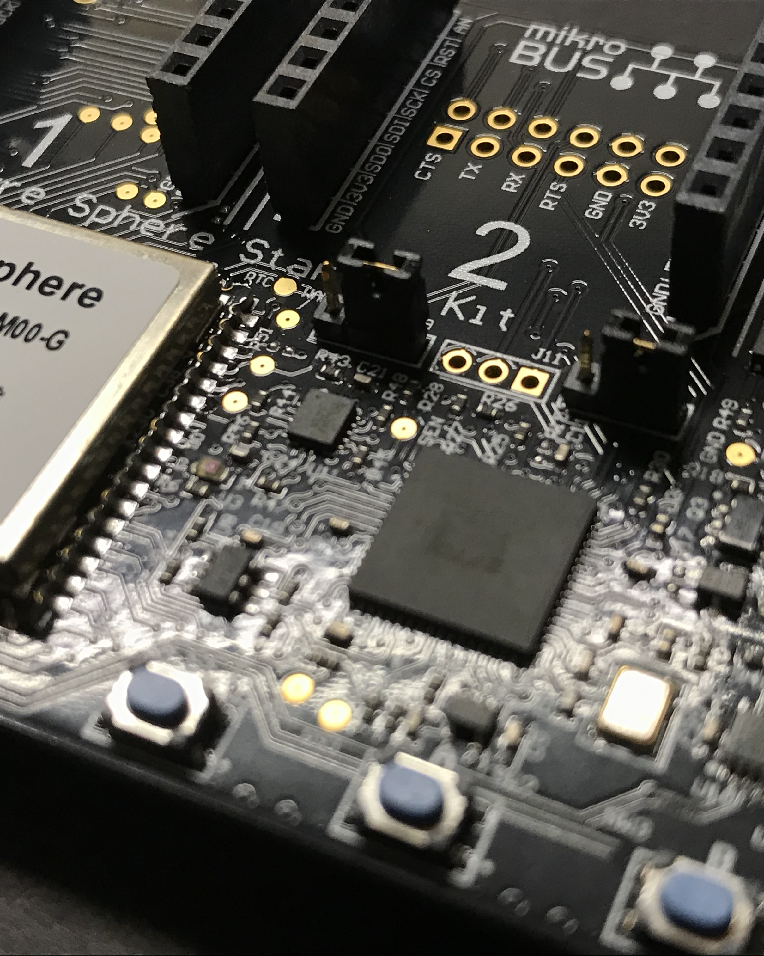
Agenda
Importance of IoT Security
What is Azure Sphere?
Security Architecture
Build & Deploy an App
Notes:
Look at Azure Sphere from security perspective
We’re developers, building IoT solutions.
Need to be sure to protect our company, our clients, and our solutions
In this session, we’ll take a look at…

Slide 3
Importance of IoT Security
Notes:
Let’s get started. What is Azure Sphere?

Slide 4
IoT Growth
9 BILLION new Microcontroller (MCU) devices built and deployed every year!
  estimated by Microsoft
Microcontrollers are low-cost, single chip computers
  Increasingly more Internet-connected!
Notes:
One of the many reasons IoT security is a growing concern is that the entire IoT market is rapidly growing. Microsoft estimates there are 9 Billion new microcontroller devices built and deployed every year. Microcontrollers are low-cost, single chip computers which are getting increasingly more Internet-connected. This is enabling a wave of a huge variety of devices becoming Internet of Things devices and being connected to the Internet. These devices are surrounding us everywhere; at home, at work, in the car, at the store, and so much more! This growth offers a tremendous amount of possibility, but it also presents a large amount of security risk that needs to be mitigated correctly.
SOURCE:
https://us.norton.com/internetsecurity-iot-5-predictions-for-the-future-of-iot.html

Slide 5




















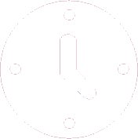









IoT Devices
Notes:
Connect all the devices

Slide 6
What could go wrong?
Connect all the things to the Internet?
Notes:
{ask audience}

Slide 7
The consequences could negate the value
What can go wrong
The cost of an attack
Devices are bricked and rendered useless
Attackers take control of the device
Device functionality is used for malicious purposes
Data and privacy breaches
Device platform protections are disabled
Attackers infect the device with malware
Devices are used in Botnet attacks
Device can not be recovered
Device cloning
Data pollution: inaccurate data and telemetry
Brand impact (loss of trust)
Cost of recovery
Financial and legal responsibility
Downtime
Security forensics

Slide 8
The 7 properties of highly secured devices
Is your device highly secured or does it just have some security features?
Hardware
Root of Trust
Defense
in Depth
Small Trusted
Computing Base
Is your device’s identity and software integrity secured by hardware?
Does your device remain protected even if some security mechanism is defeated?
Is your device’s security-enforcement code protected from bugs in application code?
Dynamic
Compartments
Certificate-Based Authentication
Error
Reporting
Renewable Security
Can your device’s security improve after deployment?
Does your device authenticate itself with certificates?
Does your device report back errors to give you in-field awareness?
Does your device software update automatically?
https://aka.ms/7properties

Slide 9
Meeting the 7 properties is difficult and costly.
Recognize and mitigate emerging threats
Distribute and apply updates on a global scale
Technology
Talent
Tactics
Design and build
a holistic solution
You’re only as secure as your weakest link.
You must to stitch disparate security components into a gap-free, end-to-end solution.
Threats evolve over time.
You must have the ongoing security expertise to identify and create the updates needed to mitigate new threats as they emerge.
Update efficiency is critical.
You must have the infrastructure, logistics, and operational excellence to deliver and deploy updates globally to your entire fleet of devices in hours.

Slide 10
What is Azure Sphere?
Notes:
Let’s get started. What is Azure Sphere?

Slide 11
What is Azure Sphere?
Secured, high-level application platform for the Internet of Things (IoT)
Integration of Hardware, Software, and Cloud!
  Custom Linux-based Operating System
  Cloud-based Security Service
  Secured, Connected, crossover Microcontroller Unit (MCU)
Notes:
Azure Sphere is a secured, high-level application platform built for the Internet of Things. It includes integrated features for communication and security, all centered around being able to built more secure internet-connected devices for any IoT solutions you’re working on. At a very high level, the Azure Sphere platform is comprised of integrations between both hardware and software. It includes a custom Linux-based operating system with multiple layers of security built-in.A cloud-based security service, and a secured, connected, crossover Microcontroller Unit or MCU.
SOURCE:
https://docs.microsoft.com/en-us/azure-sphere/product-overview/what-is-azure-sphere

Slide 12
Azure Sphere
General Availablilty
February 2020
Azure Sphere’s mission is to empower every organization on the planet to connect and create secured and trustworthy IoT devices.

Slide 13



End-to-End Solution for Securing MCU Devices
The Azure Sphere OS with ongoing updates creates a Microsoft-secured software platform
Azure Sphere certified MCUs, from our silicon partners, with built-in Microsoft hardware root of trust
The Azure Sphere Security Service guards every Azure Sphere device.
It brokers trust, detects emerging threats, and renews device security
Over 10 years of security and OS updates delivered directly to each device by Microsoft
Notes:
Azure Sphere is an end-to-end solution for creating highly-secured, connected MCU or microcontroller devices. There are three pillars of the Azure Sphere platform.
First, is the Azure Sphere secured MCUs that provide a hardware root of trust, and a firm foundation for building a connected device.
Second, is the secured operating system. The Azure Sphere OS combines the best of both Microsoft and Open Source Software to create a trustworthy platform for building new IoT experiences.
And, Third, is the Azure Sphere Security Service. This protects the devices and brokers trust between the devices and the cloud. Through this service you can detect emerging threats and bring the devices up-to-date.
Throughout this course we’ll take a look at each of these three pillars in more detail.
SOURCE:
Build 2019 Session BRK3035
https://mybuild.techcommunity.microsoft.com/sessions/77056?source=sessions

Slide 14


Silicon Ecosystem
AVAILABLE NOW
COMING SOON
COMING SOON
MT3620
MCU form factor
Wi-Fi-enabled
Diverse HW ecosystem :
Development kits
Build-in modules
Guardian Modules
Part of the i.MX8 family
Optimized for performance
and power:
Richer experiences
Artificial Intelligence (AI)
Graphics
Video
Chip details to be disclosed
Built for anytime, anywhere connectivity:
Cellular enabled
Support for ultra-low power scenarios

Slide 15
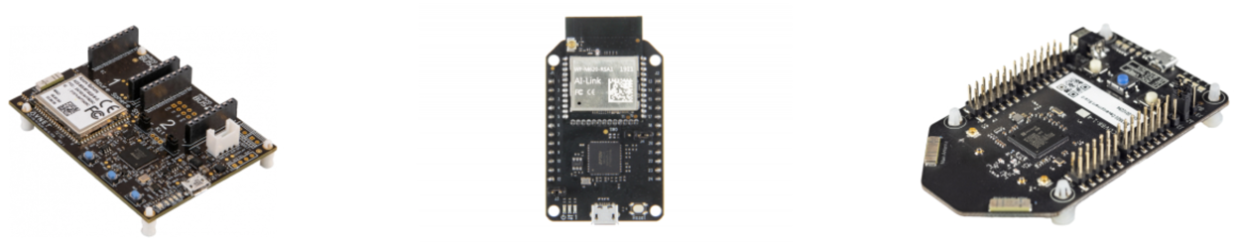
Azure Sphere Dev Kits
AVNet MT3620
Starter Kit
Seeed MT3620
Mini Dev Board
Seeed MT3620
Dev Kit
These all use the Mediatek MT3620

Slide 16
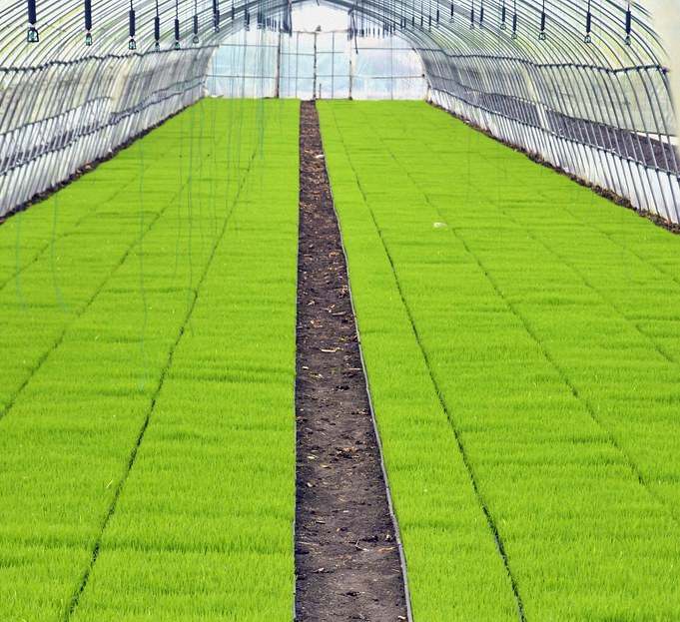

Two types of implementations
Greenfield
New devices and equipment
Brownfield
Existing devices and equipment
Common use cases: ​
Food services​
Refrigeration​
Industrial equipment​
HVAC controls

Slide 17
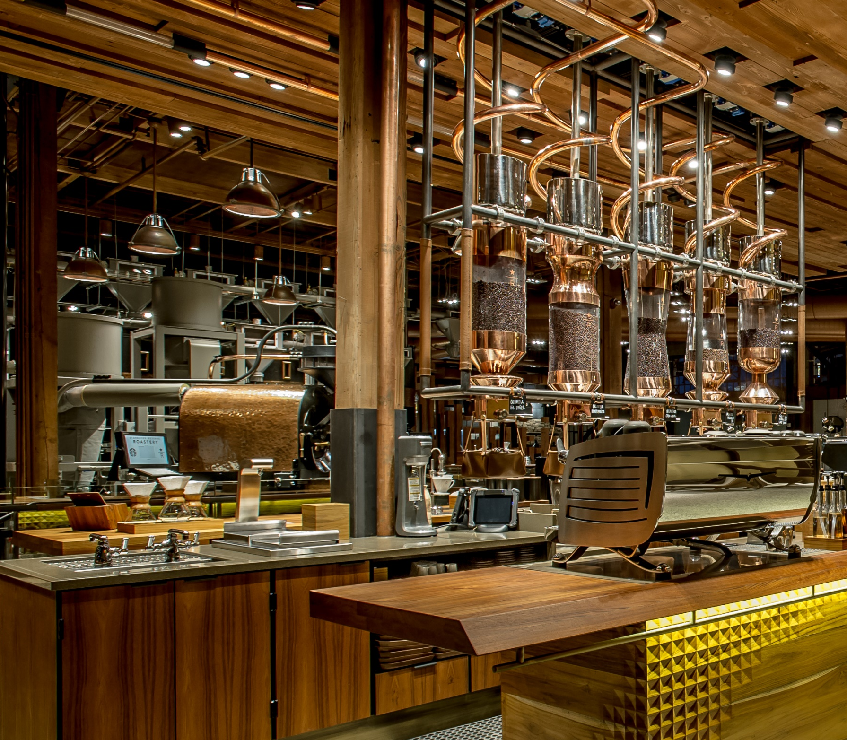

Azure Sphere helps Starbucks deliver the perfect pour
Microsoft Ignite 2019 Session BRK2228
In pursuit of the perfect pour: How Starbucks tackled IoT at scale

Slide 18
Azure Sphere Architecture
Notes:
Let’s take a look at the architecture of Azure Sphere.
SOURCE:
https://docs.microsoft.com/en-us/azure-sphere/product-overview/what-is-azure-sphere#azure-sphere-architecture
https://azure.microsoft.com/en-us/blog/azure-sphere-s-customized-linux-based-os/

Slide 19
Azure Sphere Architecture
Hardware
  Crossover Microcontroller Unit (MCU)
Software
  Azure Sphere OS (Linux-based Operating System)
Cloud
  Azure Sphere Security Service
Notes:
The Azure Sphere platform is made up of three different architecture areas; hardware, software, and cloud. These three all work together to provide a cohesive secure IoT platform.
The hardware architecture and the crossover microcontroller unit provide a secure compute base allowing you to focus more on your product.
The software architecture is built with Azure Sphere OS; a secured custom Linux kernel running on top of the Microsoft-written Security Monitor. This enables you to focus more on adding value to your IoT devices, and working with device-specific features.
The cloud architecture utilizes the Azure Sphere Security Service. This cloud service supports authentication, software updates, and failure reporting over secured communication channels.
SOURCE:
https://docs.microsoft.com/en-us/azure-sphere/product-overview/what-is-azure-sphere#azure-sphere-architecture

Slide 20
Azure Sphere Hardware Architecture
Azure Sphere MCU
  Microsoft Pluton security subsystem
  High-level application core
  Real-time core(s)
  Hardware firewalls
  Integrated RAM, flash, and connectivity
Multiple trusted domains
  Resource isolation
  Increased security
Microsoft Pluton
Security
subsystem
FLASH
>= 16MB
Network
Connection
Built-in Wi-Fi
Microsoft I/O Firewalls
ARM Cortex-A
Optimized for
low power
SRAM
>= 4MB
ARM Cortex-M(s)
For real-time processing
Multiplexed I/O
GPIO
PWM
TDM
I2S
UART
I2C
SPI
ADC
Notes:
The Azure Sphere hardware architecture provides a secured computing base for building connected IoT devices, allowing you to focus more on your product.
The Azure Sphere MCU microcontroller includes several integrated components; such as the Microsoft Pluton security subsystem, High-level application processor cores, Real-time processor cores, hardware firewalls, in addition to integrated RAM, Flash, and connectivity features.
SOURCE:
https://docs.microsoft.com/en-us/azure-sphere/product-overview/what-is-azure-sphere#azure-sphere-architecture

Slide 21
Azure Sphere OS Security Architecture
Notes:
Compartmentalization of the Operating System
The Azure Sphere software architecture, with it’s secured custom Linux operating system kernel, built on top of the Microsoft-written Security Monitor, enables you to concentrate more on your software and it’s value-added IoT and device specific features.
https://www.microsoft.com/en-us/azure-sphere/details
https://www.electronicdesign.com/iot/azure-sphere-os-built-compact-secured-linux

Slide 22
Azure Sphere Security Service (AS3)
Provides device authentication and attestation
Create AS3 Tenant
  Claim Azure Sphere devices to the Tenant
  Device is then locked to that Tenant

Slide 23
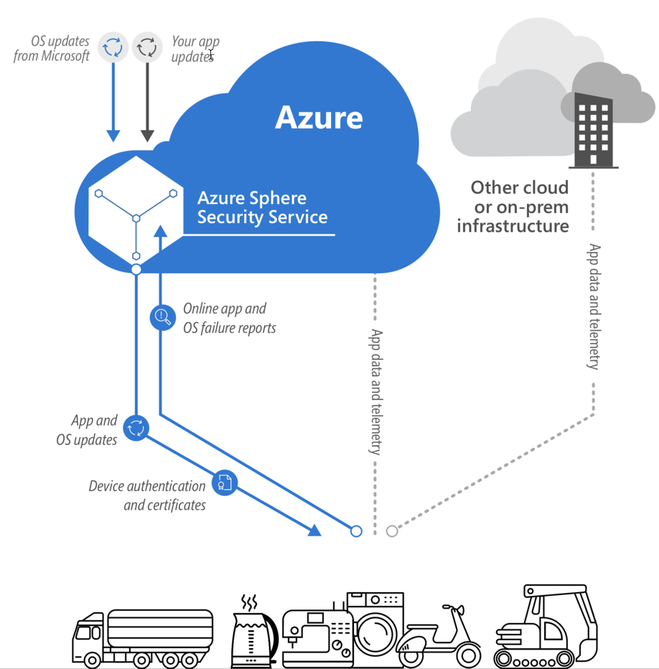
Azure Sphere Security Service

Slide 24
Application Development

Slide 25
Azure Sphere Development
Dev Machine Requirements
  Windows 10
  Visual Studio 2017 / 2019
    w/ Azure Sphere SDK for Visual Studio
  USB port to connect device
Azure Sphere Development Kit
Programming Language: C

Slide 26
Demo
Azure Sphere MT3620 Starter Kit from AVNet
Visual Studio 2019
Azure Sphere SDK
Azure IoT Hub & Device Provisioning Service

Slide 27

Thank You!
Chris Pietschmann
Microsoft MVP – Azure
Solution Architect / Developer, Solliance
Blog: Build5Nines.com
Email: cpietschmann@solliance.net

Slide 28
Please use EventsXD to fill out a session evaluation.
Thank you!

Slide 29

Build5Nines
Cloud & Enterprise Technology
https://Build5Nines.com

