Slide 1

Implementing Real-Time IoT Stream Processing in Azure
Chris Pietschmann
cpietschmann@solliance.net
Notes:
Good morning! {Intro myself}
{ask questions}

Slide 2
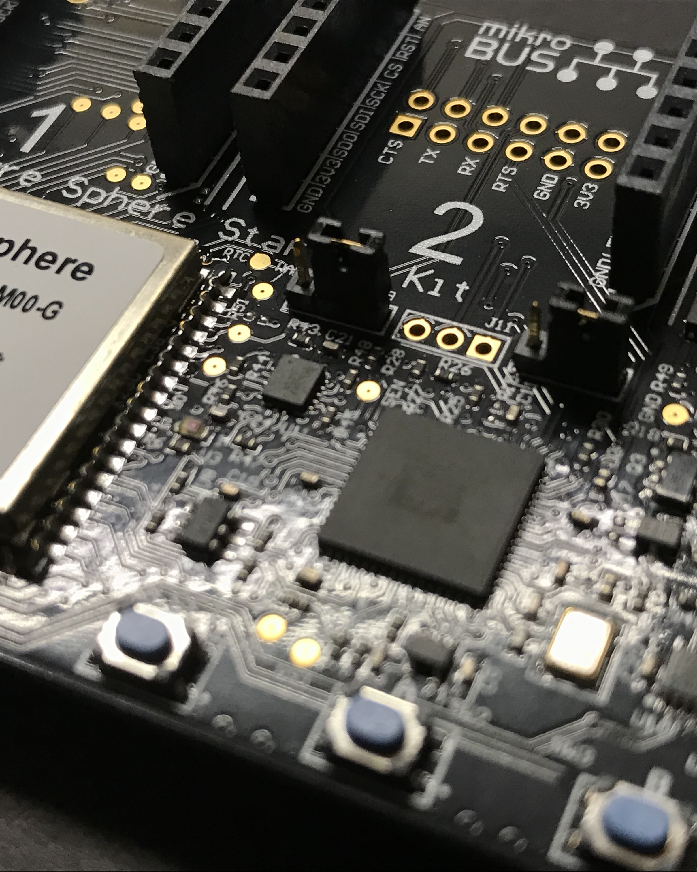
Agenda
Lambda Architecture
Azure Stream Analytics
Notes:
Look at Azure Sphere from security perspective
We’re developers, building IoT solutions.
Need to be sure to protect our company, our clients, and our solutions
In this session, we’ll take a look at…

Slide 3
Lambda Architecture
Data aggregation design patter
Real-Time Processing / Analytics
Fast / Hot path
Batch Processing
Slow / Cold Path

Slide 4





Lambda Architecture
Action
IoT Devices
Real-Time
(Hot)
Stream
Processor
Broker
Storage
Batch
(Cold)

Slide 5
Lambda Architecture
Action
Azure Functions
Broker
IoT Hub
Event Hub
Stream Processor
Stream Analytics
HDInsight Spark Streaming
Storage
Cosmos DB
SQL Database
Service Bus
Azure Data Lake

Slide 6
Azure Stream Analytics
Real-time stream processing
Stream millions of events per second
Multiple Input and Output Streams
Familiar SQL-like language
Serverless

Slide 7
Stream Analytics Data Flow
Processing
Data
Output(s)
Data
Stream(s)

Slide 8







Azure Stream Analytics in the Cloud
Ingest
Analyze
Deliver
Alerts and actions
IoT Devices
Event Hubs, Service Bus, Azure Functions etc.
Dynamic Dashboarding
Continuous Intelligence/ Real-time analytics
Logs, Files, Media
IoT Hub
Power BI
Data Warehousing
Customer data, Financial Transactions
SQL Data Warehouse
Kafka
Azure Stream Analytics
Storage / Archival
Event Hubs
Weather data
SQL DB, Azure Data Lake Gen1 and Gen 2,
Cosmos DB, Blob Storage etc.
Reference Data
Real-time scoring
(SQL DB, Blob store)
(Azure ML service)
Business Applications

Slide 9
Stream Analytics Inputs
Data Stream
Azure IoT Hub
Azure Event Hub
Reference Data
Azure Blob Storage
Azure SQL Database

Slide 10
Stream Analytics Outputs
Cosmos DB
SQL Database
Azure Table Storage
Azure Service Bus
Power BI
Azure Data Lake

Slide 11
Stream Analytics Query
Perform processing on data stream
Stream Analytics Query Language
SQL-like language
SELECT
*
INTO
[YourOutput]
FROM
[YourInput]

Slide 12
Stream Analytics Query
Aggregate
AVG, COUNT, Collect, CollectTOP, MAX, MIN, Percentile_Cont, Percentile_Disc, SUM, TopOne, VAR
Analytic
ISFIRST, LAG, LAST
Array
GetArrayLength, GetArrayElement, GetArrayElements
Conversion
CAST, GetType, TRY_CAST
Geospatial
CreateLineString, CreatePoint, CreatePolygon
Date and Time
DATEADD, DATEDIFF, DATENAME, DATEPART, DAY, MONTH, YEAR
Mathematical
ABS, CEILING, EXP, FLOOR, POWER, SIGN, SQUARE, SQRT
Record
GetRecordProperties, GetRecordPropertyValue
String
CONCAT, LEN, LOWER, UPPER, SUBSTRING, REGEXMATCH

Slide 13
Window Functions
Temporal Window Functions
TumblingWindow
HoppingWindow
SlidingWindow

Slide 14
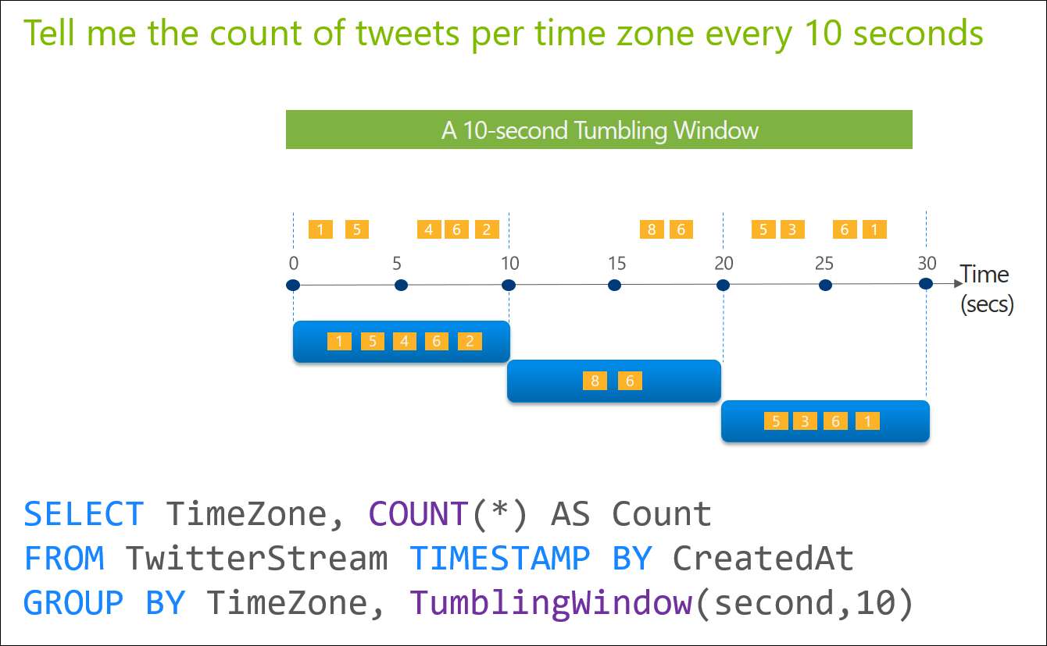
Tumbling Window

Slide 15
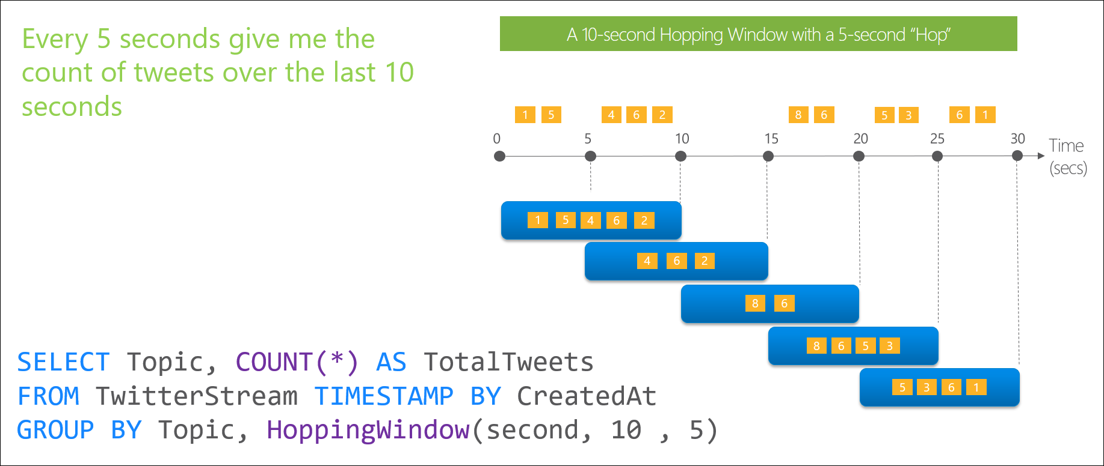
Hoping Window

Slide 16
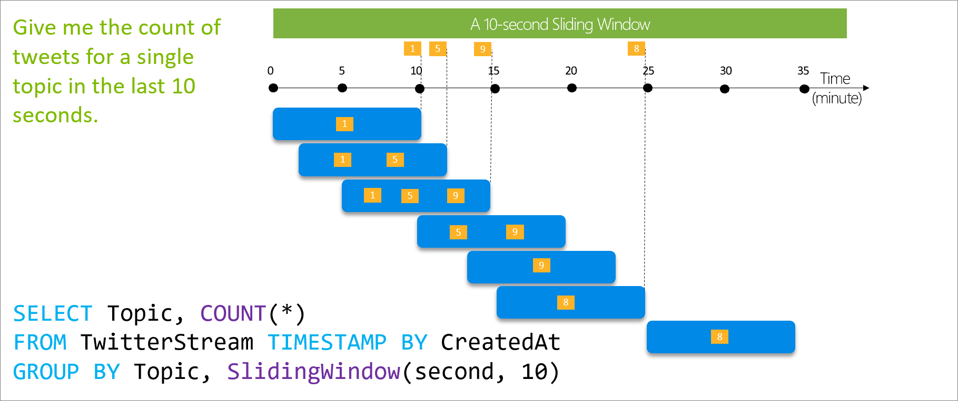
Sliding Window

Slide 17
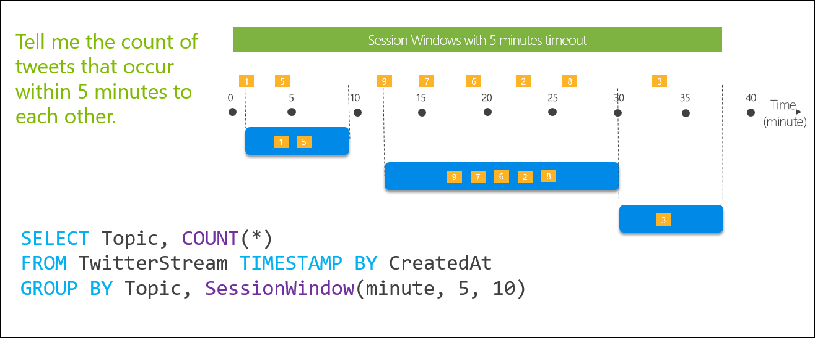
Session Window
Notes:
https://docs.microsoft.com/en-us/azure/stream-analytics/stream-analytics-window-functions#session-window

Slide 18
Functions
JavaScript UDF (user defined functions)
// Convert Hex value to integer.function hex2Int(hexValue) {
return parseInt(hexValue, 16);
}
SELECT time,
UDF.hex2Int(offset) AS IntOffset
INTO output
FROM InputStream

Slide 19
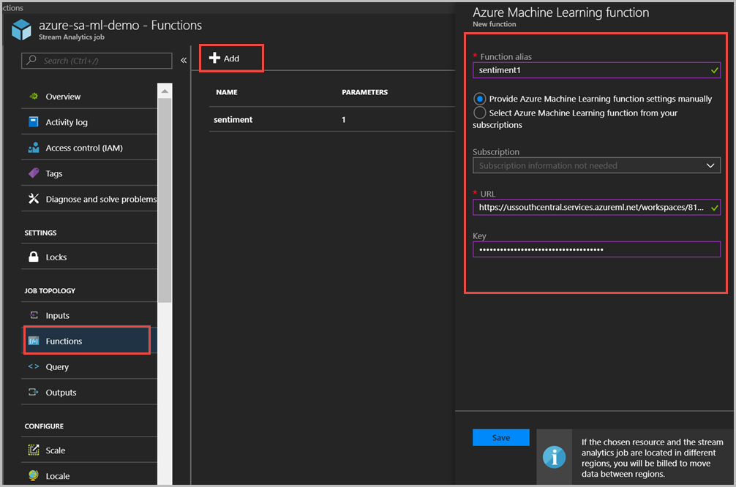
Functions
Integrate Azure Machine Learning
WITH sentiment AS (
SELECT text, sentiment1(text) as result
FROM datainput
)
SELECT text, result.[Score]
INTO datamloutput
FROM sentiment

Slide 20
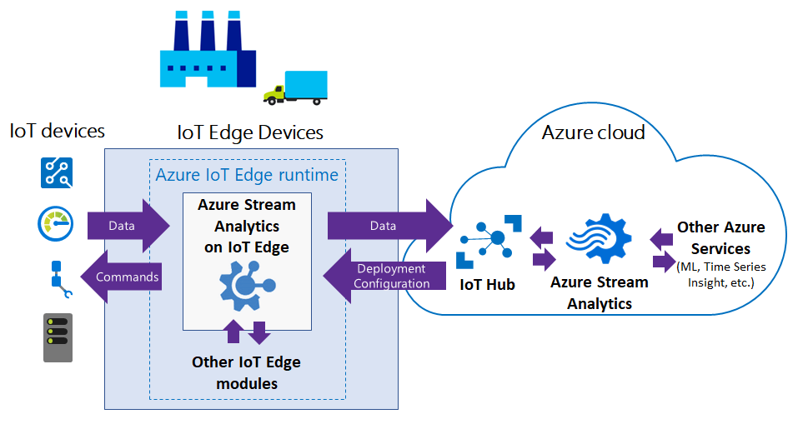
Azure Stream Analytics on IoT Edge
Notes:
https://docs.microsoft.com/en-us/azure/stream-analytics/stream-analytics-edge

Slide 21
Azure Stream Analytics on IoT Edge
Industrial IoT
Too much data to upload to cloud
Send aggregate, average, or only “significant” events where values changed
Examples:
Jet Engines – single flight can produce 1TB of data
Manufacturing – sensors can produce 1MB/s to 10MB/s of event data

Slide 22
Demo
Setup Azure Stream Analytics
Input from Azure IoT Hub
Output to Cosmos DB and Azure Functions
Setup Lambda Architecture

Slide 23

Thank You!
Chris Pietschmann
Microsoft MVP – Azure
Solution Architect / Developer, Solliance
Blog: Build5Nines.com
Email: cpietschmann@solliance.net

Slide 24
Please use EventsXD to fill out a session evaluation.
Thank you!

Slide 25

Build5Nines
Cloud & Enterprise Technology
https://Build5Nines.com

