Slide 1
Knowledge Mining and Cognitive Search
Microsoft Azure + AI Conference
Fall 2019
Adding intelligent enrichments to unstructured data
Kyle Bunting

Slide 2
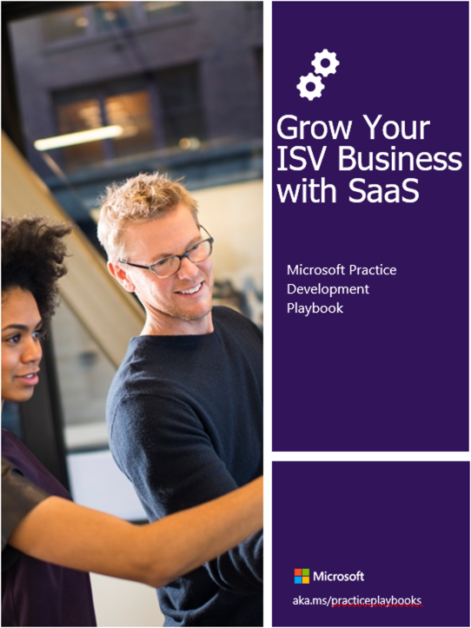
Kyle Bunting
Data Engineer, Solliance
kyle@solliance.net
https://www.linkedin.com/in/kylebunting
20+ years in IT
MBA from the Krannert School of Management at Purdue University
Author / contributor on multiple books on Azure

Slide 3
What is Knowledge Mining?
Using AI to unlock valuable information lying latent in all your content
Form 5471
Your business documents

Slide 4
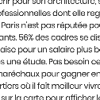
…And Cognitive Search?
Enrichment Pipeline
Documents
Cutting-edge AI: Cognitive Skills
Fully text-searchable rich index
Key Phrase extraction
Location entity extraction
Sentiment analysis
Organization entity extraction
Persons entity extraction
Language detection
Form 5471
Face detection
Celebrity recognition
Tag extraction
Custom skills
Landmark detection
Printed text recognition

Slide 5
Why is Knowledge Mining needed?
Unstructured data makes up 80% of enterprise data and is growing at the rate of 55% and 65% per year
organizations are leaving vast amounts of valuable data on the business intelligence table
No pre-defined data model
May be text, Images, Videos, Forms, or other Formats
Difficult to search

Slide 6
When to use it
Document Analysis
Understanding Engineering Plans
Lack of Metadata
Forms Reading
Handwritten Information
Image Analysis

Slide 7
Azure Cognitive Search*
AI-powered Search-as-a-service
Provides a rich search experience over private data
Optional Knowledge Mining via AI to enrich documents
Functionality exposed via REST API or .NET SDK
* Azure Search was rebranded as Azure Cognitive Search at Microsoft Ignite 2019

Slide 8
AI Enrichment Pipeline
Ingest
Any Data format
Any Azure Store
Enrich
Cognitive Skills
Explore & Analyze
Azure Search API
Portal
Power BI
Azure ML
AI Enrichment Pipeline

Slide 9
Azure Cognitive Search Pipeline
Cognitive skills
Data
Enriched documents
Document cracking
AI enrichment
Search Index
Projections
Knowledge
store
Ingest Enrich Explore & Analyze

Slide 10
Components of a Cognitive Search pipeline
Data source
Skillset
Indexer
Index
Knowledge store

Slide 11
data sources
Blob storage
Table storage
Azure Cosmos DB
Azure SQL Database
SQL Server
on Azure VM
REST API

Slide 12
Index
Persistent store of documents and other constructs used for filtered and full text search
Conceptually, a document is a single unit of searchable data in your index
Mapping these concepts to more familiar database equivalents: an index is conceptually like a table, and documents are roughly equivalent to rows in a table.
When you add or upload an index, Azure Cognitive Search creates physical structures based on the schema you provide.

Slide 13
Indexer
Crawler that extracts searchable data and metadata from an external Azure data source
Populates an index based on field-to-field mappings between the index and your data source.
Pulls data in without you having to write any code
Based on data source types or platforms
Can be used as the sole means of data ingestion or as part of a combination of techniques that include the use of an indexer for loading just some of the fields in your index.
Can be run on demand or on a recurring schedule

Slide 14
Document cracking
Data from supported Azure data sources OR REST API
Indexer “cracks” or extracts text from source data
Cognitive skills
Data
Enriched documents
Document cracking
AI enrichment
Search Index
Projections
Knowledge
store

Slide 15
Demo: Document Cracking
Creating a basic cognitive search index using the Azure portal

Slide 16
AI Enrichment
Leverages AI to extract information and enrich search index
Enrichment through cognitive skills
Cognitive skills
Data
Enriched documents
Document cracking
AI enrichment
Search Index
Projections
Knowledge
store

Slide 17
Skillset
Define the AI enrichments to apply to ingested documents
Collection of Cognitive Skills
Cognitive skills are atomic transformations in an enrichment pipeline
Text-based output can be mapped to a field in an index or used as an input for other skills
Skillset based on predefined cognitive skills or custom skills
Moves documents through a sequence of enrichments

Slide 18
Cognitive skills
Text
Entity recognition
Key phrase extraction
Language detection
Sentiment analysis
Merge
Split
Translation
Vision
Image analysis
OCR
Custom skills
Apply whatever enrichments you want

Slide 19
Azure Cognitive Services
Cloud-based APIs that you can use in artificial intelligence (AI) applications and data flows
Provide machine learning capabilities to solve general problems
APIs, SDKs, and services available to help developers build intelligent apps
No direct AI or data science skills or knowledge required

Slide 20
Text Analytics
Sentiment analysis
Key phrase extraction
Named entity recognition
Language detection
Understand if a record has positive or negative sentiment
Extract key phrases from a piece of text, and retrieve topics
Identify 7 different entity types such as person, location, organization, and activate entity linking
Identify the language, 120 supported languages

Slide 21
Vision APIs
Computer Vision
Custom Vision
Face API
Form Recognizer
Ink Recognizer
Video Indexer

Slide 22
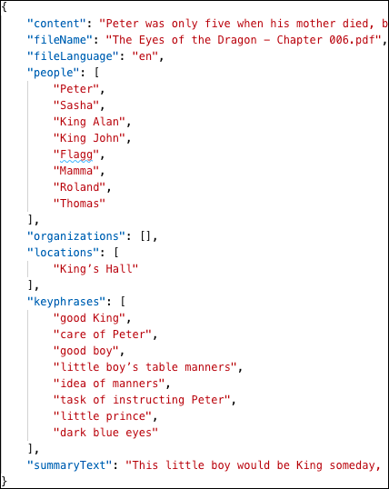
AI Enrichment
transforming unstructured data into information
Cognitive skills
Data
Language detection
Entity recognition
Key phrases extraction
Text summarization
Document cracking
Search Index
Projections
Knowledge
store

Slide 23
Demo: AI Enrichment Pipeline
Create an AI Enrichment Pipeline in the Azure portal

Slide 24
AI Enrichment using custom skills
Simple and clear interface for connecting custom skills to enrichment pipelines
Use the WebApiSkill
Can be added using Visual Studio or via the REST API
Can call any REST API that accepts inputs and emits outputs in ways that are consumable within the skillset

Slide 25
Azure Functions
event-driven serverless compute platform
provide the easiest method for creating custom cognitive skills
Integrated into the Cognitive Search pipeline via the REST API or the .NET SDK

Slide 26
The Pre-built and Custom AI Spectrum
Pre-Built AI
Custom AI
Microsoft Cognitive Services
Azure Machine Learning
Pre-built models
Custom models
Models are pre-trained using Microsoft supplied data
Models “customized” with your data
Models tailored to your scenario and your data

Slide 27
Deploying with Azure Machine Learning
Azure ML deploys containers to:
Web Server Application
Containerized Model
Azure Kubernetes Service
Trained Model
Use the trained model to make predictions
Azure Container Instance

Slide 28
Demo: Deploy Custom ML Model
deploying a trained Machine Learning model to Azure Container Instances Using the Azure Machine Learning Python SDK

Slide 29
Interacting with the REST API
You may not want to create a small application or write and execute scripts just to create and update your search pipeline.
For this, we recommend using Postman, a free tool that helps you quickly work with HTTP endpoints with all available verbs (GET, POST, PUT, etc.), headers, and data formats. Plus, you can save and share your commands.
Postman natively runs on Windows, macOS, and Linux operating systems.
Download it today! https://getpostman.com/

Slide 30
Demo: Create Pipeline with Custom Skills
Create, update, and retrieve pipeline components

Slide 31
Search index and query-based access
Fully text-searchable index consisting of enriched documents
Accessed via REST API or .NET SDK
Cognitive skills
Data
Enriched documents
Document cracking
AI enrichment
Search Index
Projections
Knowledge
store

Slide 32
Knowledge store
Persists output from an AI enrichment pipeline for later analysis or other downstream processing
Results saved to a knowledge store in Azure Storage (Blob or table projections)
Use tools like Power BI or Storage Explorer in the Azure portal to explore the knowledge store

Slide 33
Knowledge store + analytics
Persists pipeline output for downstream processing
Consumable by any tool that can connect to Azure Storage
Cognitive skills
Data
Enriched documents
Document cracking
AI enrichment
Search Index
Projections
Knowledge
store

Slide 34
Helpful resources for getting started
https://kma.azurewebsites.net/
https://github.com/solliancenet/tech-immersion-data-ai/tree/master/ai-exp2
https://azure.github.io/LearnAI-KnowledgeMiningBootcamp/
https://azure.github.io/LearnAI-Cognitive-Search/

Slide 35
Thank You
Kyle Bunting
Data Engineer, Solliance
kyle@solliance.net
https://www.linkedin.com/in/kylebunting

