Slide 1
Data Modeling Trends for 2019 and Beyond
Ike Ellis
@ike_ellis

Slide 2

Ike Ellis
MVP since 2011
Author of Developing Azure Solutions, Power BI MVP Book
Speaker at PASS Summit, SQLBits, DevIntersections, TechEd, Craft
General Manager – Data & AI Practice Solliance
Founder of San Diego Power BI and PowerApps UserGroup
San Diego Tech Immersion Group
/ikeellis
@ike_ellis
www.ikeellis.com

Slide 3
agenda
where we are today:
physical storage design
logical data schema design
where we are headed:
data lakes
lambdas
iot
challenges to data modeling from the business
challenges with the cloud
positioning with the business

Slide 4
reasons we build a data system for analytics
alert for things like fraud
reporting to wall street, auditors, compliance
reporting to upper management, board of directors
tactical reporting to other management
data analysis, machine learning, deep learning
data lineage
data governance
data brokerage between transactional applications
historical data, archiving data
Notes:
hss = high school sex

Slide 5


common enterprise data architecture (eda)
source
source
ods
data warehouse
staging
etl
etl
etl
etl
source
and/or
source

Slide 6
kimball method: sample project plan
1) find executive sponsor
2) gather requirements/
define vocabulary/
wikidefinitions/
requirements document
3) physical design
4) dimensional modeling
5) etl development
6) deployment/training

Slide 7
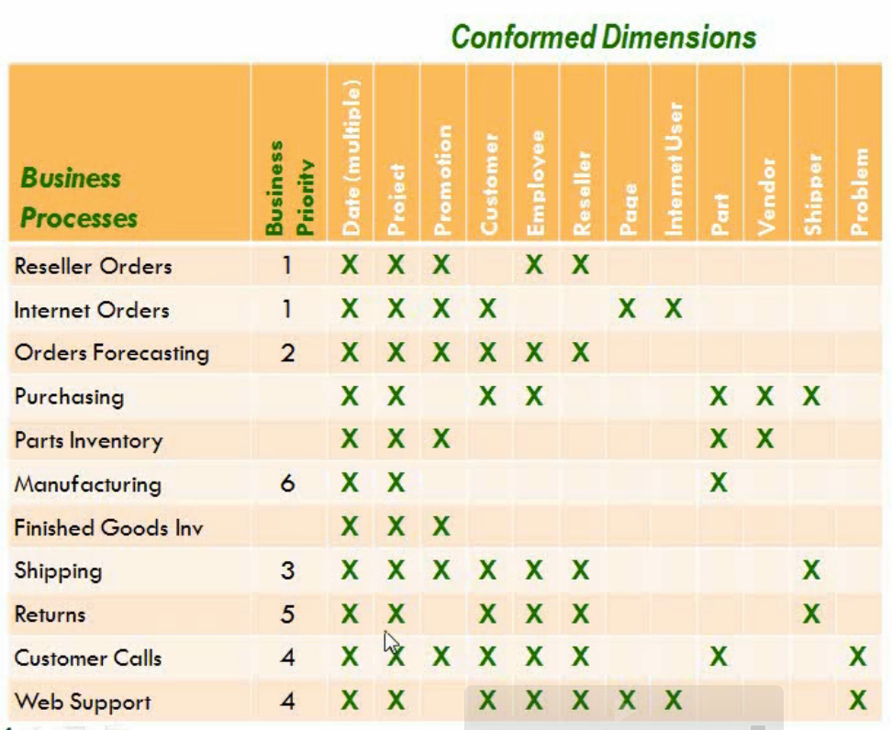
enterprise bus matrix

Slide 8
kimball dimensional modeling
business questions focus on measures that are aggregated by business dimensions
measures are facts about the business (nouns and strong words)
dimensions are ways in which the measures can be aggregated:
pay attention to the “by” keyword
examples:
sales revenue by salesperson
profit by product line
order quantity by Year
Product Line
Time
Quantity
Revenue
Profit
Salesperson

Slide 9
star schemas
group related dimensions into dimension tables
group related measures into fact tables
relate fact tables to dimension tables by using foreign keys
DimSalesPerson
SalesPersonKey
SalesPersonName
StoreName
StoreCity
StoreRegion
DimCustomer
CustomerKey
CustomerName
City
Region
FactOrders
CustomerKey
SalesPersonKey
ProductKey
ShippingAgentKey
TimeKey
OrderNo
LineItemNo
Quantity
Revenue
Cost
Profit
DimDate
DateKey
Year
Quarter
Month
Day
DimProduct
ProductKey
ProductName
ProductLine
SupplierName
DimShippingAgent
ShippingAgentKey
ShippingAgentName
Notes:
Show Adventure Works Dimensions so they can see
Repeated data
Imagine Hierarchies

Slide 10
considerations for fact tables
grain:
use the lowest level of detail that relates to all dimensions
create multiple fact tables if multiple grains are required
keys:
the primary key is usually a composite key that includes dimension foreign keys
measures:
additive: Measures that can be aggregated across all dimensions
nonadditive: Measures that cannot be aggregated
semi-additive: Measures that can be aggregated across some dimensions, but not others
degenerate dimensions:
dimensions in the fact table
Grain =
Order Line Item
FactOrders
CustomerKey
SalesPersonKey
ProductKey
Timekey
OrderNo
LineItemNo
PaymentMethod
Quantity
Revenue
Cost
Profit
Margin
Degenerate Dimensions
Additive
Nonadditive
Semi-additive
FactAccountTransaction
CustomerKey
BranchKey
AccountTypeKey
AccountNo
CreditDebitAmount
AccountBalance

Slide 11
reasons to make a star schema
easy to use and understand
one version of the truth
easy to create aggregations by single passing over the data
much smaller table count (12 – 25 tables)
faster queries
good place to feed cubes (either azure analysis services or power bi shared datasets)
supported by many business intelligence tools (excel pivot tables, power bi, tableau, etc)
what i always say:
“you can either start out by making a star schema, or you can one day wish you did. those are the two choices”

Slide 12
snowflake schemas
normalized dimension tables
consider when:
a subdimension can be shared between multiple dimensions
a hierarchy exists, and the dimension table contains a small subset of data that may be changed frequently
a sparse dimension has several different subtypes
multiple fact tables of varying grain reference different levels in the dimension hierarchy
DimSalesPerson
SalesPersonKey
SalesPersonName
StoreKey
DimStore
StoreKey
StoreName
GeographyKey
DimDate
DateKey
Year
Quarter
Month
Day
FactOrders
CustomerKey
SalesPersonKey
ProductKey
ShippingAgentKey
TimeKey
OrderNo
LineItemNo
Quantity
Revenue
Cost
Profit
DimGeography
GeographyKey
City
Region
DimCustomer
CustomerKey
CustomerName
GeographyKey
DimShippingAgent
ShippingAgentKey
ShippingAgentName
DimProductLine
ProductLineKey
ProductLineName
DimProduct
ProductKey
ProductName
ProductLineKey
SupplierKey
DimSupplier
SupplierKey
SupplierName

Slide 13
slowly changing dimensions
types of change to a dimension member:
type 1: Changing attributes are updated in the dimension record
type 2: Historical attribute changes result in a new record
type 3: The original and current values of historical attributes are stored in the dimension record (rarely used)
Key | AltKey | Name | Phone | City
101 | C123 | Mary | 5551234 | New York
Key | AltKey | Name | Phone | City
101 | C123 | Mary | 5554321 | New York
Key | AltKey | Name | Phone | City | Current
101 | C123 | Mary | 5551234 | New York | True
Key | AltKey | Name | Phone | City | Current
101 | C123 | Mary | 5551234 | New York | False
102 | C123 | Mary | 5551234 | Seattle | True
Key | AltKey | Name | Phone | OriginalCity | CurrentCity | EffectiveDate
101 | C123 | Mary | 5551234 | New York | New York | 1/1/00
Key | AltKey | Name | Phone | OriginalCity | CurrentCity | EffectiveDate
101 | C123 | Mary | 5551234 | New York | Seattle | 6/7/11

Slide 14
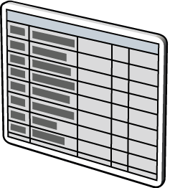
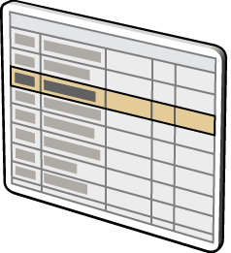
partitioning
partition large fact tables:
typically on a date key
gain from several benefits:
improved query performance through partitioned table parallelism
faster data loading and deletion
improved index manageability
increased backup and restore flexibility
use partition-aligned indexed views:
indexed views or summary aggregates are aligned with table partitions
Pre-Jan
Jan–Jun
Jul–Dec

Slide 15
where do we store aggregations?
power bi shared dataset
azure analysis services tabular cubes (dax)
aggregation tables made by elt or etl processes
could be aggregation files stored in the file system
columnstore indexing can make this method very fast
Why are we doing this?
So that aggregations and calculations are consolidated and consistent with one another and trustworthy
what are your opinions on which is better?
they should be consistent

Slide 16
common enterprise data architecture (eda)
source
source
ods
data warehouse
staging
etl
etl
etl
etl
source
and/or
source

Slide 17

weaknesses

Slide 18
weakness #1: let’s add a single column
source
4
6
8
2
1
3
5
7
source
ods
data warehouse
staging
etl
etl
etl
etl
source
and/or
source
x9!!!!
9

Slide 19
so many of you have decided to just go directly to the source!
source
power query

Slide 20
mayhem
spread business logic
when something changes, you have to change a ton of places
inconsistent
repeatedly cleaning the same data
source
power query
source
power query
source
power query
source
power query
source
power query
source
power query
source
power query
source
power query
source
power query
source
power query
source
power query
source
power query
source
power query
source
power query

Slide 21
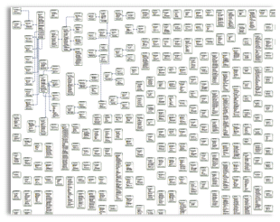
and i’ve seen these data models

Slide 22
weakness #2: sql server for staging/ods
sql actually writes data multiple times on the insert
one write for the log (traverse the log structure)
and then writing for the disk subsystem
one write to mdf
and then writing for the disk subsystem
writing to maintain indexing
and then writing for the disk subsystem
sql is strongly consistent
the write isn’t successful until all the tables and indexes represent the consistent write and all the triggers fire
sql is expensive
you get charged based on the amount of cores you use

Slide 23
weakness #3: great big data warehouses are very difficult to change and maintain
all tables need to be consistent with one another
historical data makes queries slow
historical data makes dws hard to backup and restore and manage
indexes take too long to maintain
dev and other environments are too difficult to spin up
shared database environments are too hard to use in development environments
keeping track of pii and sensitive information is very difficult
creating automated tests is very difficult

Slide 24

weakness #4: very difficult to move this to the cloud
Cloud you pay for four things, all wrapped up differently
CPU
Memory
Network
Disk
Most expensive
CPU/compute!
When you have a big data warehouse, you often need a lot of memory
but this is anchored to the CPU
Big things in the cloud are a lot more expensive then a lot of small things
Make the big things cheap, and the small things expensive so you have lot of knobs to turn

Slide 25
common business complaints about analytic teams
“they don't change as quickly as we'd like”
“they said they'd work for all departments, but it seems like they only work for finance and sales”
hr, it, and supporting departments never get attention
“the data is unreliable”
“this report is far different than this other report”
“every time i ask for something new, it takes six weeks and by then the opportunity has passed”
“the cubes have outdated references to business concepts”
outdated terms

Slide 26

these problems are actually caused by the business
It only takes 4 – 16 hours to make a report
It’s making it consistent and reliable that takes so long
Consistency
Speed

Slide 27
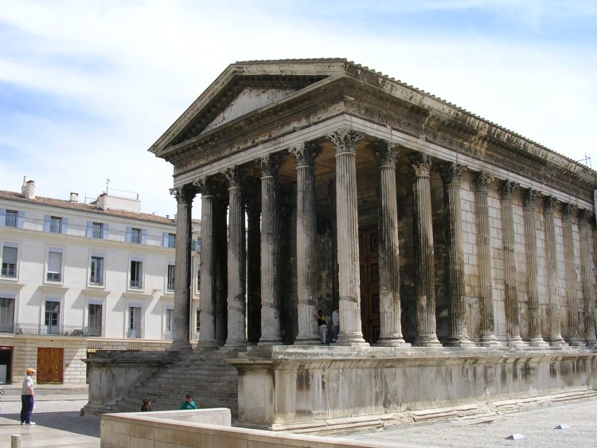
the business worships at the alter of consistency

Slide 28
three types of consistency that cause overhead
internal consistency: does the report match what the report is saying?
external consistency: does the report match every other report?
historical consistency: does the report match itself from years past?
the first one is mandatory, but the remaining two can cause a lot of problems and a lot of headache
how can the business change key metrics and then maintain consistency in the future?
do we change the past?
do we keep the past, but then have two different versions of the metric, the report, the cube?

Slide 29

boat ownership

Slide 30
no separation of concerns in the architecture
trying to make a star schema do everything
alert for things like fraud
reporting to wall street, auditors, compliance
reporting to upper management, board of directors
tactical reporting to other management
data analysis, machine learning, deep learning
data lineage
data governance
data brokerage between transactional applications
historical data, archiving data
source
source
ods
data warehouse
staging
etl
etl
etl
etl
source
and/or
source

Slide 31
data latency
data movement takes a long time
ods
data warehouse
source
staging
etl
etl
etl
etl

Slide 32
don’t be afraid of files
files are fast!
files are flexible
new files can have a new data structure without changing the old data structure
files only write the data through one data structure
files can be indexed
file storage is cheap
files can have high data integrity
files can be unstructured or non-relational

Slide 33
parquet files
Organizing by column allows for better compression,
The space savings are very noticeable at the scale of a Hadoop cluster.
I/O will be reduced as we can efficiently scan only a subset of the columns while reading the data.
Better compression also reduces the bandwidth required to read the input.
Splittable
Horizontally scalable

Slide 34
in the cloud small things are scalable and change-able
we want a lot of small things
we want to avoid compute charges for historical data, snapshotting, and archival

Slide 35

basic physical idea of a data lake
data mart
staging
ods
data mart
source
etl
etl
etl
etl
data mart
etl
etl
etl

Slide 36


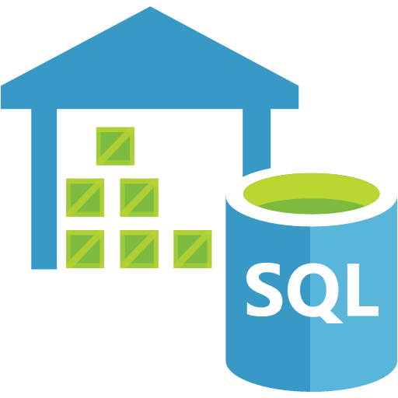



example modern data architecture
LONG TERM STORAGE
SERVING STORAGE
DATA PROCESSING
source
etl
WEB APPLICATIONS
ETL Logic
DATA LAKE STORE/
Azure Blob Storage
Calculations
SQL DB / SQL Server
AZURE DATABRICKS
Triggered & Scheduled Pipelines
Mapping Dataflows
SQL DW
SSIS Packages
DASHBOARDS
DATA FACTORY
Pipelines
AZURE ANALYSIS SERVICES
ORCHESTRATION
DIRECT
DOWNLOAD
AZURE STORAGE

Slide 37
back to this list: these should be separate parts of a single system
alert for things like fraud
reporting to wall street, auditors, compliance
reporting to upper management, board of directors
tactical reporting to other management
data analysis, machine learning, deep learning
data lineage
data governance
data brokerage between transactional applications
historical data, archiving data

Slide 38
pitch it to the business: consistent path
LONG TERM STORAGE
SERVING STORAGE
source
etl
DATA LAKE STORE/
Azure Blob Storage
SQL DB / SQL Server
Triggered & Scheduled Pipelines
Mapping Dataflows
SSIS Packages
DASHBOARDS
DATA FACTORY
Pipelines
AZURE ANALYSIS SERVICES
ORCHESTRATION

Slide 39
consistent path tips
never say:
one version of the truth
all the data will be cleaned
all the data will be consistent
keep total number of reports on the consistent path to less than 50
remind them of boat ownership
new report authoring takes a long time
changes are slow and methodical

Slide 40

new logo

Slide 41
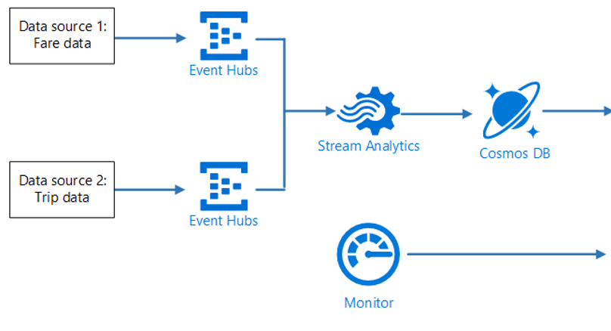
pitch it to the business: alerting
LONG TERM STORAGE
DATA PROCESSING
source
etl
ETL Logic
WEB APPLICATIONS
Calculations
DATA LAKE STORE/
Azure Blob Storage
AZURE DATABRICKS
DASHBOARDS
DIRECT
DOWNLOAD

Slide 42
pitch it to the business: just-in-time reporting (flexible, inconsistent, but we don’t say that)
done in a couple of days
decoupled, not quite as clean, useful
done in a couple of weeks
coupled, clean, consistent
staging
ods
BoD
data mart
source
etl
etl
etl
etl
data mart
etl
etl
etl

Slide 43
a properly designed data lake
easy to organize!
do it by folders
staging
ods
organize by source with folders
sap
salesforce
greatplains
marketingorigin
salesorigin
historical
snapshot
design by security
adls allows you to choose the expense of the file without changing the uri
allows delta loads
read, analyze with a myriad of tools, including azure databricks, power bi, excel
separation from compute so we don’t get charged for compute!

Slide 44
data virtualization as a concept
data stays in it’s original place
sql server
azure blob storage
azure data lake storage gen 2
metadata repository is over the data where it is
data can then be queried and joined in a single location
spark sql
polybase
hive
power bi
sql server big data clusters

Slide 45
design security
encryption
role-level security
access control
all done through azure active directory (aad)

Slide 46
conclusion
yes, we still make star schemas
yes, we still use slowly-changing dimensions
yes, we still use cubes
we need to understand their limitations
don’t be afraid of files and just in time analytics
don’t conflate alerting and speed with consistency

Slide 47
Agenda
summary of where we’ve been in data modeling
current priorities, state of data modeling, and design guidelines
practice modeling data

Slide 48
through-out this presentation, remember three things
schema controls scalability (performance) and changeability
in the average transactional application, reads outnumber rights by 10 to 1, schema often emphasizes writes, but it should emphasis the reads
schema has to change for the future
change with the business
change with technology

Slide 49
schema definition
a representation of a plan or theory in the form of an outline or model
would you begin any major project without a plan or a theory?

Slide 50

EF Codd

Slide 51
first normal form
That the data is in a database table. The table stores information in rows and columns where one or more columns, called the primary key, uniquely identify each row.
Each column contains atomic values, and there are not repeating groups of columns.
Example:
There is a primary key
Each column only has one piece of data.
Bad Example: Order1Date, Order2Date, Order3Date, etc.

Slide 52
second normal form
A table is in 2nd Normal Form if:
The table is in 1st normal form, and
All the non-key columns are dependent on the table’s primary key.
Example:
you wouldn’t put corporateHeadquartersAddress in the orders table. it’s irrelevant.

Slide 53
third normal form
A table is in third normal form if:
A table is in 2nd normal form.
It contains only columns that are non-transitively dependent on the primary key
Example:
you wouldn’t put employeeFullName in the orders table, even though employeeID is in the orders table

Slide 54

EF Codd’s ideas are a bit outdated
his assumptions and priorities are not our assumptions and priorities

Slide 55
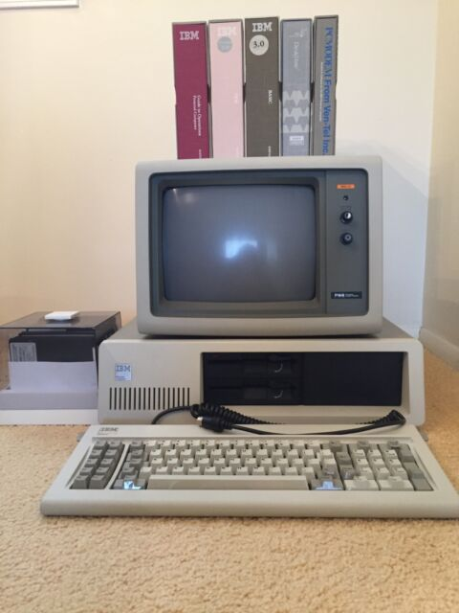
assumption: disks will always be expensive
my first hard drive was 10MB and cost my dad $1,400 in 1984

Slide 56
results
this means that we need normalization to decrease repeating data and thus decrease the overall size of the data on the disk
this means that there would be a benefit to over-normalization, ie a person table

Slide 57
results of over-normalization: terrible performance with joins
over-normalization has several drawbacks
too many joins in a query will always have bad performance
over-normalized data models are too difficult for new developers or contractors to learn
the total number of tables explodes on us. 300 tables per database is very common in a transactional model
over-normalization is too steep a learning curve to figure out how to delete or insert records
data has to be constantly aggregated to show results if we avoid repeating data

Slide 58


assumption: the database is the center of all applications

Slide 59
results
one application can’t release changes to the database without testing all applications
this greatly increased the testing surface area, and delays product releases

Slide 60
results: database as an integration point
application 1 uses the database to communicate to application 2

Slide 61

results: database as a messaging service
application1 tells application2 what to do by using the database
multiple columns in a table that have status date tells you there might be a queue
deletes on a queue are logged operations. takes a lot of time and locks the table between applications

Slide 62
results: applications affect the performance of other applications
high load on app1 is now affecting the performance of app2

Slide 63
results: in order to upgrade app1, you have to upgrade app2
app1 might need money and better performance. we have to pay to upgrade app2 as a result.

Slide 64
assumption: because the database is shared, it’s best to have it be responsible for data accuracy and consistency
data is only stored one time between all applications. the database is in charge of the data being accurate.

Slide 65
result: business logic begins to go in the database
it’s the one place where business logic is guaranteed to be enforced
this loads the cpu of the database
hurts sql server licensing
hurts database scalability
incentivizes the use of stored procedures and triggers to consolidate business logic
both things are difficult to test, difficult to refactor, difficult to read

Slide 66

NOW LET’S TALK ABOUT CURRENT DESIGN PRIORITIES (CDP)

Slide 67
cdp#1: the data needs to be consistent and high quality
choose the correct data type
allow for nulls when the value is unknown
when data is wrong, create a correction plan and fix the bug
build automated tests around data quality

Slide 68
cdp #2: schema should be able to change
business is complaining that the database is not changing as fast as the business
business changes taxonomy. they change student to learner. they change eligibility to enrollment. if the database doesn’t change, this creates bugs, confusion, and ambiguity
technology changes
new index structures, new table structures, new database technology, new versions of existing technology
very fast pace of change
moving to the cloud

Slide 69
cdp#2: the microservices method ~ ways to keep schema flexible
one application to one database
No Excel
No ETL
No other apps
No SSRS, Power BI

Slide 70
cdp#2: consolidate database logic in a data tier layer
data tier for all data access

Slide 71

cdp#2: use an ORM, views, codegen, swagger
data tier for all data access

Slide 72

cdp#2: application integration is through apis, messaging, and eventing

Slide 73
cdp #3: optimize for reads
the application will be judged based on read-speed, not write speed. users expect writes to take a long time. schema should focus on the reads

Slide 74
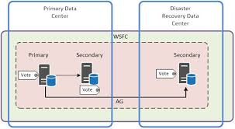
cdp#3: optimize for reads

Slide 75

cdp#3: optimize for reads

Slide 76
cdp#3: optimize for reads
Orders Table
OrderID
OrderDate
Qty
UnitPrice
TotalPrice
Customers Table
CustomerID
CustomerName
Address
TotalOrderAmount
AllOpenOrdersJSON

Slide 77
cdp#3: reads ~ index table
Create three tables
Customers
Orders
CustomerOpenOrders

Slide 78
cdp#4: make the schema easy and discoverable
delete columns no one is using
delete tables no one is using
avoid acronyms in naming
avoid jargon
avoid spaces
remove unnecessary tables
name the tables after business names

Slide 79
cdp#5: it’s the network, not the disk
the network is the real problem
tough to upgrade
shared by everything
latency
hard to optimize
create schema for the network
minimize round-trips
only get the columns and rows that you need
keep transactions small
it’s ok to say no to users

Slide 80


cdp#5: optimize for network
mobile carrier bandwidth
load times and too much network affect SEO and bounce rates

Slide 81
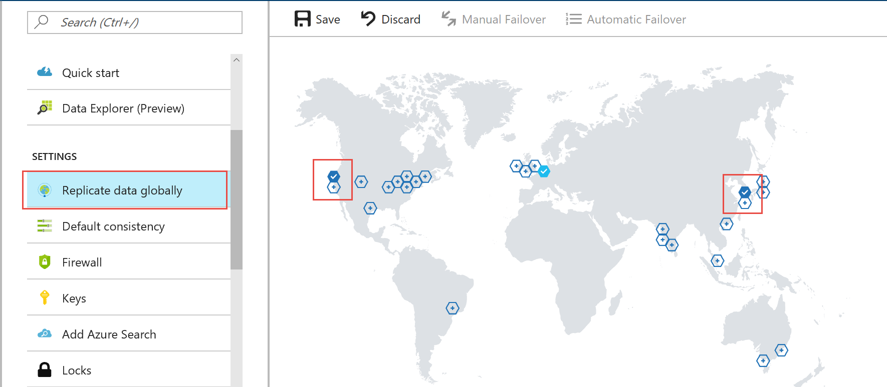
cdp #5: network ~ data locality

Slide 82
cdp #6: raw performance
think of de-normalization as just another index
proper schema can increase performance by 1,000 times
limit joins
think of the indexing

Slide 83
cdp #7: what can we remove that isn’t 100% necessary?
audit trails: different database
blobs: azure blob storage
temp data: different database
staging data: different database, azure blob storage

Slide 84
cdp #8: plan for partitioning
choose a partition key
make partition key available in every applicable table
shouldn’t have to join to a different table to get the partition key
shouldn’t have to hunt for the partition key
keep lookup tables small or in their own database
use api for lookup with caching backend as their own domain

Slide 85
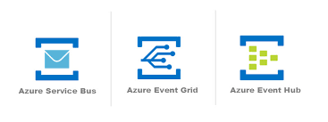
cqrs
command query segregation responsibility
app takes your order or request
app responds to user “we’ve received your request”
publish
ack
pull
data store
function takes request and transforms the data into data repo optimized for read and cache
persist

Slide 86
Contact Me!
Ike Ellis
Twitter: @ike_ellis
YouTube: https://www.youtube.com/user/IkeEllisData
Solliance
Microsoft MVP
www.solliance.net
www.craftingbytes.com
www.ikeellis.com

