Slide 1
A Guide to Creating Data Pipelines in Azure
Ike Ellis
@ike_ellis

Slide 2
Why I hate SSIS and Hope We Can Stop Discussing It
Ike Ellis
@ike_ellis

Slide 3
And At The End Of My Talk, So Will You
Ike Ellis
@ike_ellis

Slide 4

Ike Ellis
MVP since 2011
Author of Developing Azure Solutions, Power BI MVP Book
Speaker at PASS Summit, SQLBits, DevIntersections, TechEd, Craft
General Manager – Data & AI Practice Solliance
Founder of San Diego Power BI and PowerApps UserGroup
San Diego Tech Immersion Group
/ikeellis
@ike_ellis
www.ikeellis.com

Slide 5
Hey Ike! Make sure your databricks clusters are pre-heated!

Slide 6
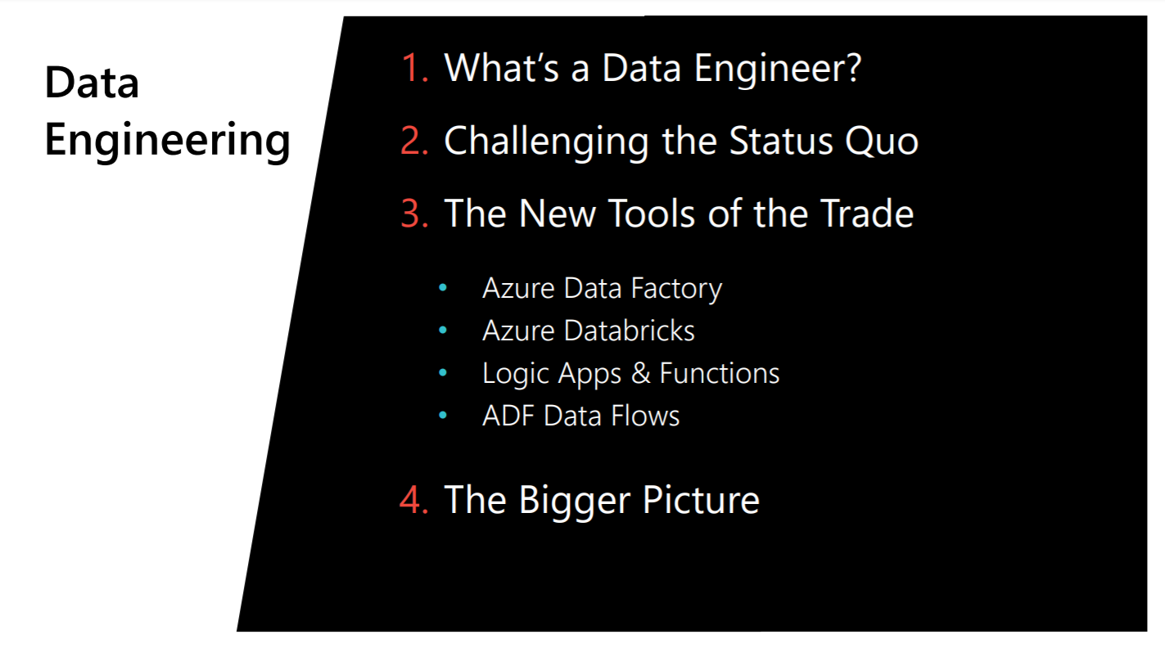

Slide 7
So what is data engineering?
https://www.freecodecamp.org/news/the-rise-of-the-data-engineer-91be18f1e603/

Slide 8
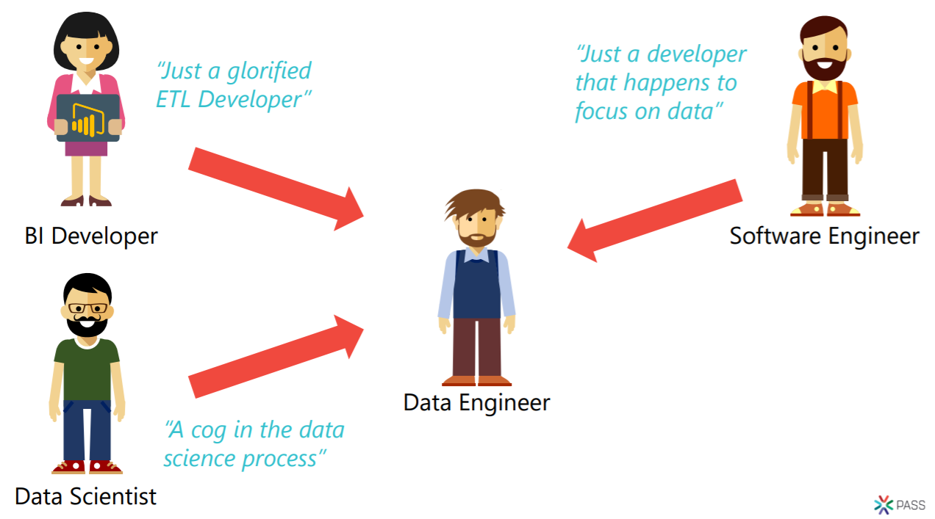

Slide 9
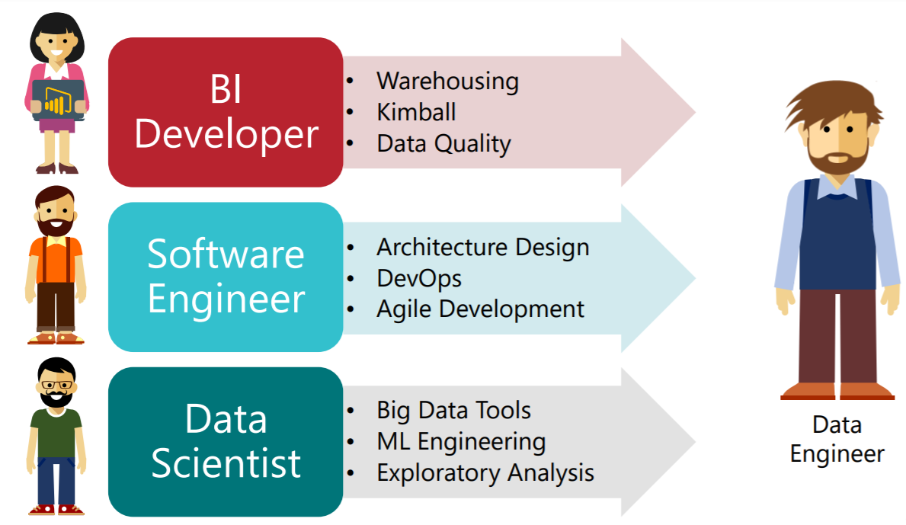

Slide 10
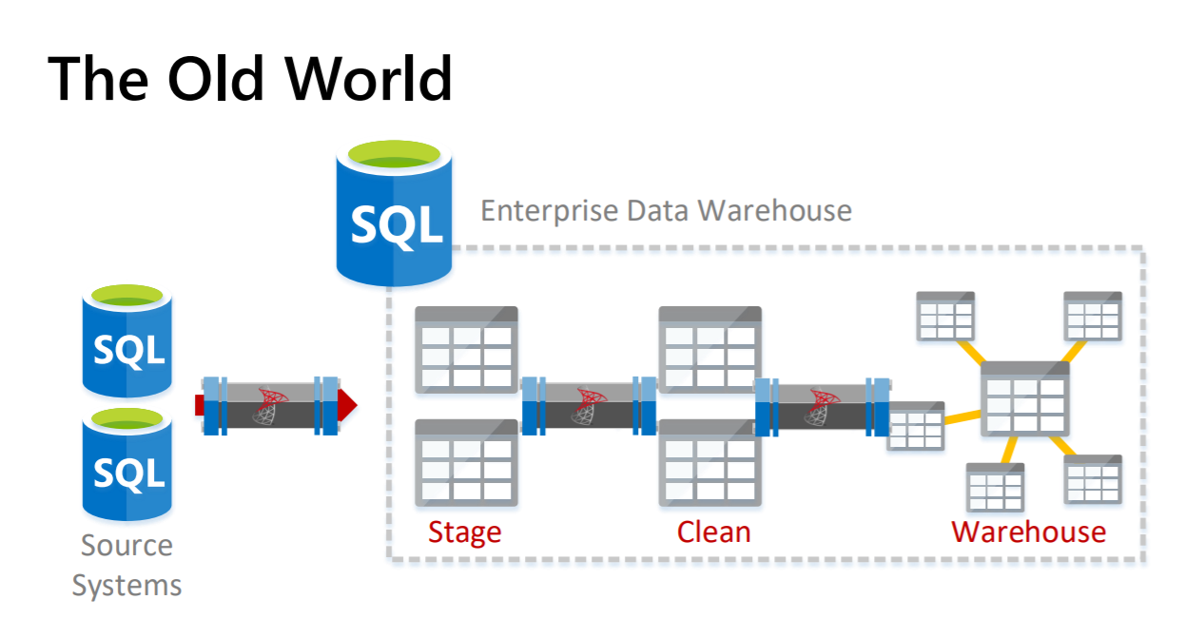

Slide 11
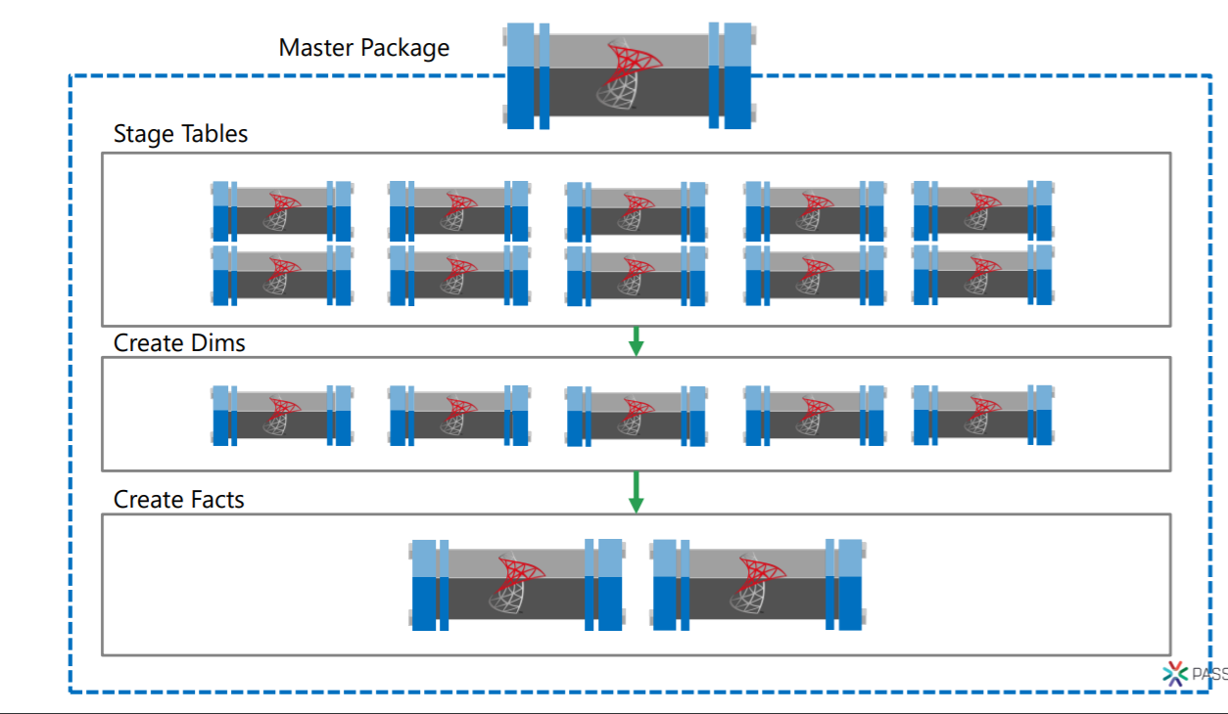

Slide 12
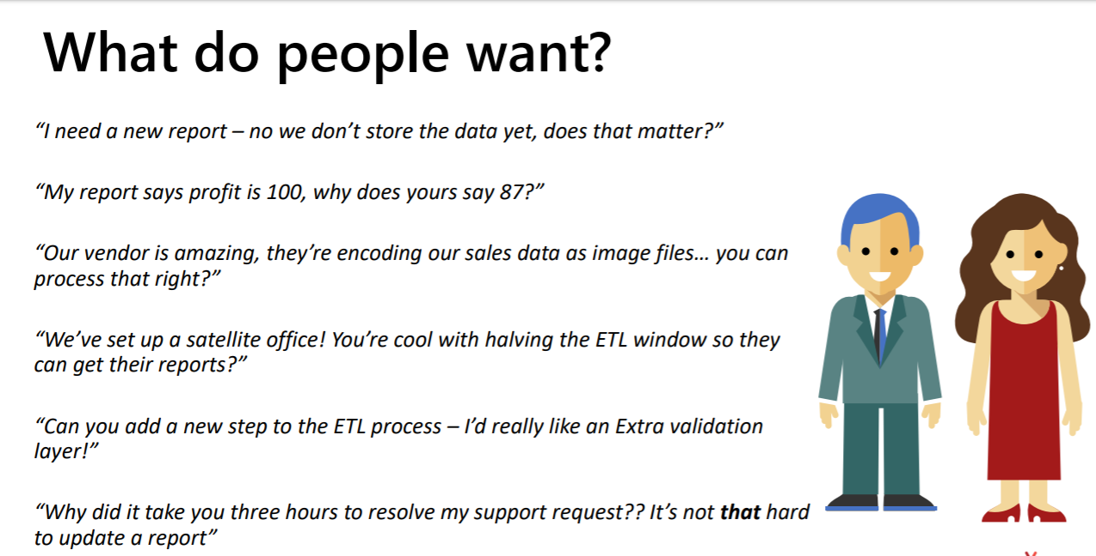

Slide 13
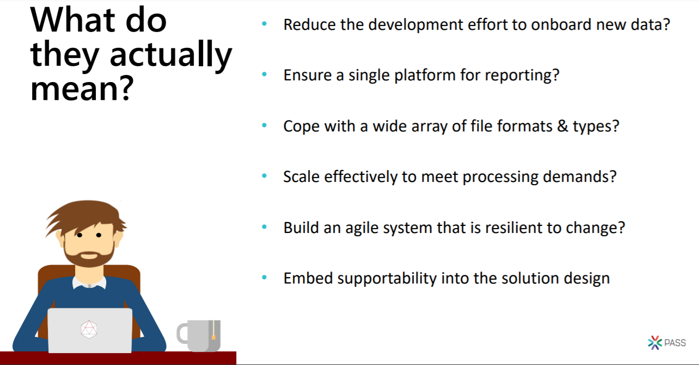

Slide 14
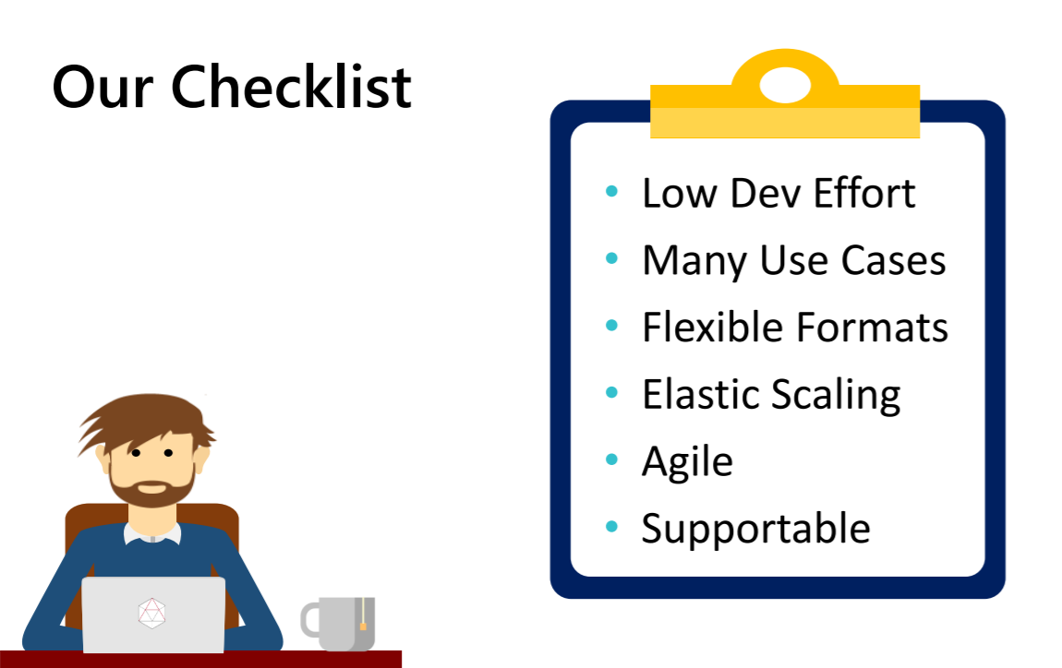

Slide 15
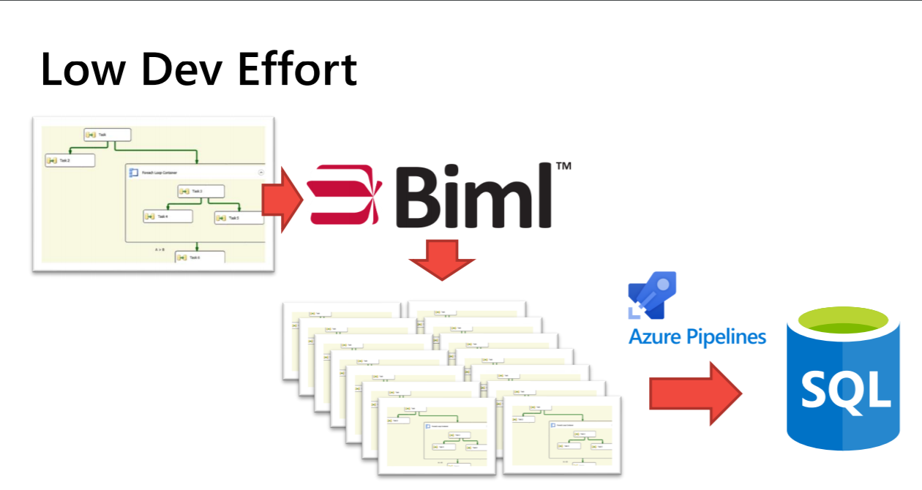

Slide 16
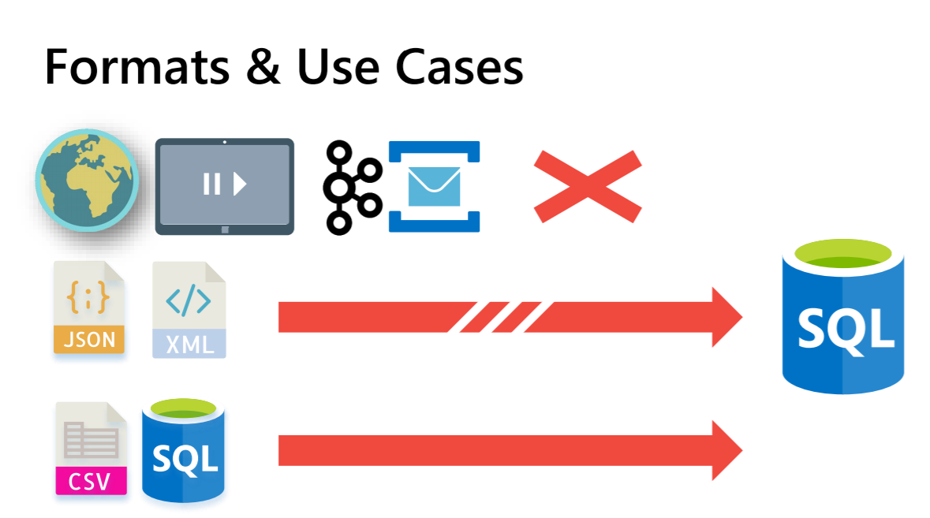

Slide 17
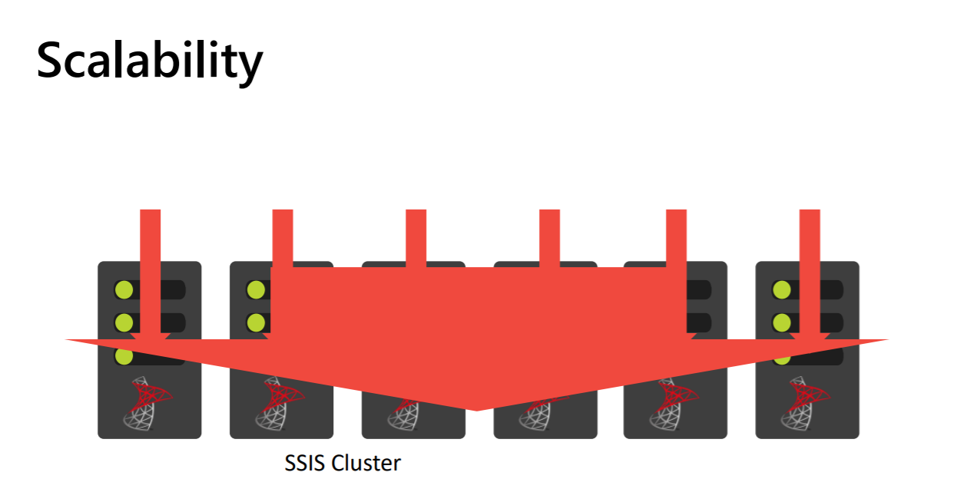

Slide 18
Agility

Slide 19
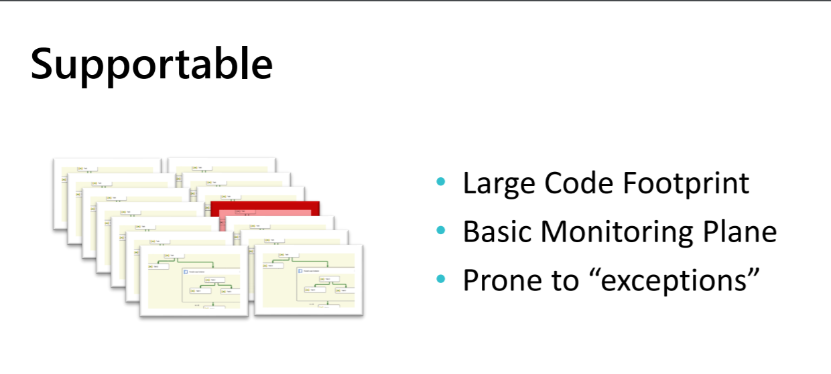

Slide 20
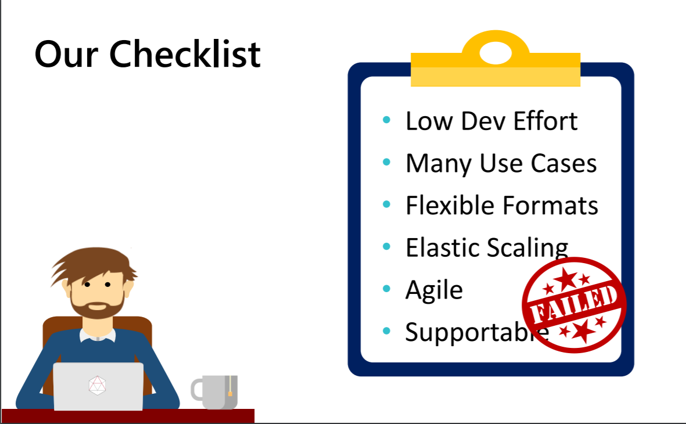

Slide 21
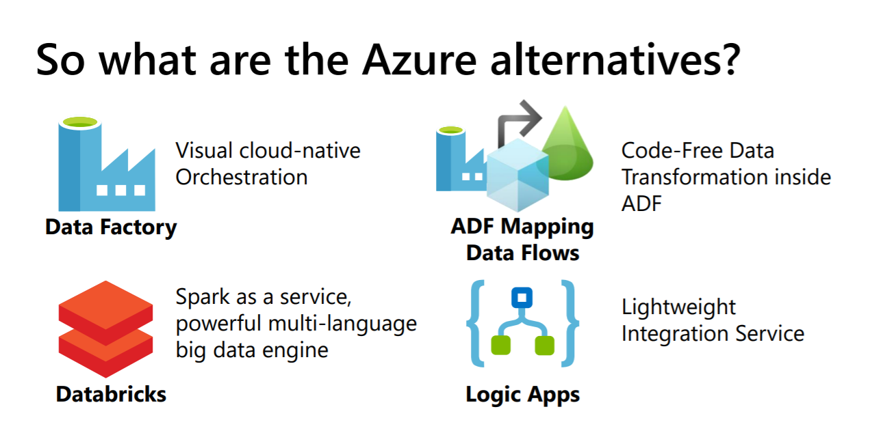

Slide 22
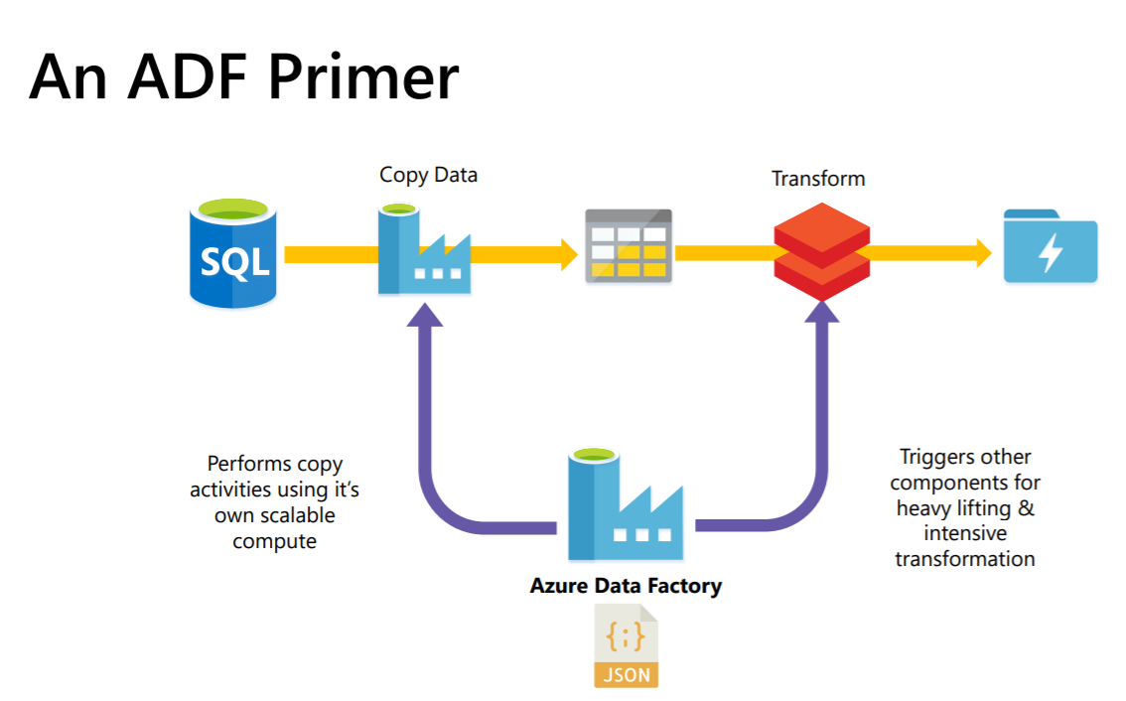

Slide 23
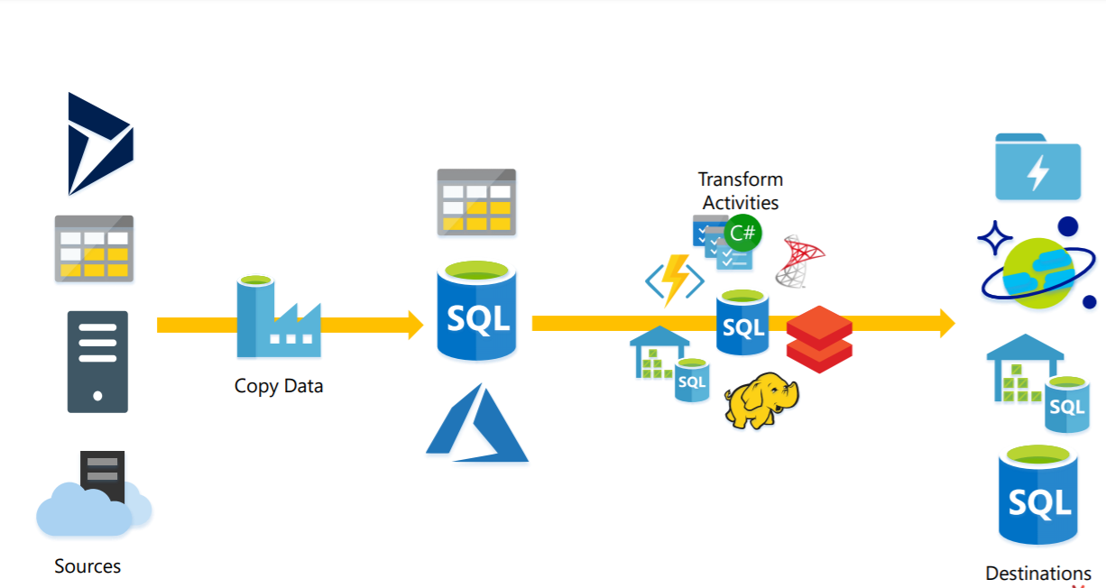

Slide 24
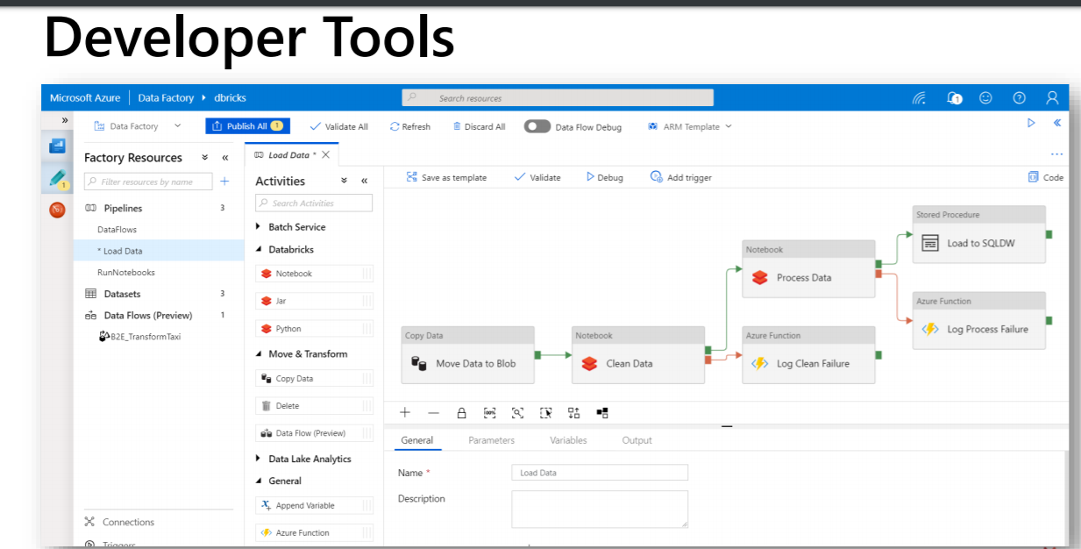

Slide 25
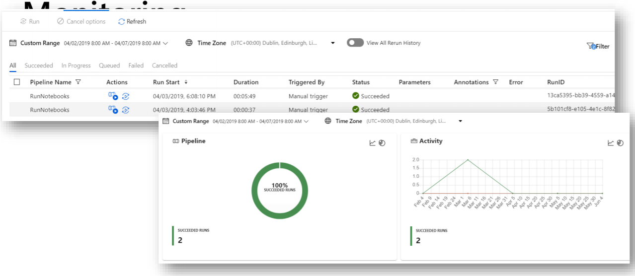

Slide 26
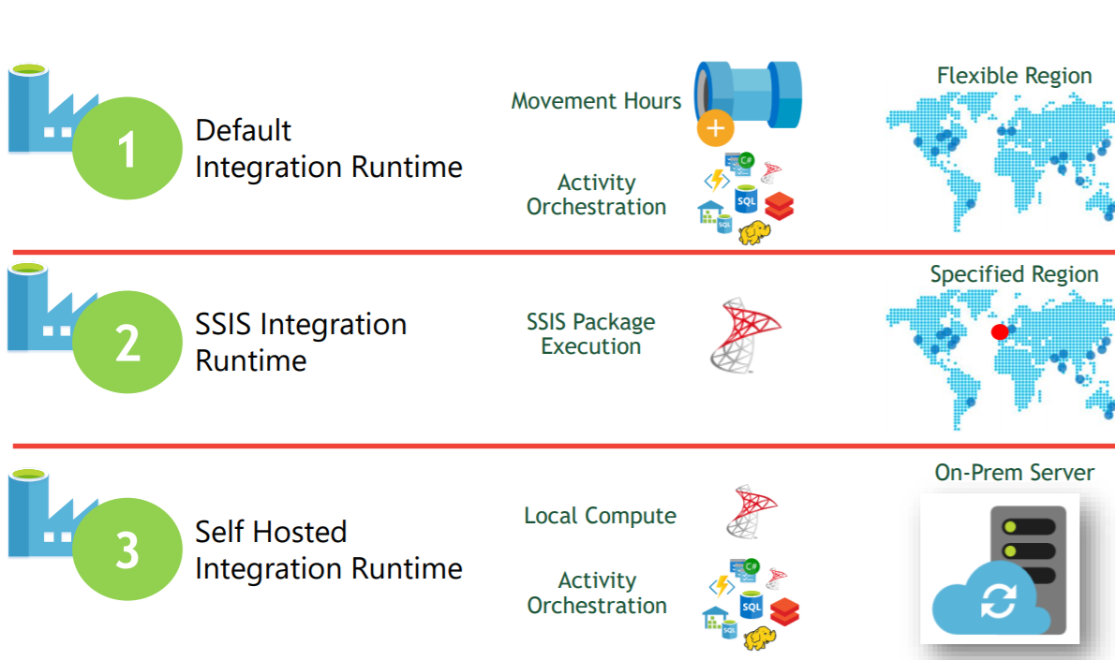

Slide 27
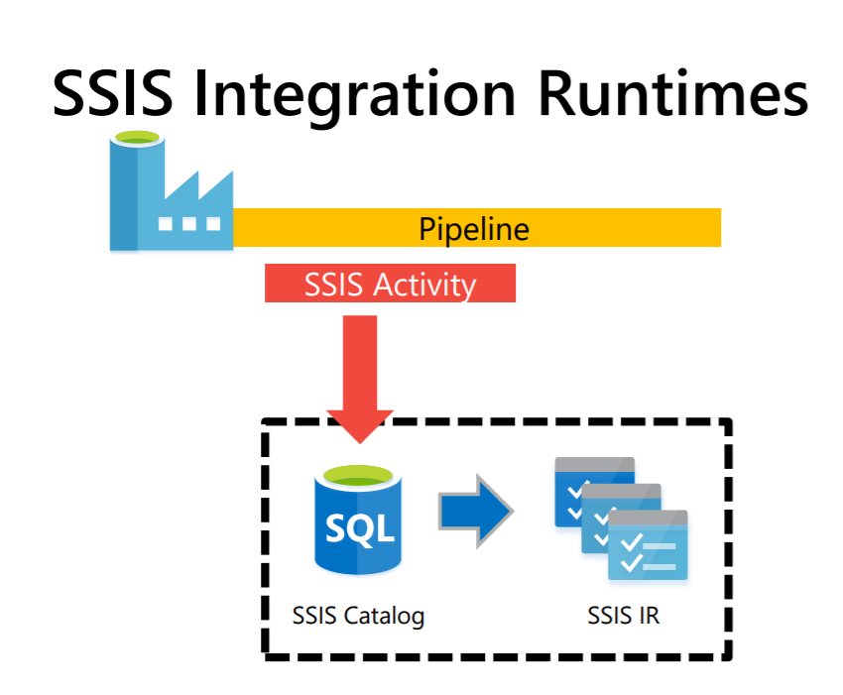

Slide 28
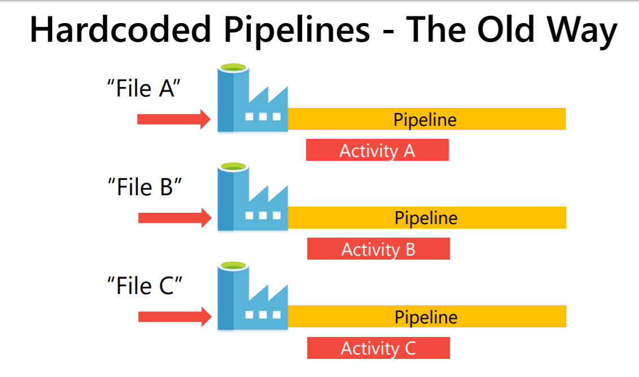

Slide 29
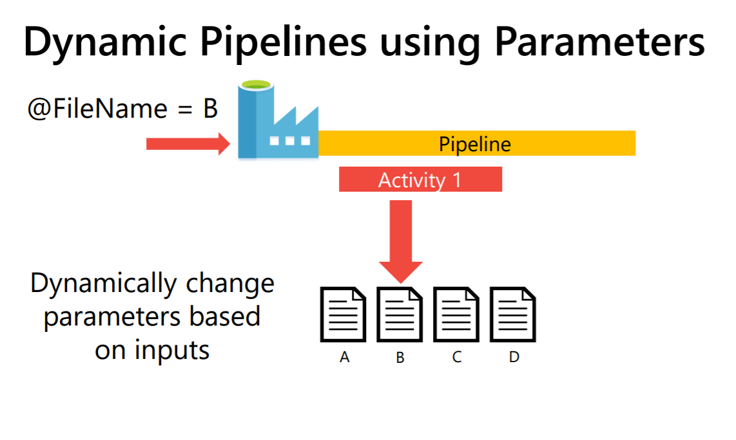

Slide 30
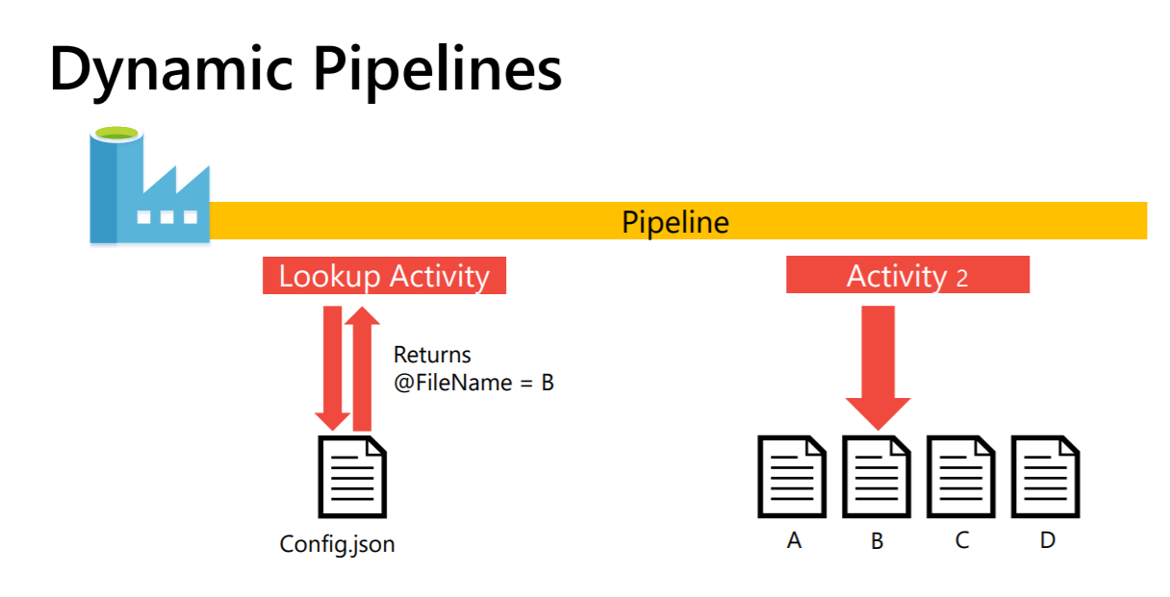

Slide 31
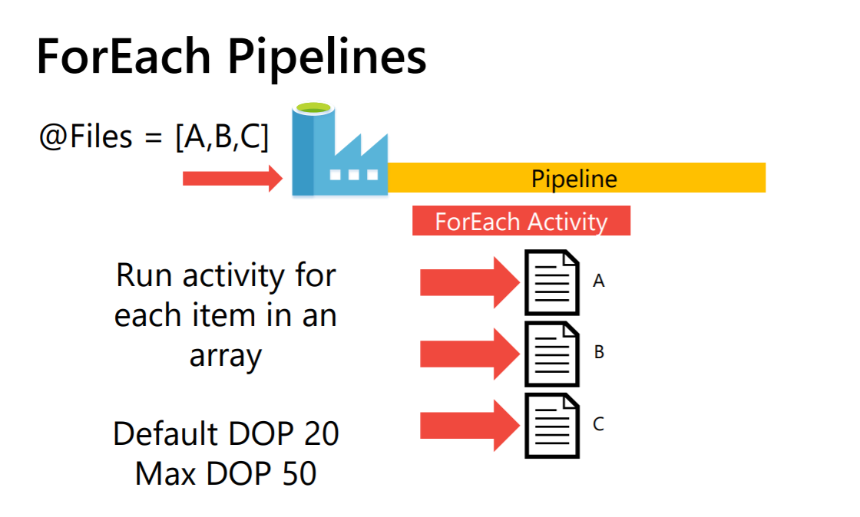

Slide 32
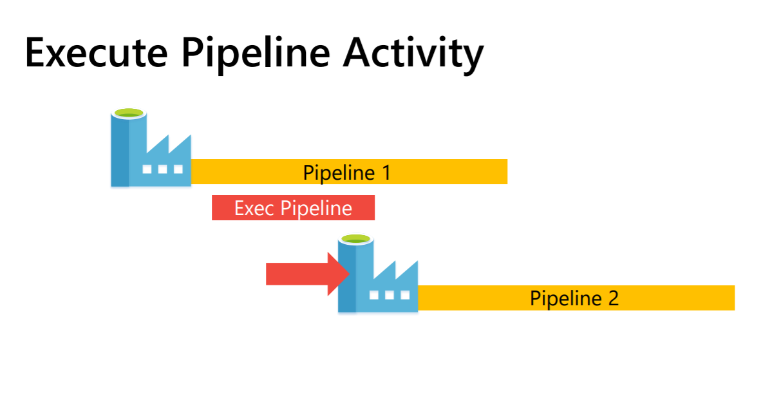

Slide 33
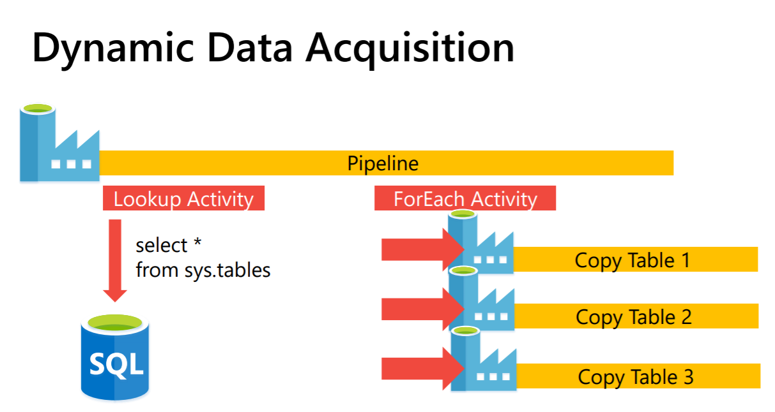

Slide 34
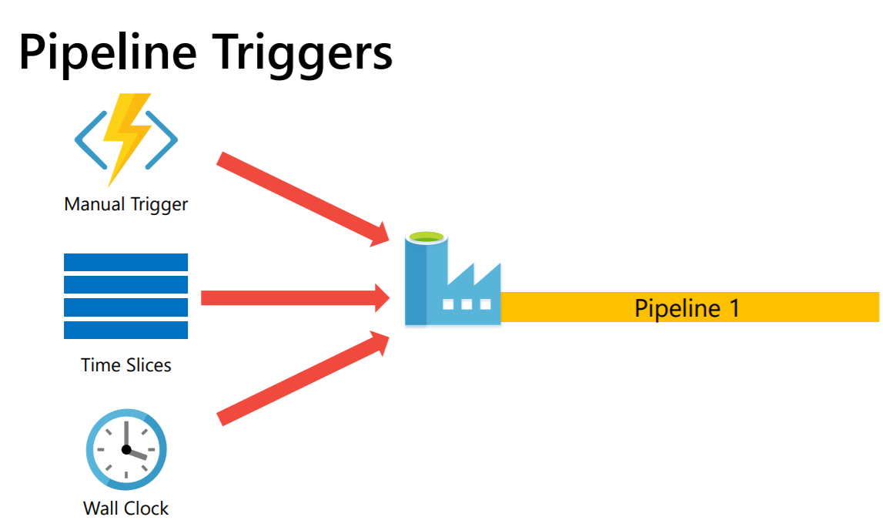
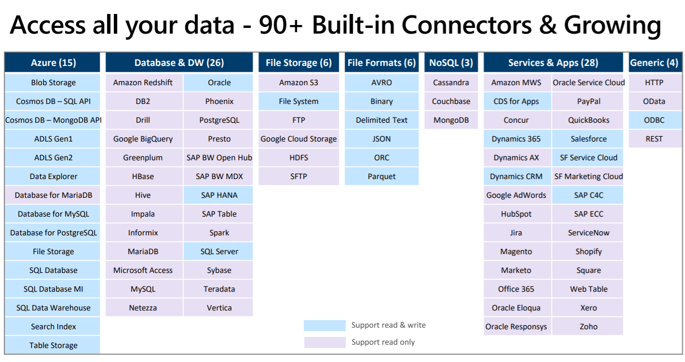

Slide 35
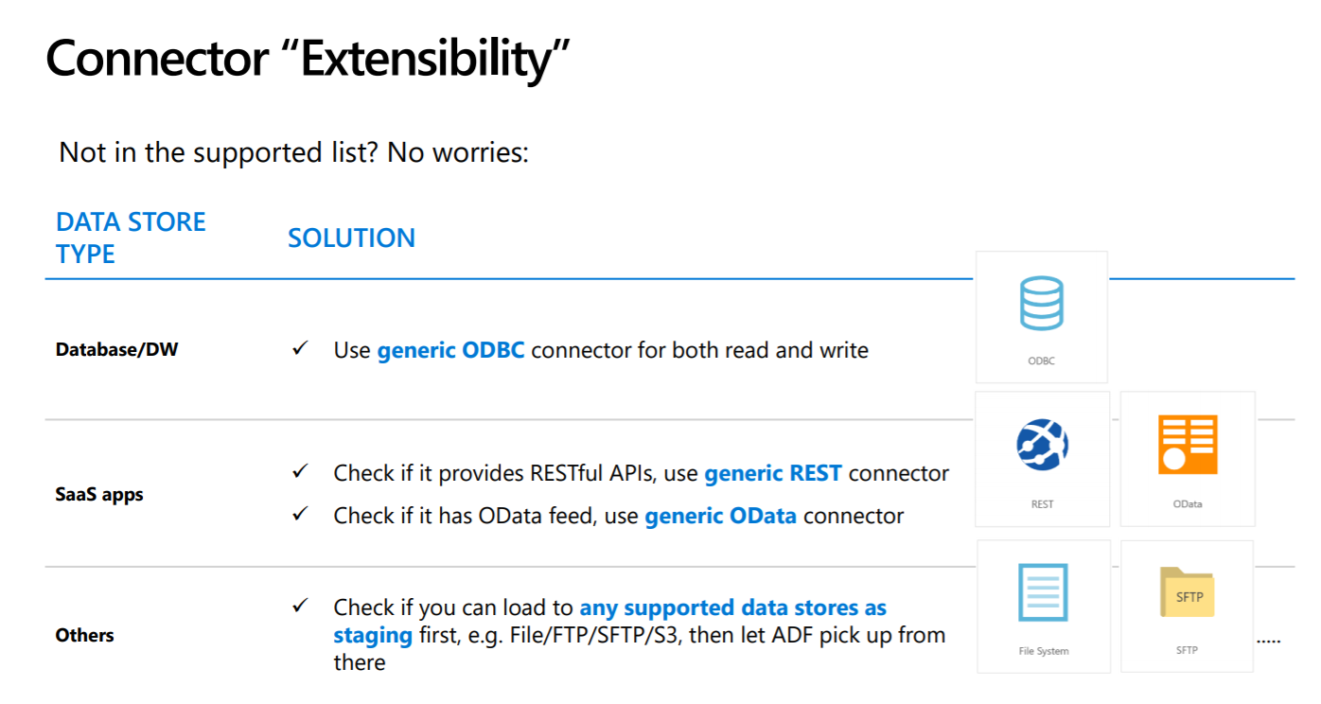

Slide 37
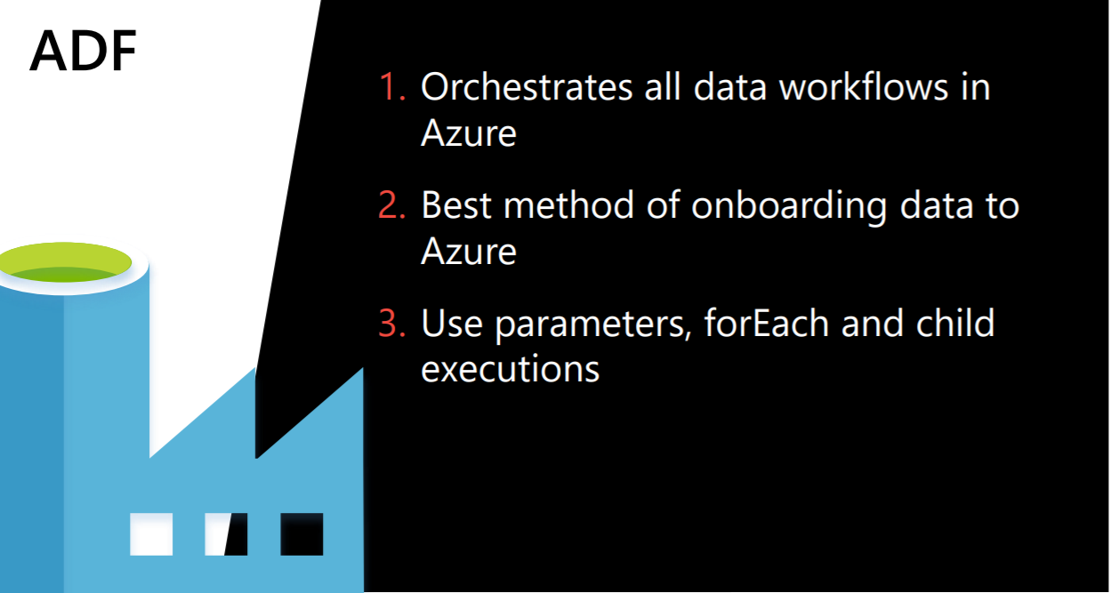

Slide 38


Slide 39
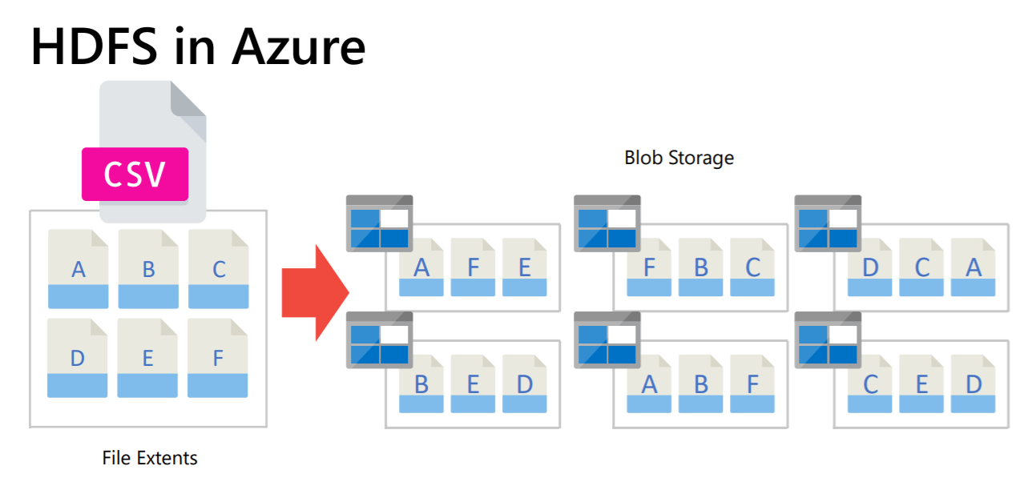

Slide 40
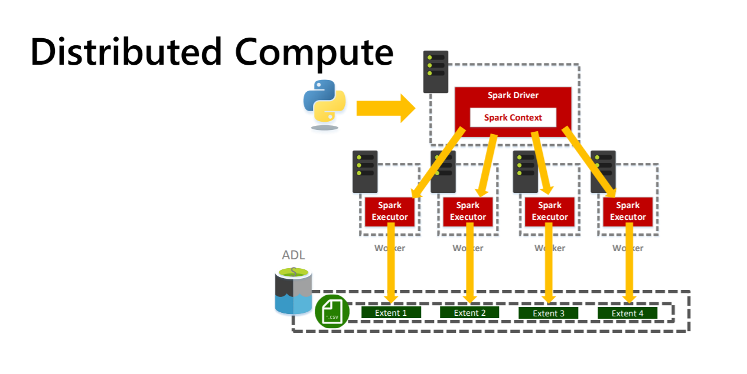

Slide 41
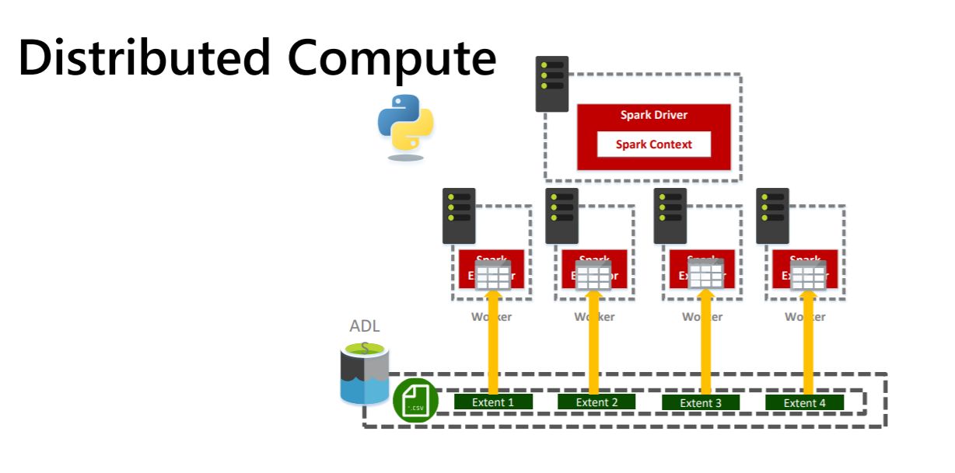

Slide 42
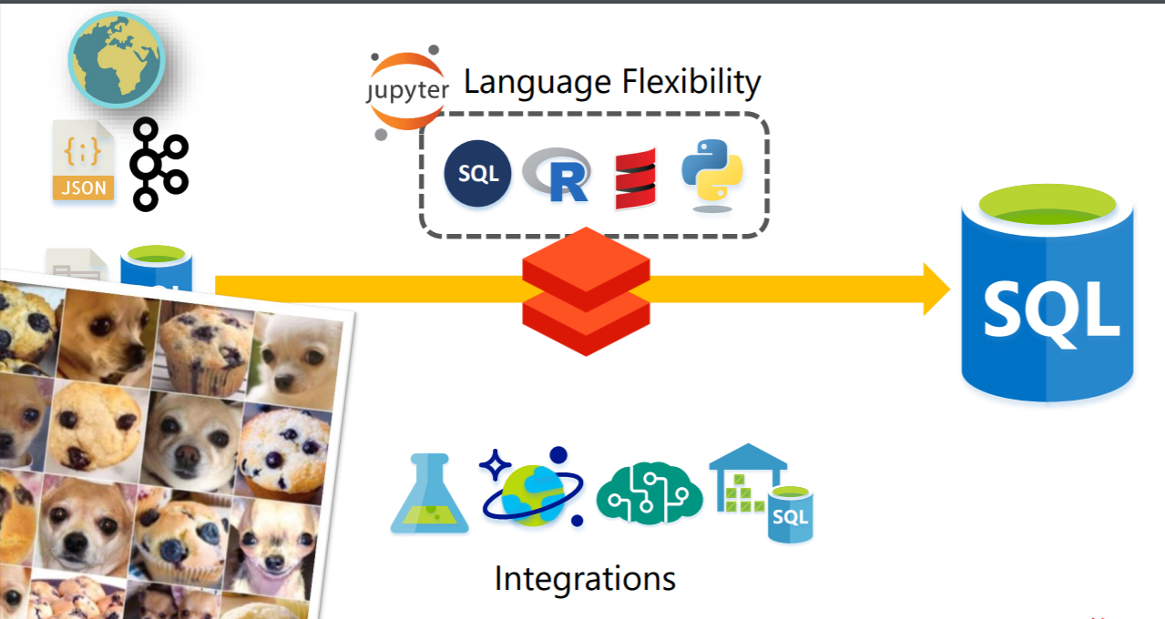

Slide 43
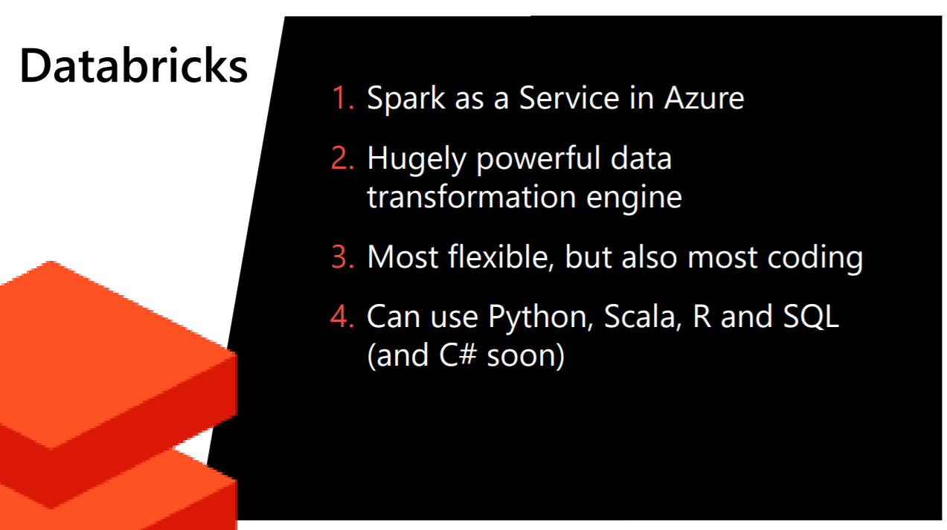

Slide 44
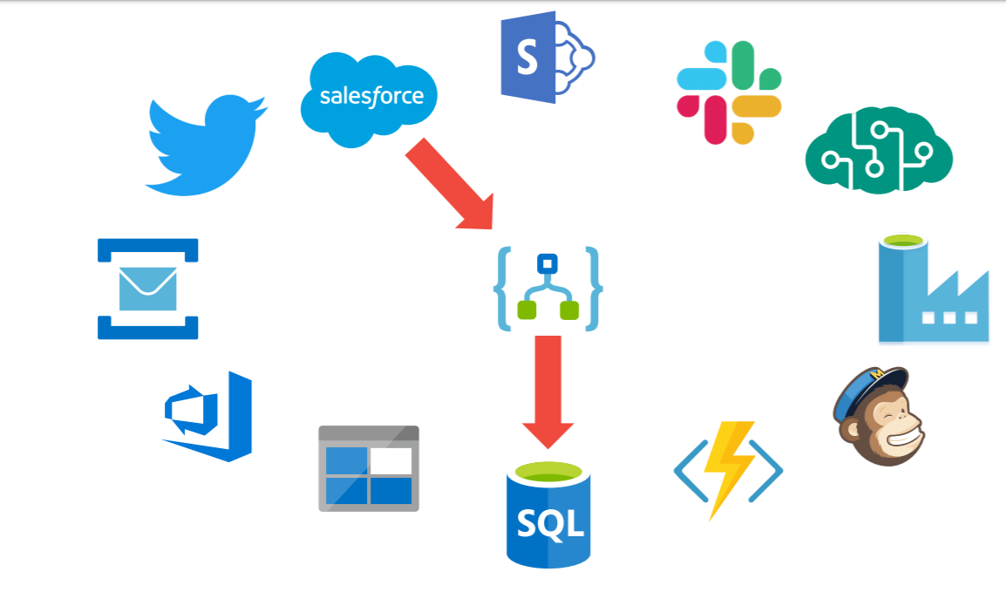

Slide 45
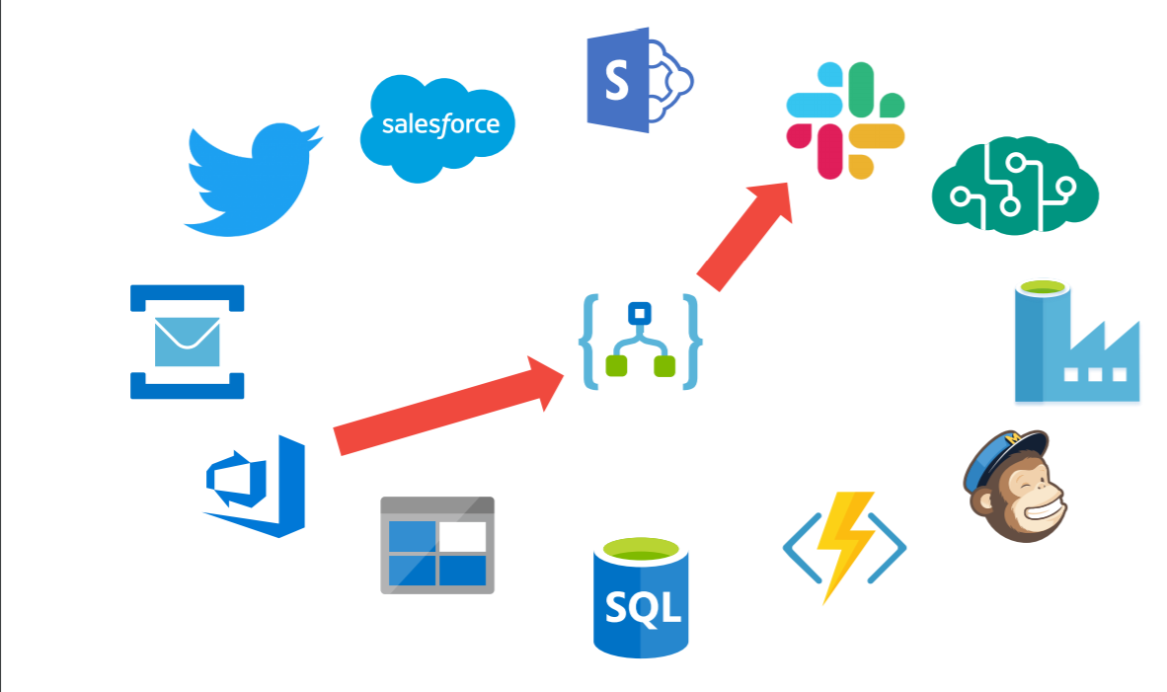

Slide 46
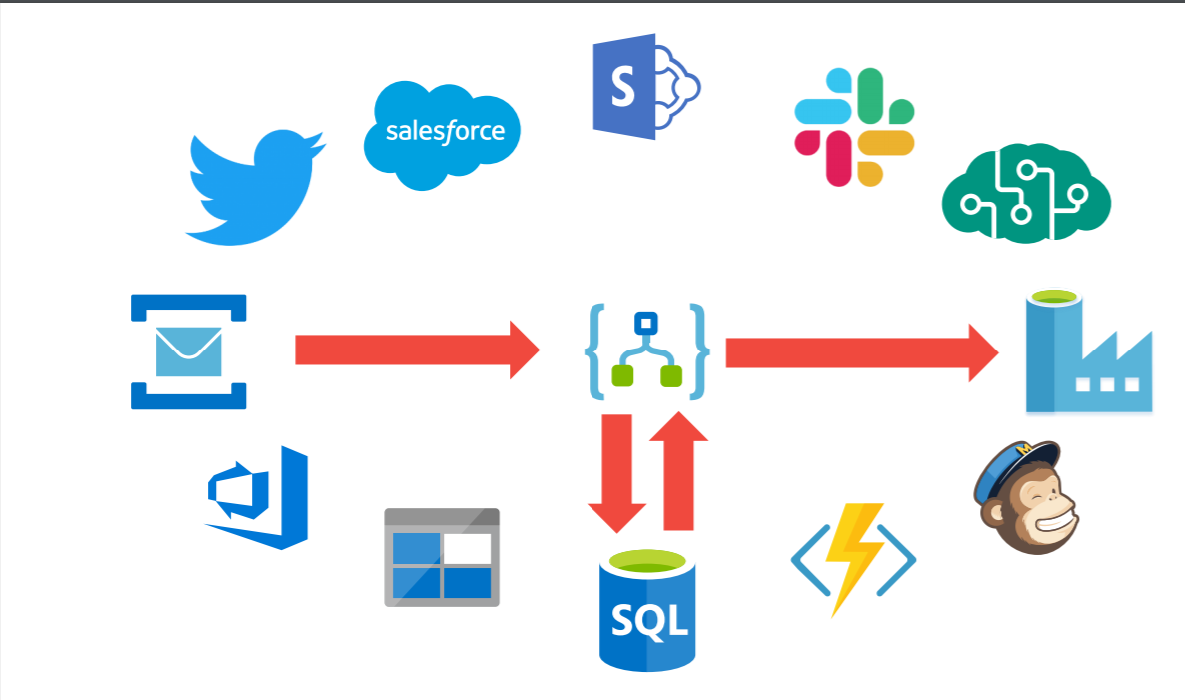

Slide 47
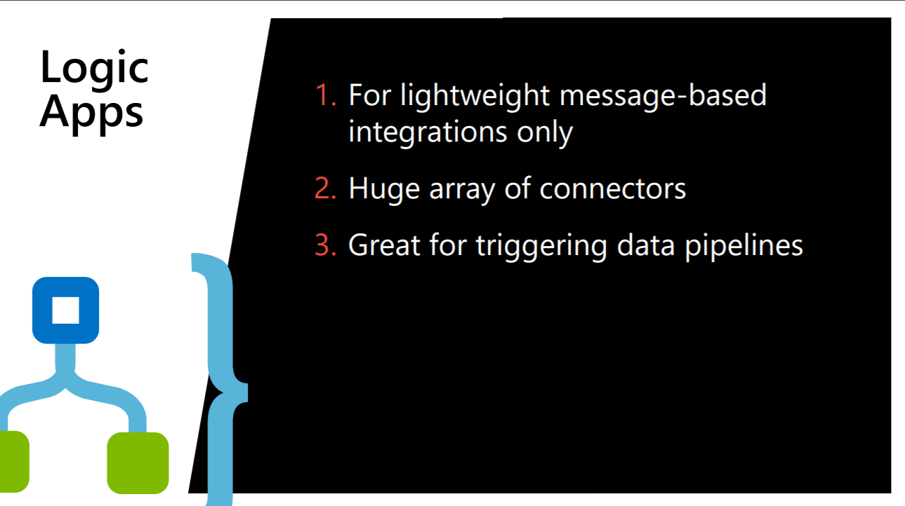

Slide 48
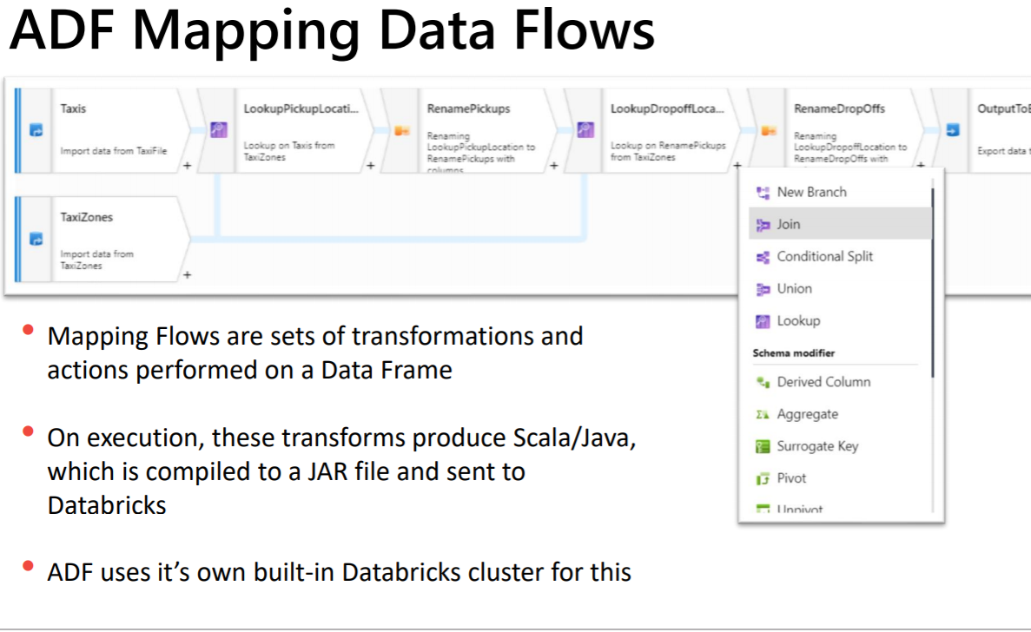

Slide 49
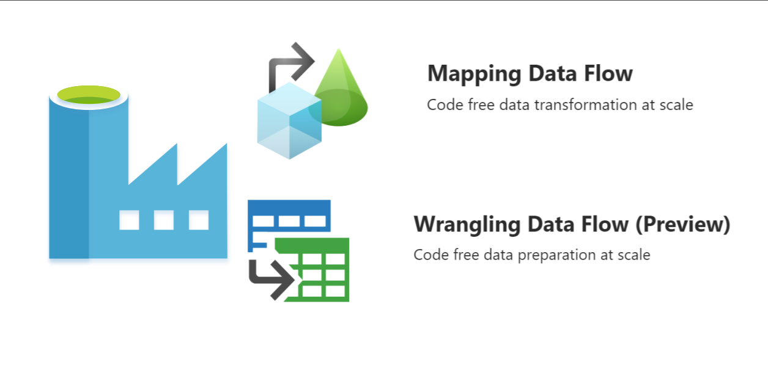

Slide 50
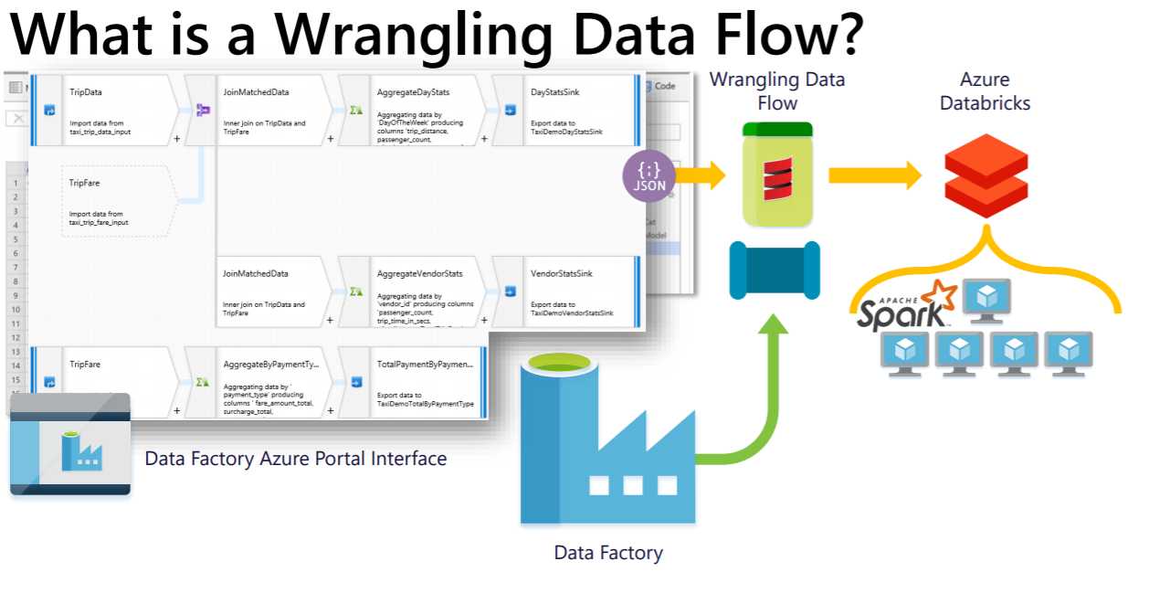

Slide 51
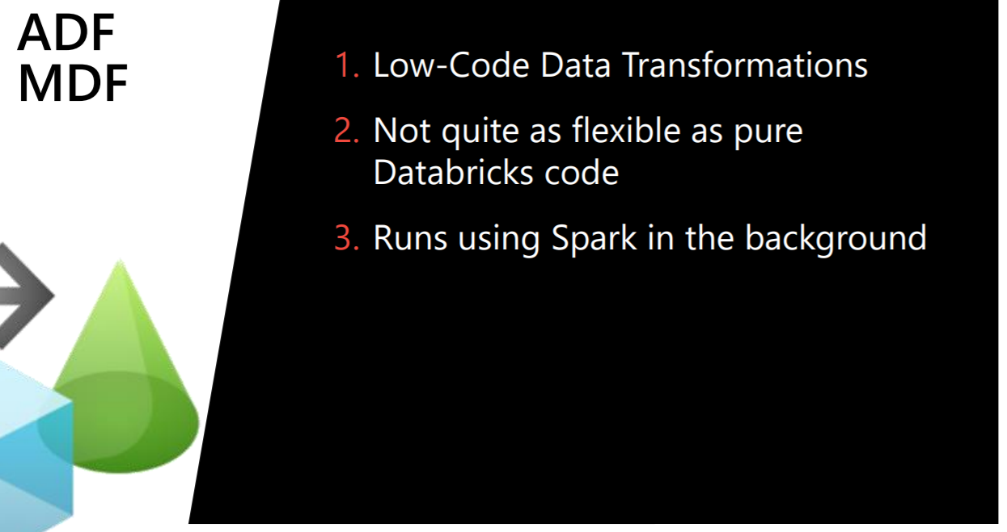

Slide 52
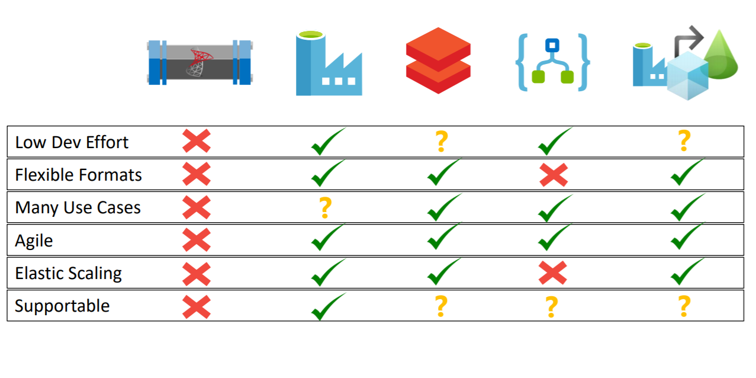

Slide 53
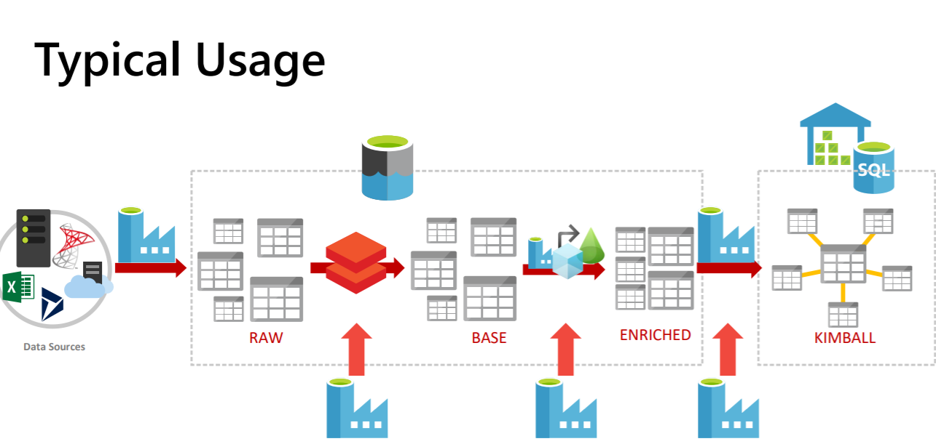

Slide 54
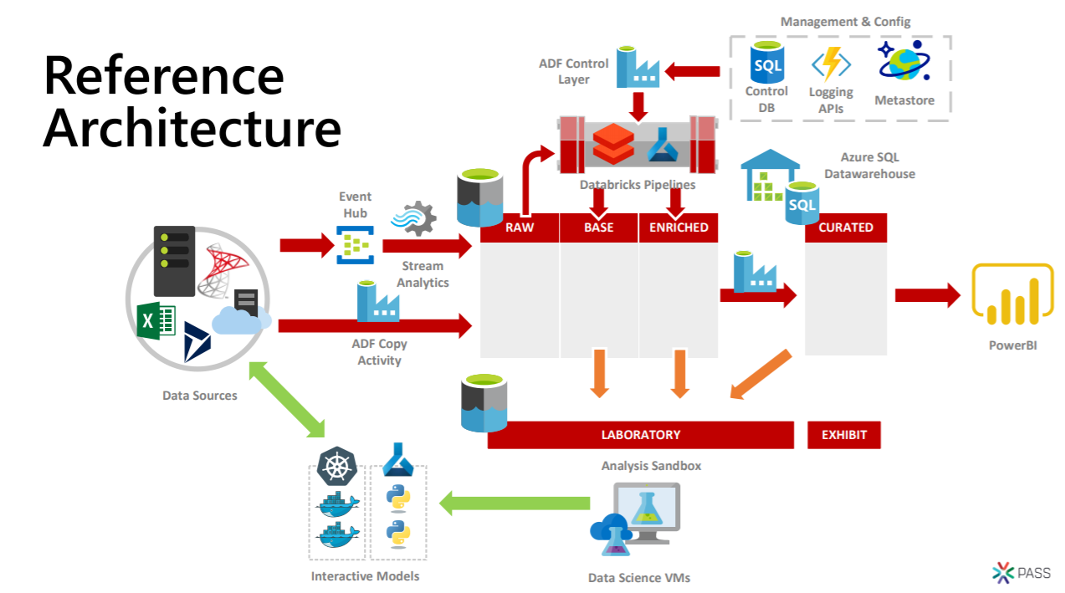

Slide 55
Please use EventsXD to fill out a session evaluation.
Thank you!

