Slide 1
Deploying and using ML models across the AI Spectrum
Microsoft Azure + AI Conference
Fall 2019
Kyle Bunting

Slide 2
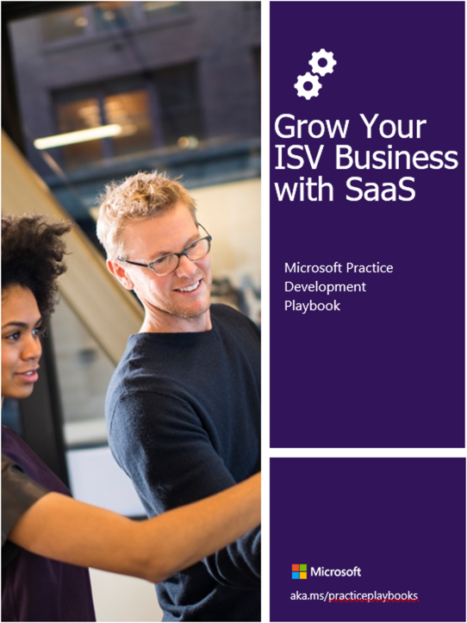
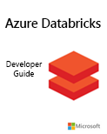
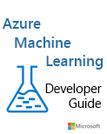
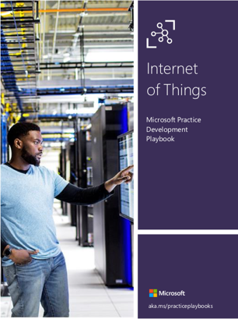
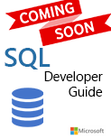
Kyle Bunting
Data Engineer, Solliance
kyle@solliance.net
https://www.linkedin.com/in/kylebunting
20+ years in IT
MBA from the Krannert School of Management at Purdue University
Author / contributor on multiple books on Azure

Slide 3
What is Artificial Intelligence?
AI refers to scenarios where a machine mimics the cognitive functions associated with human minds, such as learning and problem solving.
1
Because AI leverages machine learning algorithms, it is viewed as an umbrella term covering Machine Learning and Deep Learning.
2

Slide 4
What is machine learning?
Machine learning gives "computers the ability to learn without being explicitly programmed."

Slide 5
What is a machine learning model?
An ML model is all the information needed to accept input data, make a prediction, and generate output data
– Dr. James McCaffrey

Slide 6
aka.ms/mlcheatsheet

Slide 7
The Pre-built and Custom AI Spectrum
Pre-Built AI
Custom AI
Microsoft Cognitive Services
Azure Machine Learning
Pre-built models
Custom models
Models are pre-trained using Microsoft supplied data
Models “customized” with your data
Models tailored to your scenario and your data

Slide 8
Azure AI
AI Apps & Agents
Knowledge Mining
Machine Learning
Azure Cognitive Services
Azure Bot Service
Azure Cognitive Search Forms Recognizer
Azure Databricks
Azure Machine Learning
Azure AI Infrastructure

Slide 9
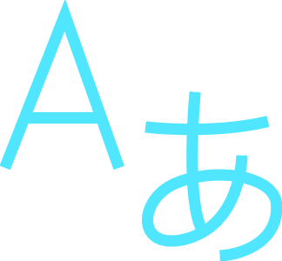
Machine Learning on Azure
Domain specific pretrained models
To simplify solution development
…
Vision
Speech
Language
Web search
Decision
Familiar data science tools
To simplify model development
Visual Studio Code
Azure Notebooks
Jupyter
Command line
Popular frameworks
To build advanced deep learning solutions
PyTorch
TensorFlow
Scikit-Learn
ONNX
Productive services
To empower data science and development teams
Azure Machine Learning
Azure Databricks
Machine Learning VMs
Powerful infrastructure
To accelerate deep learning
CPU
GPU
FPGA
From the Intelligent Cloud to the Intelligent Edge

Slide 10
Azure Cognitive Services
Cloud-based APIs that you can use in artificial intelligence (AI) applications and data flows
Provide machine learning capabilities to solve general problems
APIs, SDKs, and services available to help developers build intelligent apps
No direct AI or data science skills or knowledge required
Vision
Speech
Language
Web Search
Decision

Slide 11
Azure Cognitive Services
Pre-trained AI with ~30 Services
Text Analytics
Personalizer
Decision
Translator Text
Bing Spell Check
Computer Vision
Language
Content Moderator
Ink Recognizer
Language Understanding
Face
Content Moderator
Anomaly Detector
Vision
QnA Maker
Video Indexer
Custom Vision
Form Recognizer
Conversation transcription capability
Custom
transcription
Bing Custom Search
Bing Video Search
Bing Entity Search
Speech
Bing News Search
Web search
Bing Local Business Search
Speech transcription
Text-to-Speech
Bing Web Search
Bing Image Search
Bing Autosuggest
Neural Text-to-Speech
Bing Visual Search

Slide 12
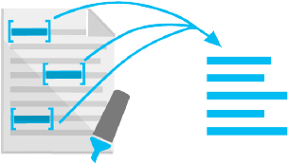
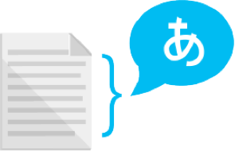
Text Analytics
Sentiment analysis
Key phrase extraction
Named entity recognition
Language detection
Understand if a record has positive or negative sentiment
Extract key phrases from a piece of text, and retrieve topics
Identify 7 different entity types such as person, location, organization, and activate entity linking
Identify the language, 120 supported languages

Slide 13
Vision APIs
Computer Vision
Custom Vision
Face API
Form Recognizer
Ink Recognizer
Video Indexer

Slide 14
Demo: Pre-built AI Solutions
Computer Vision

Slide 15
Azure Cognitive Search*
AI-powered Search-as-a-service
Provides a rich search experience over private data
Optional Knowledge Mining via AI to enrich documents
Functionality exposed via REST API or .NET SDK
* Azure Search was rebranded as Azure Cognitive Search at Microsoft Ignite 2019

Slide 16
Azure Cognitive Search Pipeline
Cognitive skills
Data
Enriched documents
Document cracking
AI enrichment
Search Index
Projections
Knowledge
store
Ingest Enrich Explore & Analyze

Slide 17
AI Enrichment
Leverage AI to extract information and enrich search index
Enrichment through cognitive skills
Cognitive skills
Data
Enriched documents
Document cracking
AI enrichment
Search Index
Projections
Knowledge
store

Slide 18
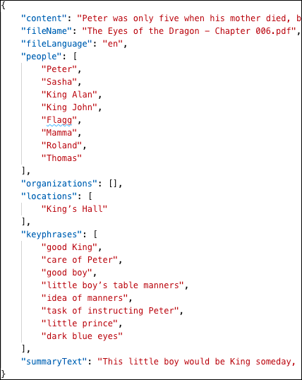
AI Enrichment
transforming unstructured data into information
Cognitive skills
Data
Language detection
Entity recognition
Key phrases extraction
Text summarization
Document cracking
Search Index
Projections
Knowledge
store

Slide 19
Demo: Azure Cognitive Search
Create an AI Enrichment Pipeline in the Azure portal

Slide 20
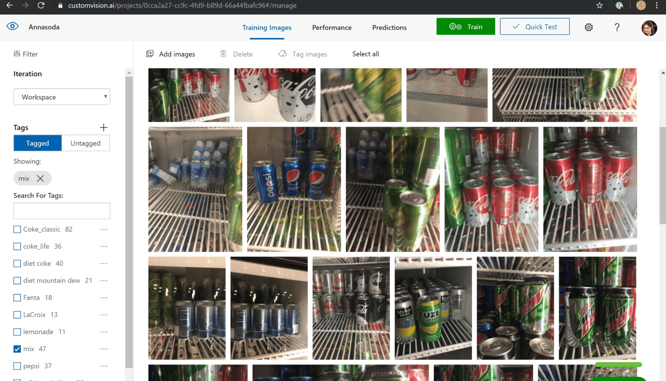
Custom Vision Service
Customize computer vision models to recognize your objects
Build, deploy and improve your own image classifiers
Classification & Object Detection
Optimization
Backed by best-in-breed security and availability

Slide 21
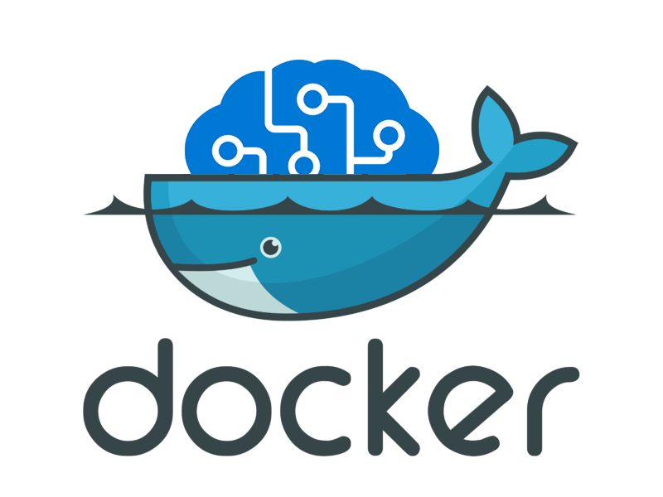
Deploy Custom Vision Docker image to ACI
Build image for Custom Vision hosted in Microsoft Container Registry
docker build -t mackey .
docker login iotedgedemo4763891828.azurecr.io -u iotedgedemo4763891828 -p /Hs8CgoOZDDqWkt8LdeYIPwkDtMaUme3
docker tag mackey iotedgedemo4763891828.azurecr.io/demos/mackey
docker push iotedgedemo4763891828.azurecr.io/demos/mackey
az container create \
--resource-group iot-edge-demo \
--name iotedgedemo4763891828 \
--image iotedgedemo4763891828.azurecr.io/demos/mackey:latest \
--registry-login-server iotedgedemo4763891828.azurecr.io \
--registry-username iotedgedemo4763891828 \
--registry-password /Hs8CgoOZDDqWkt8LdeYIPwkDtMaUme3 \
--restart-policy OnFailure \
--cpu 2 --memory 3.5 \
--ports 80 \
--dns-name-label mackey

Slide 22
Customized Pre-built AI demo
Custom Vision model training and deployment

Slide 23
How can we do Custom AI on Azure?
Azure Machine Learning
Spark on HDInsight
Azure Databricks
Batch AI
SQL Server Machine Learning Services
Data Science VM
Azure Notebooks
ML Server

Slide 24
The Data Science Process
Re-train
Model
Collect Data
Prepare Data
Train Model
Evaluate Model
Deploy Model

Slide 25
Data Wrangling
Iterative process of cleansing, restructuring and enriching raw data

Slide 26
Azure Databricks
Databricks as a managed service on Azure
The preferred service for running Spark workloads in Azure
A comprehensive option for notebook driven AI development

Slide 27
What is Apache Spark?
One framework to rule them all.
Spark Unifies:
Batch Processing
Interactive SQL
Real-time processing
Machine Learning
Deep Learning
Graph Processing
Spark SQL
Interactive Queries
Spark MLlib
Machine Learning
Spark
Structured Streaming
Stream processing
GraphX
Graph Computation
Spark Core Engine
Yarn
Mesos
Standalone Scheduler
Spark runs batch and streaming workloads 100x faster than Hadoop

Slide 28
Azure Machine Learning service
Simplified machine learning
End to end lifecycle management
Open platform

Slide 29
Simplify machine learning for any skill level
New capabilities in Azure Machine Learning service
Automated machine learning UI
Visual interface
Machine learning notebooks

Slide 30
What are Azure ML pipelines?

Slide 31
Deploying a trained model – the traditional way
Get the model file (any format)
Create a scoring script (.py)
Optionally create a schema file describing the web service input (.json)
Create a real-time scoring web service
Call the web service from your applications
Repeat the process each time you re-train the model

Slide 32
Deploying with Azure Machine Learning
Device Application
Azure ML deploys containers to:
Serialized Model
Desktop Application
Serialized Model
Containerized Model
Azure Kubernetes Service
Trained Model
Use the trained model to make predictions
Web Server Application
Containerized Model
IoT Edge Device
Serialized Model
Azure Container Instance
Containerized Model

Slide 33
Deploying AML models to AKS
AKS cluster must be connected to your workspace
Creation or attachment process is a one-time task
Once an AKS cluster is connected, you can use it for deployments
To secure your AKS cluster using an Azure Virtual Network, you must create the virtual network first
To deploy a model to Azure Kubernetes Service, create a deployment configuration that describes the compute resources needed. (e.g., number of cores and memory).
Key-based authentication is enabled by default

Slide 34
Azure Container Instances
Start a container in seconds with a single command without VMs or even AKS (Azure Kubernetes Service)
Pull container images from Docker Hub or Azure Container Registry
Containerize your application using Docker technology and execute immediately with one click
Take advantage of per-second billing & container-based compute on demand
Great for very rapidly deploying new containers with no other setup
Can be used with container orchestration platforms, such as AKS
Compare to AKS, which creates a container orchestrator cluster
Compare to Web App for Containers, which functions similarly, but has a longer spin-up time and you pay if it exists.

Slide 35
Demo: Deploy Custom ML Model
deploying a trained Machine Learning model to Azure Container Instances Using the Azure Machine Learning Python SDK

Slide 36
What is the Edge?

Slide 37
What’s driving AI to the Edge
Latency
Process and evaluate data on-site and only push information to the cloud as needed
scenario: IoT edge device collecting and evaluating vehicle telemetry in real time and only sending anomaly data to the cloud vs. sending all the data all the time
scenario: ML model on edge connected to security cameras, recognizes a crime is underway, sends alert to security
Network reliability
Cannot have interruption on service because the network is down or slow
Only occasionally connected to the internet, so you send in batch as needed
Privacy / Security
Hospital patient monitoring
Integration with existing infrastructure
Oil field has sensors onsite which need to be monitored for anomalies. Connect to edge device to evaluate data using deployed ML model and store locally for collection or send via internet as needed

Slide 38
IoT Edge Devices
Any kind of hardware device
Usually small with limited power and memory
Unreliable / non-existent network connection

Slide 39
Device Management with IoT Hub
Central message hub for bi-directional communication between apps and IoT devices
Provides reliable and secure communications between millions of IoT devices and cloud-hosted solution backend
Connect virtually any device
Device Provisioning Service automatically provisions devices

Slide 40
Microsoft Embedded Learning Library (ELL)
Open Source project
Hosted on GitHub
Designed to facilitate the process of bring AI to small devices
Intended to ease the development effort required to deploy an ML model to an IoT Edge device

Slide 41
Microsoft Embedded Learning Library (ELL)
The ELL system accepts an ML model created by a supported library, such as CNTK or a supported model format, such as open neural network exchange (ONNX)
uses the input model to generate an intermediate model as an .ell file
uses the intermediate .ell model file to generate executable code of some kind for a supported target device
Think of ELL as a sort of cross-compiler for ML models

Slide 42
Helpful resources for getting started
https://microsoftcloudworkshop.com/
https://github.com/Microsoft/MCW-Cognitive-Services-and-Deep-Learning
https://github.com/sollian
https://github.com/solliancenet/aml-notebook-tutorials
https://github.com/solliancenet/azure-machine-learning-service-labs
https://github.com/solliancenet/Azure-Machine-Learning-Dev-Guide

Slide 43
Thank You
Kyle Bunting
Data Engineer, Solliance
kyle@solliance.net
https://www.linkedin.com/in/kylebunting

