Slide 1
Serverless and Azure Functions pro-tips and tricks
Jeff Hollan
Jeff.Hollan@microsoft.com
Notes:
Azure Functions enables you to build cloud scale applications without having to manage the underlying infrastructure. However, serverless does introduce a new paradigm in how applications can be built. Learn best practices, tips, and tricks from the product manager of Azure Functions based on learnings from real-world use cases around the world.

Slide 2

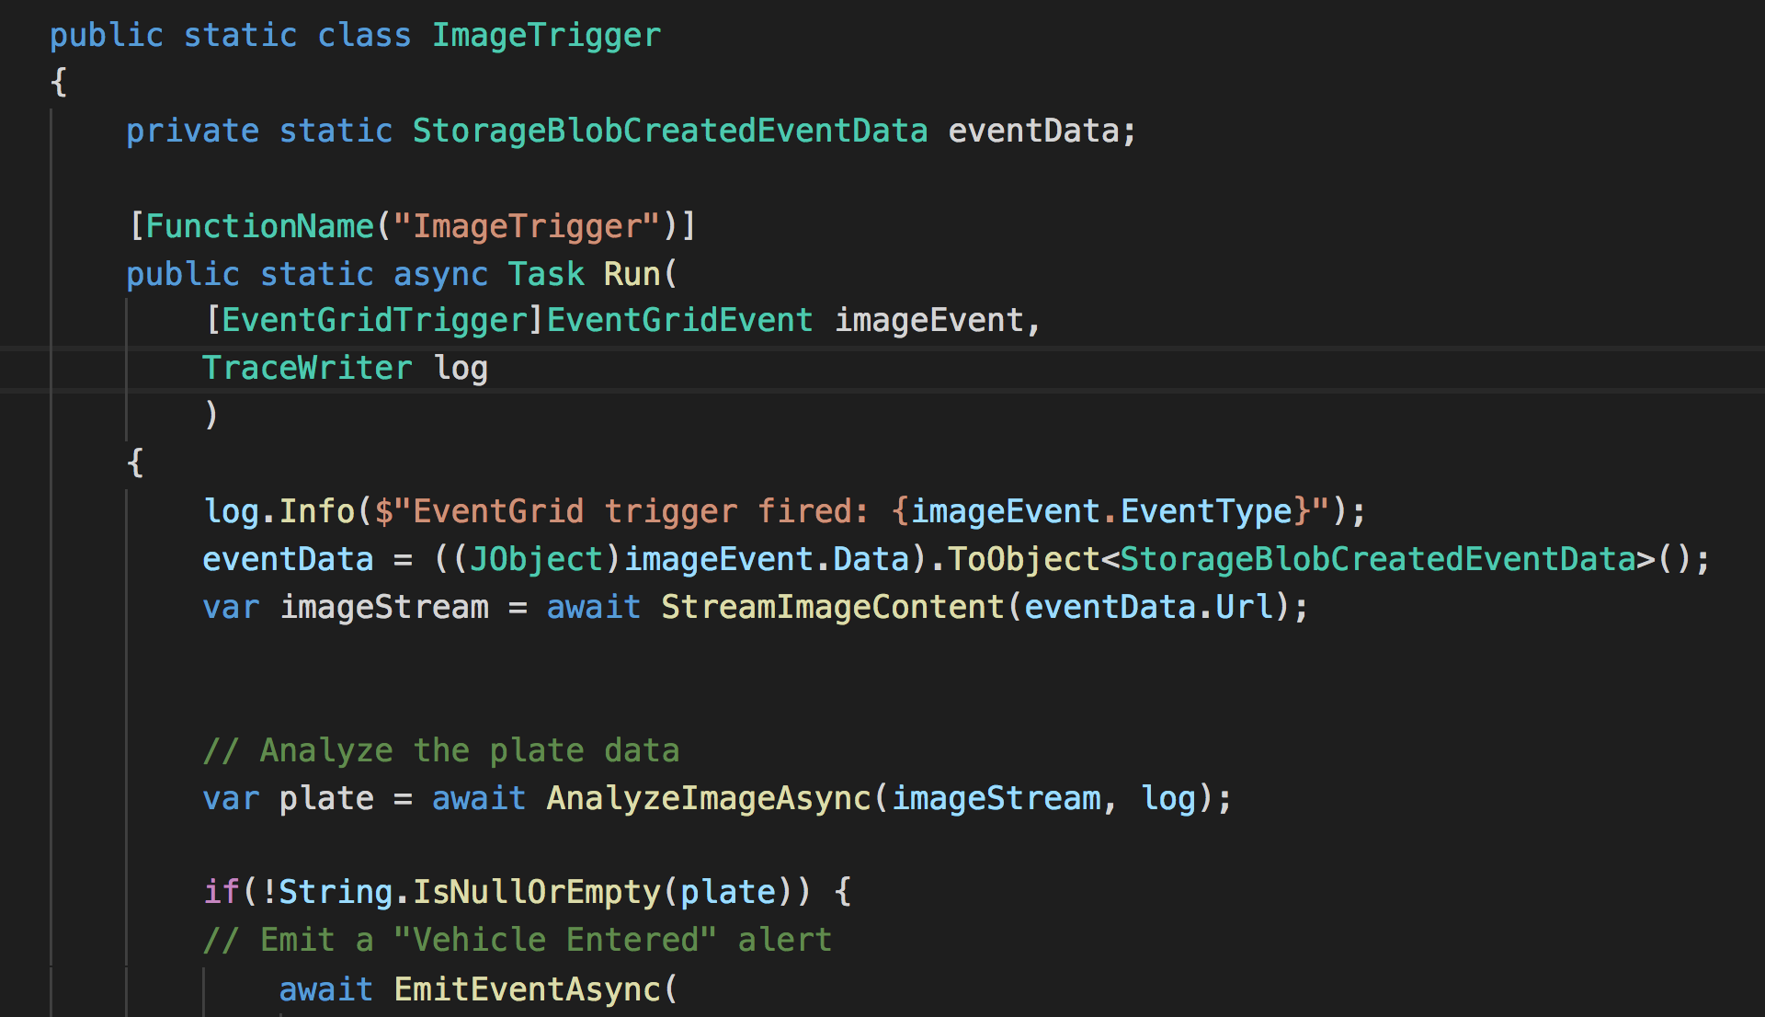
Azure Functions is Serverless Compute
Deploy code, the rest is managed for you
C#, JavaScript, Java, and Python
Rich tooling and local debugging
  Visual Studio, VS Code, Portal, IntellJ, Eclipse, and more
Observability and monitoring
Trigger on dozens of event sources
  HTTP
  Queues
  Event Hub
  Storage
  Cosmos DB
Notes:
Domain Specific Language

Slide 3
Why Serverless?
Write the code you want to run in response to some event
Publish it to the cloud
Fully managed scale and hosting
Spend time and energy on code, not infrastructure
Pay for what you need
Connect faster to your services

Slide 4


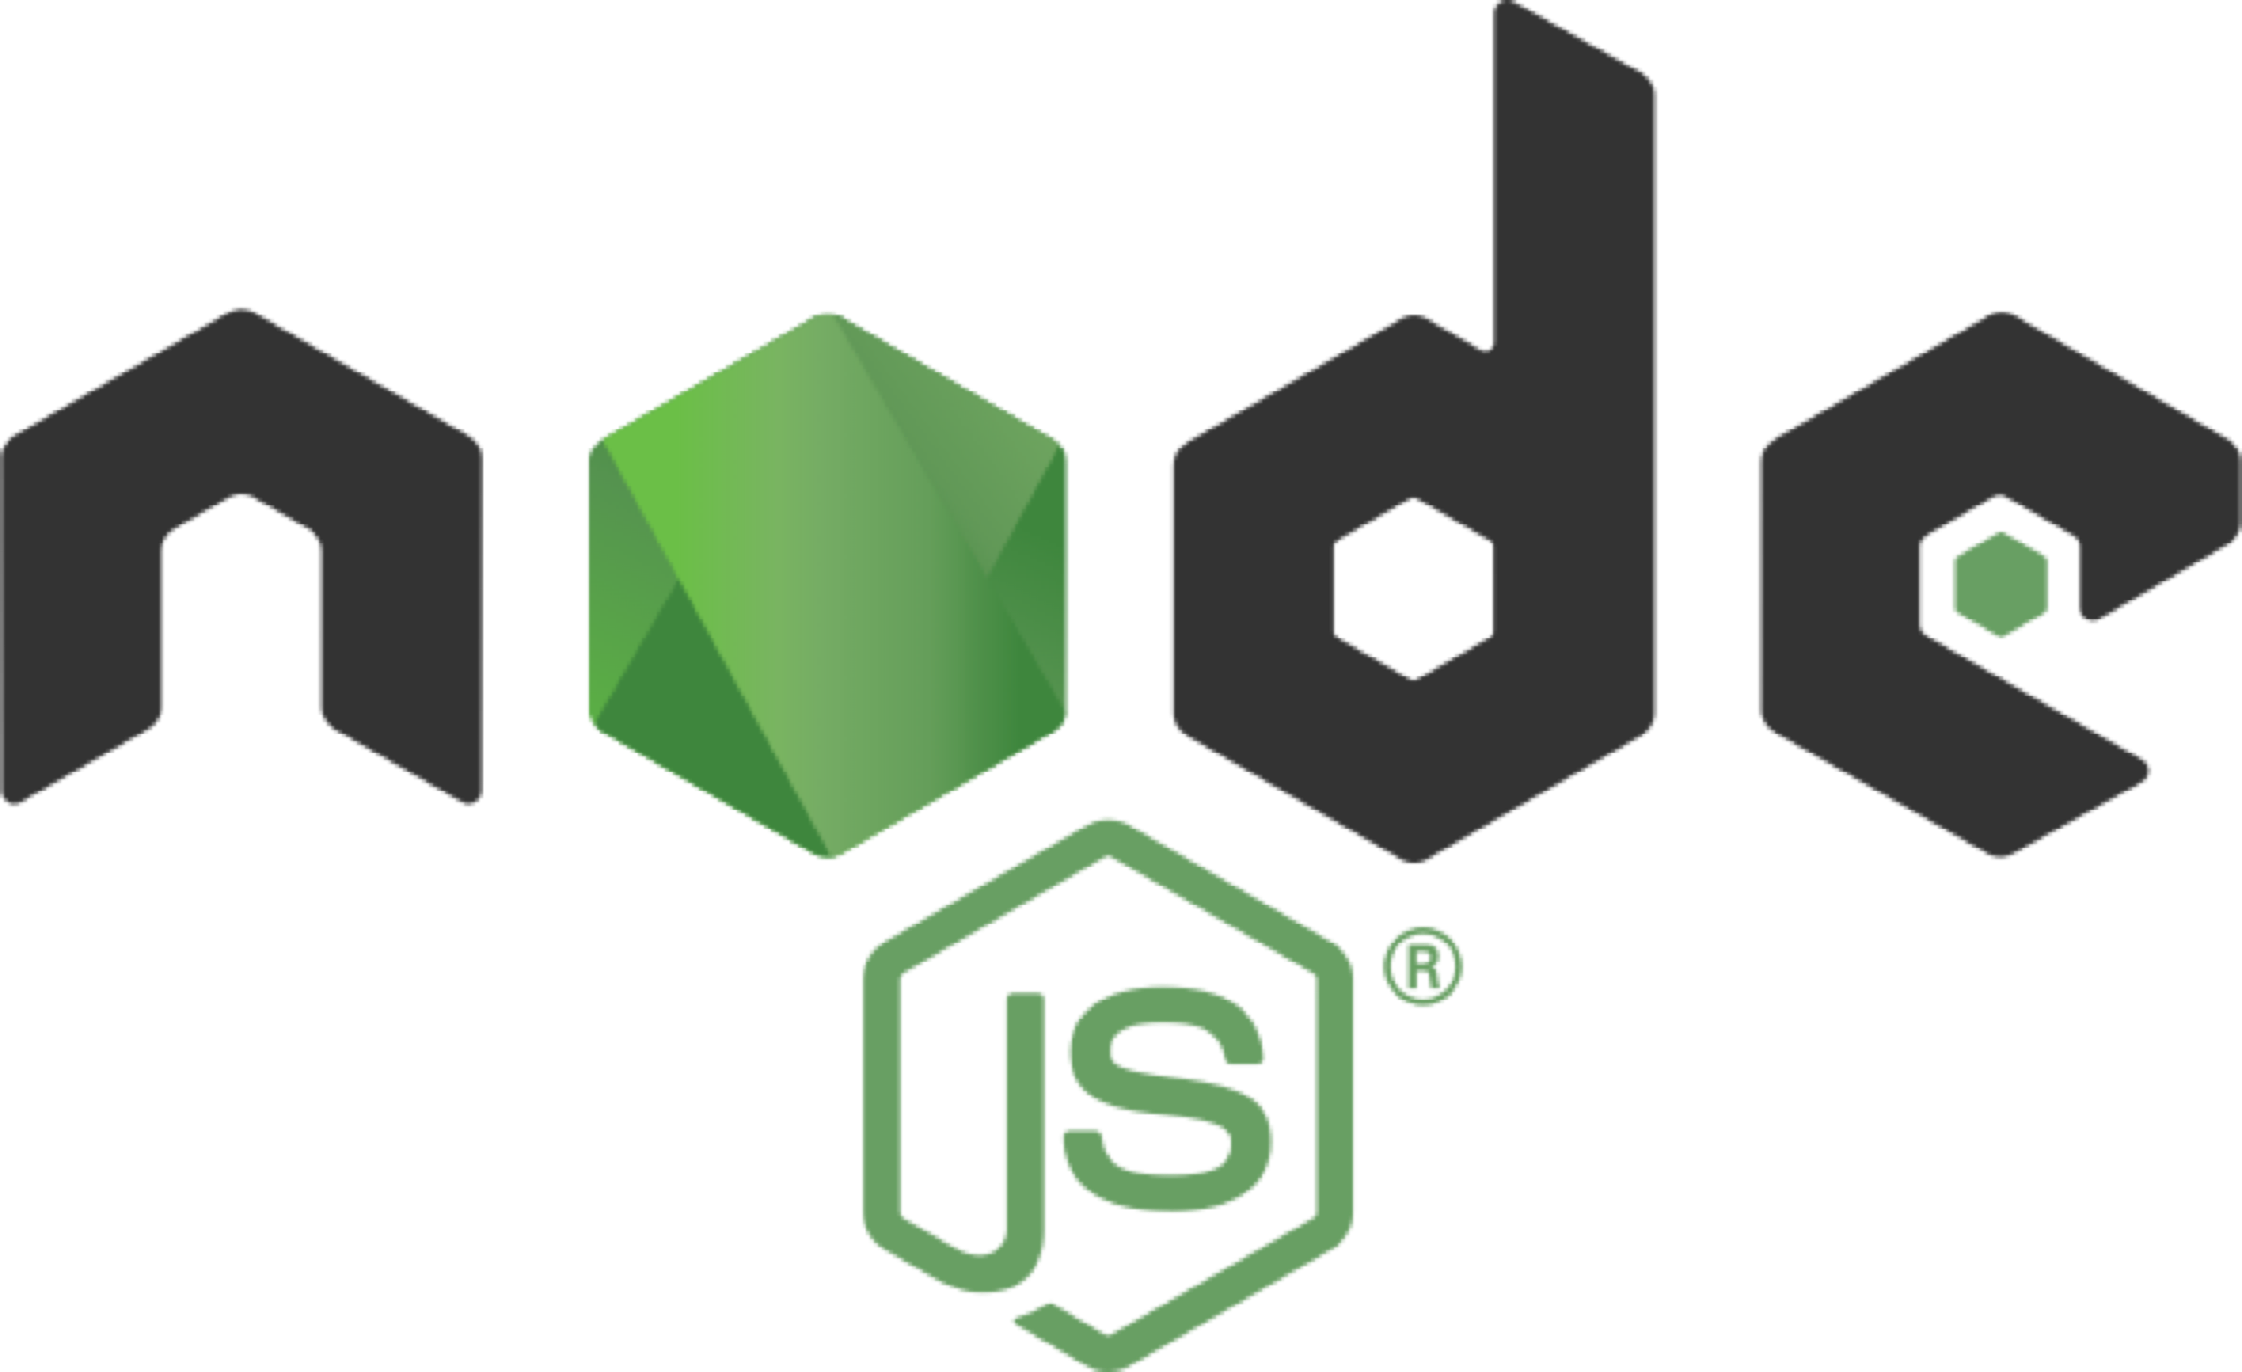


Language options
Generally available
Public preview

Slide 5
Functions “Behind the scenes”
  Azure Infrastructure
Functions Instance
Azure Functions Runtime
HTTP Request
Event Source (HTTP Front-end)
Functions Instance
HTTP Response
Azure Functions Runtime
Scale Controller
Functions Instance
Azure Functions Runtime

Slide 6
Pro-tips and tricks
#1 – Dependency Injection

Slide 7
Pro-tips and tricks
#1 – Dependency Injection
#2 – What and why of `host.json`

Slide 8
Functions “Behind the scenes”
  Azure Infrastructure
Functions Instance
Azure Functions Runtime
HTTP Request
Event Source (HTTP Front-end)
Functions Instance
HTTP Response
Azure Functions Runtime
Scale Controller
Functions Instance
Azure Functions Runtime

Slide 9
Host.json
Configures the settings for a specific *instance*, not globally
Useful for host behaviors like logging
Allows you to control *instance* concurrency (how many queue messages to pull concurrently, how many HTTP requests to process concurrently, etc.)

Slide 10
Pro-tips and tricks
#1 – Dependency Injection
#2 – What and why of `host.json`
#3 – Use key vault for secrets

Slide 11


Securing Secrets
Load in as environment variables
Locally – local.settings.json
  Not checked into source control
Deployed – App Settings
  Optional – App Settings backed by Key Vault
  Managed Identities for Azure Resources

Slide 12
Pro-tips and tricks
#1 – Dependency Injection
#2 – What and why of `host.json`
#3 – Use key vault for secrets
#4 – Use Logic Apps for integration workflows

Slide 13
Pro-tips and tricks
#1 – Dependency Injection
#2 – What and why of `host.json`
#3 – Use key vault for secrets
#4 – Use Logic Apps for integration workflows
#5 – Use durable for codeful orchestration

Slide 14
Report Generator Service
Orders
Shipment
APIs
Generate Report

Slide 15
Pro-tips and tricks
#1 – Dependency Injection
#2 – What and why of `host.json`
#3 – Use key vault for secrets
#4 – Use Logic Apps for integration workflows
#5 – Use durable for codeful orchestration
#6 – Event streams: partitions and batches

Slide 16
Functions “Behind the scenes”
  Azure Infrastructure
Functions Instance
Azure Functions Runtime
HTTP Request
Event Source (HTTP Front-end)
Functions Instance
HTTP Response
Azure Functions Runtime
Scale Controller
Functions Instance
Azure Functions Runtime

Slide 17
Partitions and Batches
Event Hubs
Part. 1
Part. 2
Part. 3

Slide 18
Partitions and Batches
Event Hubs
Part. 1
Part. 2
Part. 3

Slide 19
Partitions and Batches
Event Hubs
Part. 1
Part. 2
Part. 3

Slide 20
Partitions and Batches
Event Hubs
Part. 1
Part. 2
Part. 3

Slide 21
Pro-tips and tricks
#1 – Dependency Injection
#2 – What and why of `host.json`
#3 – Use key vault for secrets
#4 – Use Logic Apps for integration workflows
#5 – Use durable for codeful orchestration
#6 – Event streams: partitions and batches
#7 – When order matters

Slide 22
Message Ordering
Client A: ABCDE
Client B: 12345
Queue
A
B
1
C
2
3
4
D
E
5

Slide 23
Message Ordering
A
B
1
Client A: ABCDE
Client B: 12345
Queue
A
B
1
C
2
3
4
D
E
5
C23
Processing Order:
AC234B1DE
4
D
E

Slide 24
Message Ordering – Event Hubs
Client A: ABCDE
Client B: 12345
Event Hub
A
B
C
D
E
1
2
3
4
5
Processing Order:
A12BCD34E5

Slide 25
Message Ordering – Queue Sessions
Client A: ABCDE
Client B: 12345
Queue
A
B
C
D
E
1
2
3
4
5
Processing Order:
A12BCD34E5

Slide 26
Pro-tips and tricks
#1 – Dependency Injection
#2 – What and why of `host.json`
#3 – Use key vault for secrets
#4 – Use Logic Apps for integration workflows
#5 – Use durable for codeful orchestration
#6 – Event streams: partitions and batches
#7 – When order matters
#8 – Observability and performance

Slide 27
References
http://aka.ms/azure-functions
http://medium.com/@jeffhollan
Azure Services
  Key Vault
  Azure Service Bus (with Sessions)
  Azure Event Hubs

Slide 28
Please use EventsXD to fill out a session evaluation.
Thank you!

Slide 29
Review

Slide 30
Durable Functions
Write long-running orchestrations as a single function while maintaining local state.
Simplify complex transactions and coordination (chaining, etc.) Easily call a Function from another Function, synchronously or asynchronously.
All of the above using code-only. No JSON schemas. No graphical designer.
Generally available (v2) - C# and JavaScript
Notes:
Durable Functions is an advanced feature of Azure Functions. They provide the ability to write long running orchestrations using a single function while still being able to maintain a global state.
Durable highly simplifies some of the scenarios that we saw in the previous slides by making it easy to implement scenarios such as chaining, fan out / fan in , etc.
While still being able to use your beloved code constructs. You don’t have to conform to an JSON schemas or adopt any graphical workflow designers.

Slide 31
Components
Starter
Function
Orchestrator Function
Activity Function
Activity Function
Activity Function
Starts orchestrations
Coordinates activities
Performs work
OrchestrationClient
OrchestrationContextTrigger
ActivityTrigger

Slide 32
What It Looks Like
Orchestrator Function
// calls functions in sequence
public static async Task<object> Run(DurableOrchestrationContext ctx)
{
try
{
var x = await ctx.CallFunctionAsync("F1");
var y = await ctx.CallFunctionAsync("F2", x);
return await ctx.CallFunctionAsync("F3", y);
}
catch (Exception)
{
// global error handling/compensation goes here
}
}
Activity Functions
Notes:
> So in Durable Functions, we introduce the concept of “an orchestrator" that will orchestrate or manage what happens between rest of the Functions.
> It is responsible for calling and receiving output from activity functions that you’re familiar with as regular functions. When an activity returns, it return value becomes part of the local state of the orchestrator function so you’re able to work with it as any other variable in that block of code.
> CallFunctionAsync uses queues under the covers, thus they can be scaled out to multiple VMs.
The other thing is that if I want to have exceptions in my code, say something goes wrong in a particular function, I can do that. We’re all familiar with the syntax and now we can do it in a distributed way.
Mention rewind feature to talk about in new developments

Slide 33


var outputs = new List<string>();
outputs.Add(await context.CallActivityAsync<string>("SayHello", “World"));
return outputs;
History Table
Orchestrator Function
Orchestrator Function
Activity Function
Orchestrator Started
Activity Function
Execution Started
Task Scheduled, SayHello, “World”
Orchestrator Completed
“Hello World!”
“Hello World!”
Task Completed, “Hello World!”
[“Hello World!”]
?
Orchestrator Started
Execution Completed, ["Hello World!”]
Orchestrator Completed
Execution History
Notes:
Grasping how orchestrators use execution history to replay and rebuild their local state is key to understanding how Durable Functions works, so let’s walk through the execution of a simple orchestrator function.
The light blue box at the top of the slide is the orchestrator’s code.
“SayHello” our activity function, which returns “Hello” and whatever input you give it.
Our execution history is currently empty. As we start to record events, they’ll show up here. (Indicate area.)
1. A request is made to the orchestrator function.
2. The orchestrator starts and begins executing until it’s asked to await some async work. In this case, we want to call an activity function.
3. The orchestrator checks the execution history for a record of the activity function.
4. There’s no record of the activity function being called or completed, so the orchestrator schedules that work.
5. While the orchestrator waits on work to complete, it shuts down.
5. The scheduled activity function runs.
6. A record of this is added to the execution history. In this case we produced output, so that’s stored.
7. Now the orchestrator has more work to do. It restarts and executes its code **from the beginning** to build up its local state.
8. As before, the orchestrator executes until it reaches an await.
9. The orchestrator checks the execution history. This time there’s a record of the async work being done.
10. The activity function’s stored output is passed back to the orchestrator. In this case, the value is added to a list of strings.
11. The orchestrator continues executing. In a more complex orchestrator with multiple await calls, the checkpoint, schedule and replay steps would repeat for each one. This orchestrator runs to completion and returns its output.
12. And we’re done!
- How does the framework know to wake up

Slide 34
Orchestrator Constraints
Orchestrator code must be deterministic
Never use random numbers, DateTime.UtcNow, Guid.NewGuid(), etc.
Use DurableOrchestrationContext.CurrentUtcDateTime
Never do I/O directly in the orchestrator
Do I/O in activity functions
Don’t write infinite loops
Use DurableOrchestrationContext.ContinueAsNew()

