Slide 1
The Cloud-Native Cookbook: Serverless, Kubernetes, and Containers
Jeff Hollan
Jeff.Hollan@microsoft.com
@jeffhollan
Notes:
How do I navigate and architect in a cloud native world? The next generation of apps will be built faster and scale further than ever before. Cloud native apps give developers the opportunity to build apps that fully take advantage of the benefits of the modern cloud. This session will help explain the key components and strengths of cloud native technology like serverless functions and Kubernetes, how they can work together, and how you can decide how best to build the apps of the future.

Slide 2

Cloud Native

Slide 3
Cloud Native
Where no matter what tool you choose, someone on Twitter will tell you it was wrong

Slide 4
Key Components of Cloud Native
Containers
Tool to package your app, run it portably on different hosts in a consistent way

Slide 5
Containers
  App
Package your application code and dependencies
You may run multiple containers all as part of the same “app”

Slide 6
Packaging an app in a container

Slide 7
Summary of Containers
Consistent and reproduceable
Support for both Windows and Linux containers
  .NET Framework / .NET Core
Universal *packaging* and distribution

Slide 8
Running Containers
Simple Feed
Reader
(Container)

Slide 9
Running Containers
Simple Feed
Reader
(Container)

Slide 10
Running Containers
Simple Feed
Reader
(Container)
Simple Feed
Reader
(Container)
Simple Feed
Reader
(Container)

Slide 11
Key Components of Cloud Native
Containers
Kubernetes
Tool to package your app, run it portably on different hosts in a consistent way
Platform to manage and scale your app reliably (made up of containers) that may span many physical and virtual machines.
A tool for operations, not development

Slide 12
Kubernetes
  App
  App
Orchestrates containerized workloads and services.
Provides a clean interface for managing distributed systems across many nodes, including replication, scaling, and state management.
Kubernetes
Master
Nodes

Slide 13
Kubernetes Terminology
Pod – a single (or sometimes collection) of containers
Deployment – A declaration of a pod that should be replicated
Service – An abstraction of a set of pods for discovery and communication (http://myservice)
Ingress – Single external endpoint that can route to multiple services (http://mysite.com/myservice and http://mysite.com/otherservice )

Slide 14
Kubernetes Demo

Slide 15
Kubernetes + Serverless Nodes
  App
  App
Leverage the Virtual Kubelet to provide “Virtual Nodes” running on serverless containers (ACI)
Kubernetes
Master
Nodes

Slide 16
Summary of Kubernetes
Container orchestrator – makes containers available, reliable, scale-able, and discoverable to other containers
Requires significant operations investments
Cloud agnostic – runs in Azure, on-prem, other clouds

Slide 17
Azure App Services
A fully managed “website orchestrator” as a service
Can run either code or containers
Comes with many features specific for web / API workloads
  Custom domains and certificates
  Slots and traffic routing
  Authentication (AAD, Google, Microsoft Account, etc.)
Focused specifically on Web and API workloads

Slide 18
Key Components of Cloud Native
Containers
Kubernetes
Serverless
Tool to package your app, run it portably on different hosts in a consistent way
Platform to manage and scale your app reliably (made up of containers) that may span many physical and virtual machines.
A tool for operations, not development
Platform for running and scaling apps where almost all of the operations tasks are managed by the cloud provider. Optimized to let developers focus on code and business value.

Slide 19
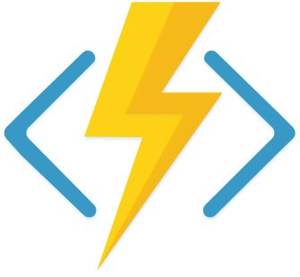
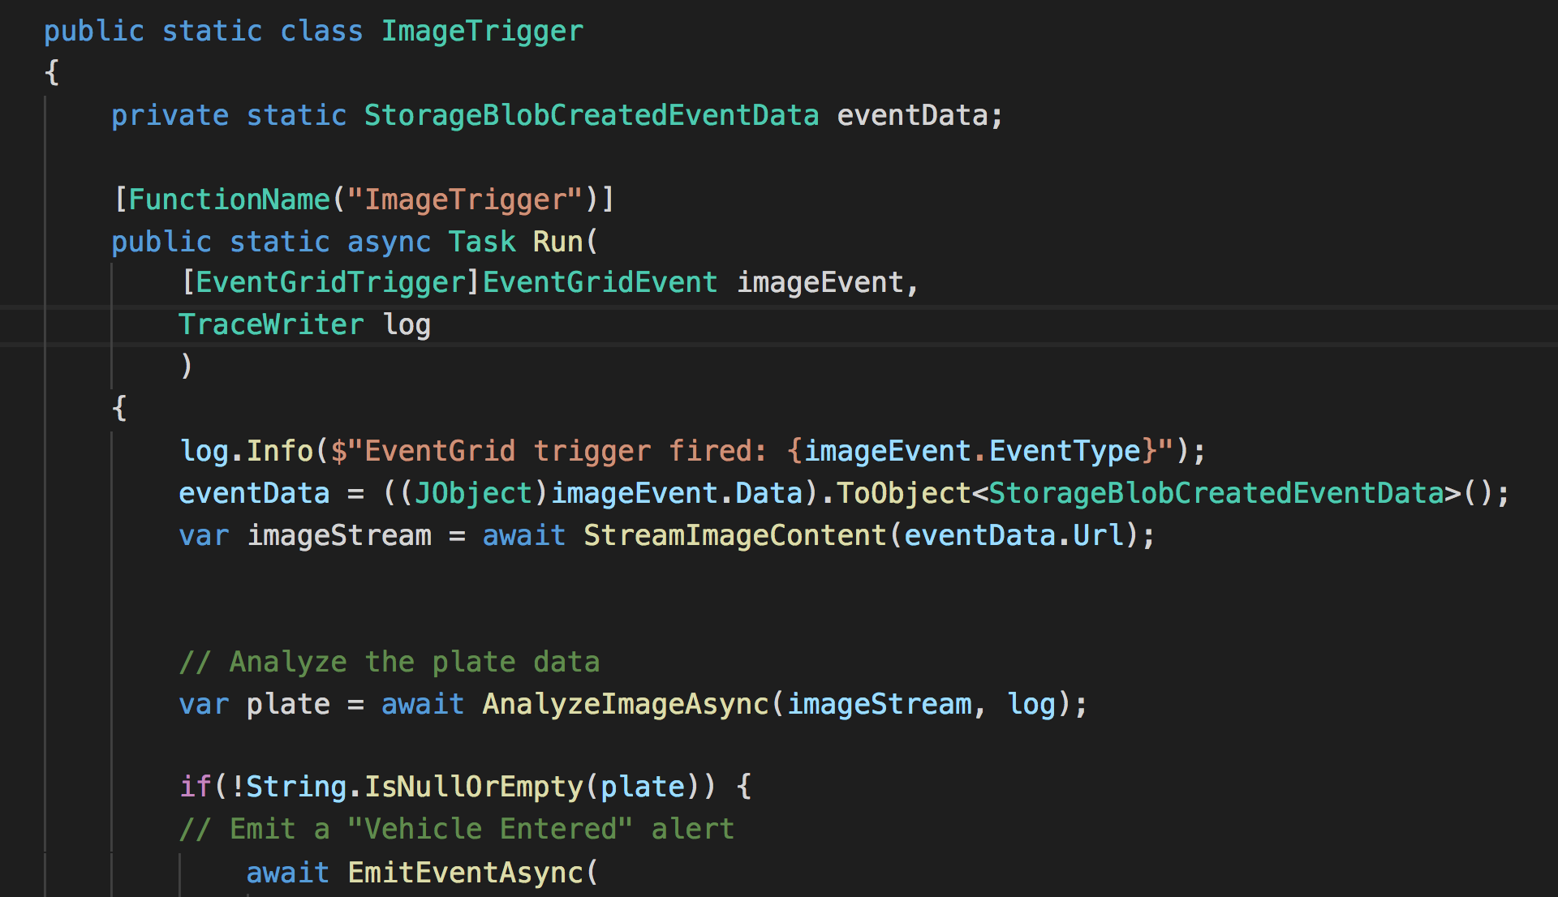
Azure Functions
Deploy code, the rest is managed for you
C#, PowerShell, JavaScript, Java, and Python
Rich tooling and local debugging
  Visual Studio, VS Code, and more
Observability and monitoring
Trigger on dozens of event sources
  HTTP
  Queues
  Event Hub
  IoT Hub
Notes:
Domain Specific Language

Slide 20
Azure Functions
  App
  App
Fully serverless offering in Azure that includes
Event driven programming model
Serverless scale, pricing, and management
Events
Azure Functions service

Slide 21
Azure Function development and hosting

Slide 22
Summary of Serverless / Functions
Event-driven highly scalable code
Very productive production environment, low operations cost
No management (and not control) of running infra

Slide 23

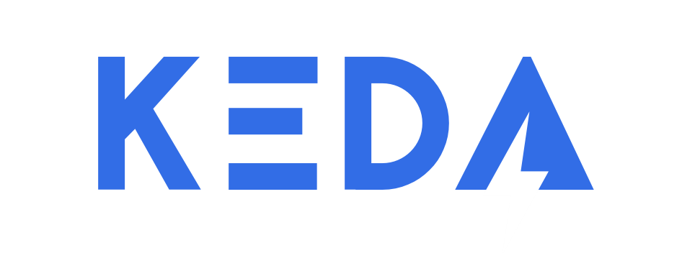
Kubernetes-based event driven autoscaling
Open source component to provide function-like scale in Kubernetes
Azure Functions native tooling and trigger support
Scale to zero or scale to thousands
Same app, same tools, flexible hosting
https://github.com/kedacore/keda

Slide 24
Bringing it all together (functions in containers on Kubernetes)

Slide 25
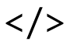
How KEDA Works
Kubernetes cluster
Kubernetes store
CLI
Register +
trigger and
scaling definition
KEDA
Horizontal
pod autoscaler
Metrics adapter
Controller
Scaler
Any events?
1->n or n->1
0->1 or 1->0
External
trigger
source
Function pods

Slide 26
When to consider KEDA
Run functions on-premises / Intelligent edge
Run functions alongside existing Kubernetes investments or requirements
Run functions on a different platform or cloud
Run functions with full control and management of scale and compute

Slide 27
Where should you host your code?
Self-Managed
Kubernetes
Kubernetes
Service
App Services
Azure Functions / Serverless
VMs
Control and Management
Productivity
Start with high productive services and move backwards
Not always an either/or – Docker & Functions, Functions & Kubernetes
Use services for their strengths

Slide 28
References
http://aka.ms/azure-kubernetes
http://aka.ms/azure-functions
http://aka.ms/azure-appservice
http://aka.ms/keda-quickstart
http://aka.ms/serverless-blazor

Slide 29
Please use EventsXD to fill out a session evaluation.
Thank you!

Slide 30
Introduction
Overview
  Please review this entire sample deck and notes

Slide 31

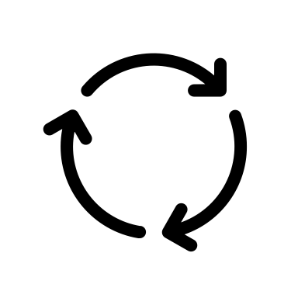


Standard Web App Architecture
*.cshtml
GET www.jeffhollan.com
Assets
App code
Database
index.html

Slide 32
Standard Web App Architecture
Database

Slide 33
Serverless Web App Architecture
Storage
GET www.jeffhollan.com
index.html
App code
*.razor
Assets

Slide 34

.NET in the browser!
Blazor lets you build interactive web UIs using C# instead of JavaScript
Uses WebAssembly to run .NET in a client-side browser
http://blazor.net

Slide 35
Serverless Web App Architecture
Storage
GET www.jeffhollan.com
index.html
App code
*.razor
Assets

Slide 36
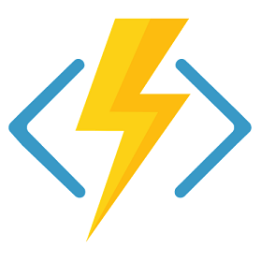
Serverless Web App Architecture
GET www.jeffhollan.com/api/posts
Database
Azure Functions
{ … }

Slide 37
Serverless Web App Architecture
Database

Slide 38
Show me!!

Slide 39
Serverless Web App Architecture
GET www.jeffhollan.com/api/posts
Database
Azure Functions
{ … }

Slide 40
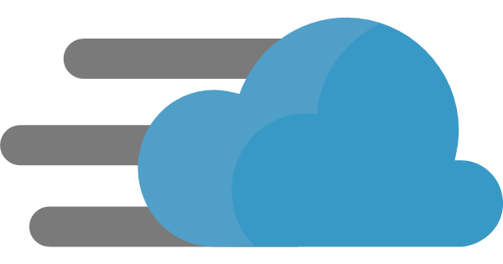
Serverless Web App Architecture
GET https://www.jeffhollan.com
Azure CDN
Database
{ … }

