Slide 1
Automated Delivery for .NET Applications
Javier Lozano
Lozanotek, Inc.
javier@lozanotek.com

Slide 2
Goal
Provide ideas on how separating builds and deployments for your application.
Breaking a problem into smaller subsets allows for different solutions along the way…

Slide 3
Caveat
The techniques covered are based on generalizations across different team cultures.
Your mileage will vary as you apply within your team culture.

Slide 4
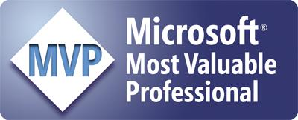
Info
javier@lozanotek.com
@jglozano
http://jglozano.io
https://github.com/lozanotek/automated-delivery/

Slide 5
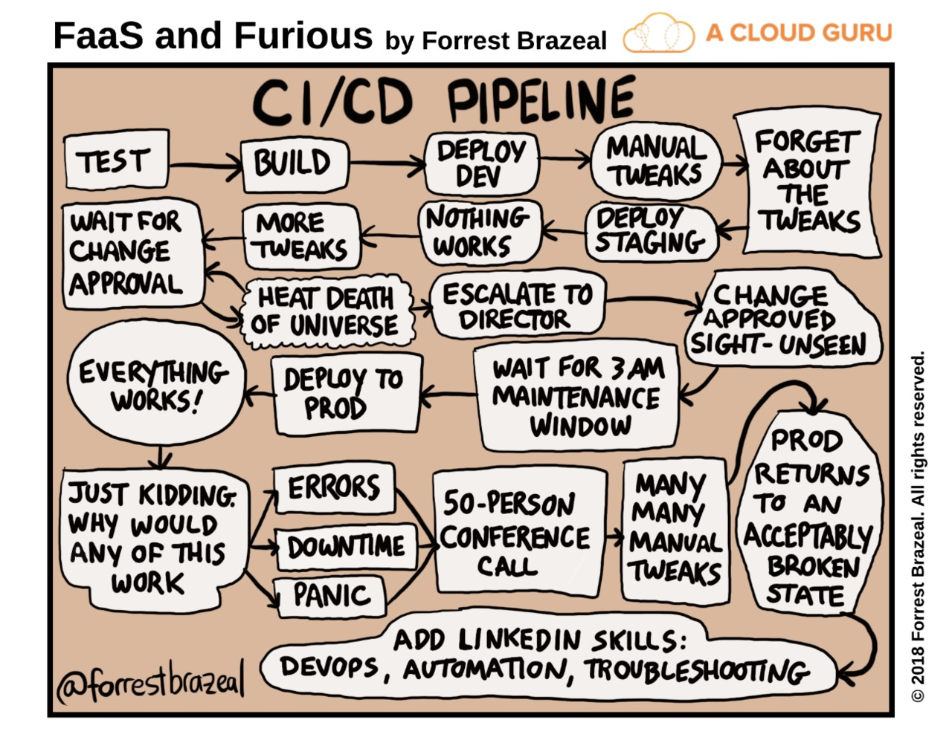

Slide 6
Foundation
Effectiveness
Efficiency

Slide 7
Foundation
Doing the right things
Doing things right

Slide 8
Foundation
Doing the right things, right…
…and predictable.

Slide 9
Foundation
Remember, you too are a customer of your processes.

Slide 10
Azure DevOps
Azure Boards
Azure Pipelines
Azure Repos
Deliver value to your users faster using proven agile tools to plan, track, and discuss work across your teams.
Build, test, and deploy with CI/CD that works with any language, platform, and cloud. Connect to GitHub or any other Git provider and deploy continuously.
Get unlimited, cloud-hosted private Git repos and collaborate to build better code with pull requests and advanced file management.
Azure Test Plans
Azure Artifacts
➔
Test and ship with confidence using manual and exploratory testing tools.
Create, host, and share packages with your team, and add artifacts to your CI/CD pipelines with a single click.
https://azure.com/devops
Notes:
So does TFS

Slide 11
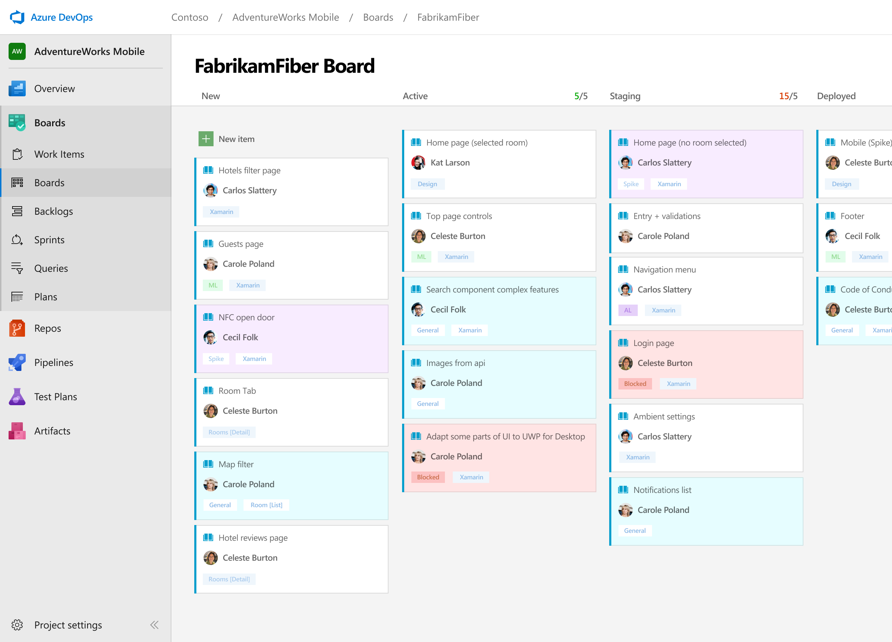
Azure Boards
Track work with Kanban boards, backlogs, team dashboards, and custom reporting
Connected from idea to release
Track all your ideas at every development stage and keep your team aligned with all code changes linked directly to work items.
Scrum ready
Use built-in scrum boards and planning tools to help your teams run sprints, stand-ups, and planning meetings.
Project insights
Gain new insights into the health and status of your project with powerful analytics tools and dashboard widgets.
➔
https://azure.com/devops
Notes:
Combine Kanban boards and drag-and-drop sprint planning with comprehensive traceability and reporting for the perfect home for all your ideas–big and small.

Slide 12
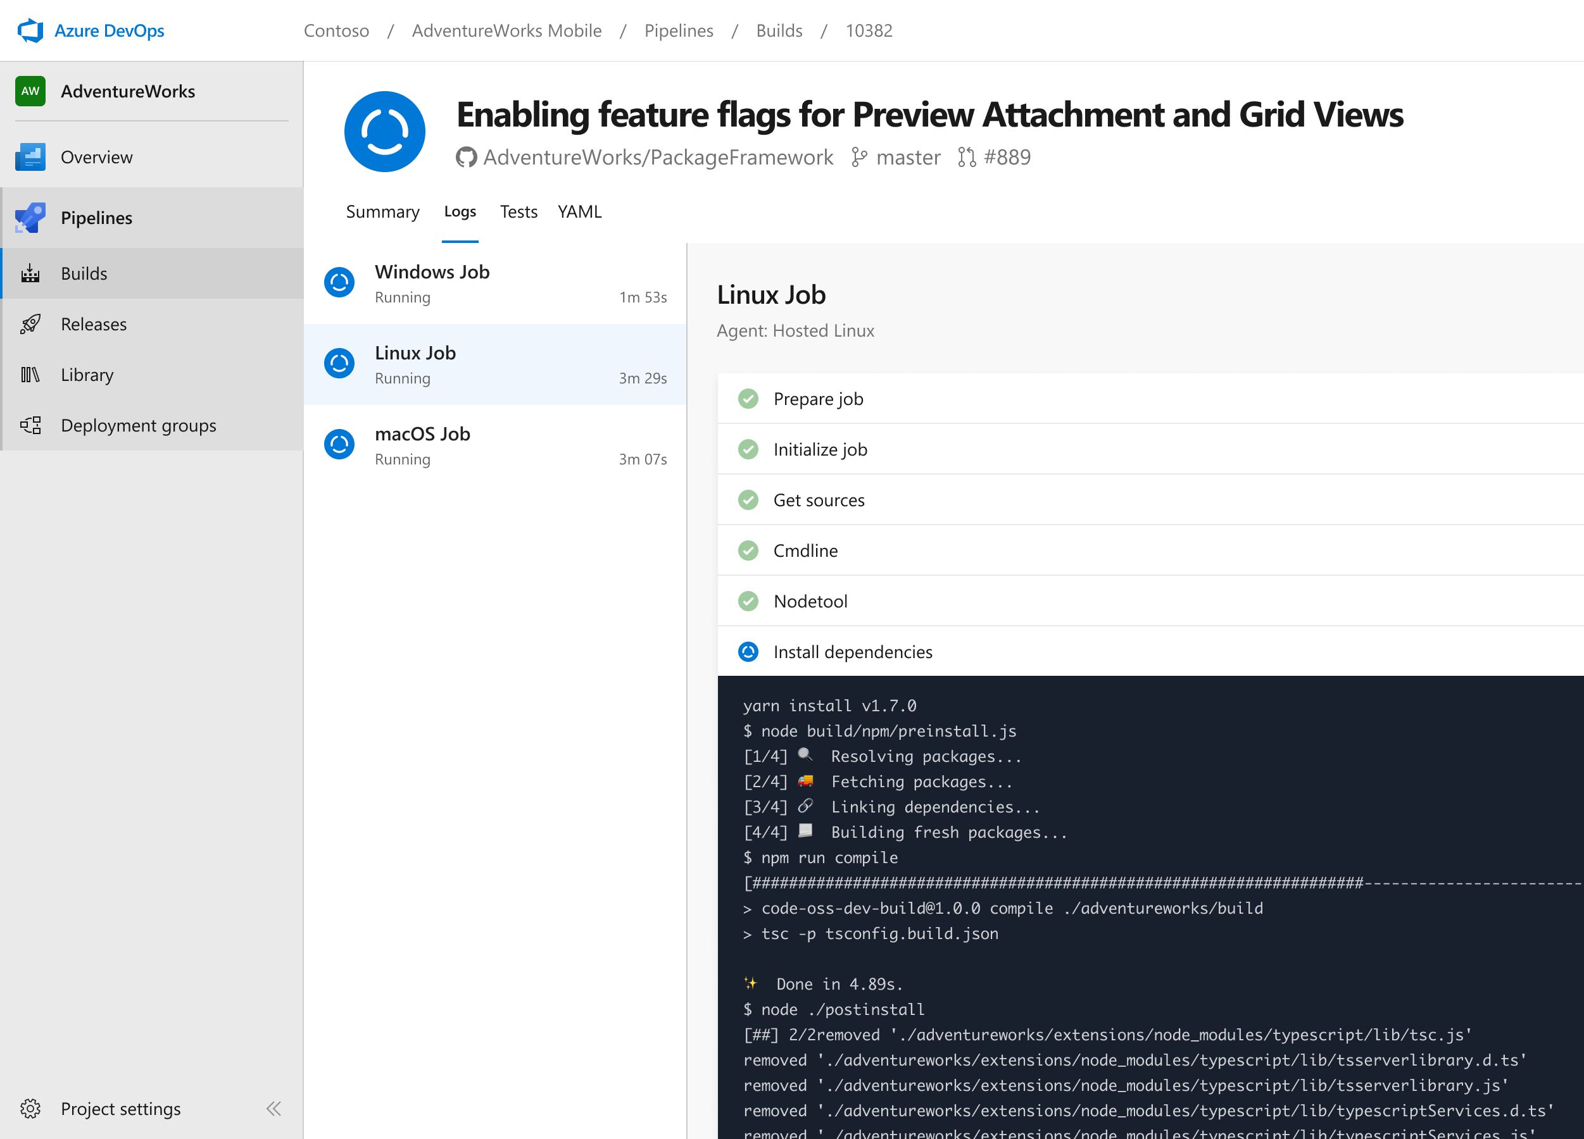
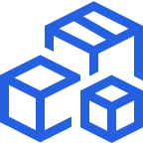
Azure Pipelines
Cloud-hosted pipelines for Linux, Windows and macOS, with unlimited minutes for open source
Any language, any platform, any cloud
Build, test, and deploy Node.js, Python, Java, PHP, Ruby, C/C++, .NET, Android, and iOS apps. Run in parallel on Linux, macOS, and Windows. Deploy to Azure, AWS, GCP or on-premises
Extensible
Explore and implement a wide range of community-built build, test, and deployment tasks, along with hundreds of extensions from Slack to SonarCloud. Support for YAML, reporting and more
Containers and Kubernetes
Easily build and push images to container registries like Docker Hub and Azure Container Registry. Deploy containers to individual hosts or Kubernetes.
Best-in-class for open source
Ensure fast continuous integration/continuous delivery (CI/CD) pipelines for every open source project. Get unlimited build minutes for all open source projects with up to 10 free parallel jobs across Linux, macOS and Windows
➔
https://azure.com/pipelines
Notes:
Azure Pipelines is the perfect launchpad for your code – automating your builds and deployments so you spend less time with the nuts and bolts and more time being creative

Slide 13
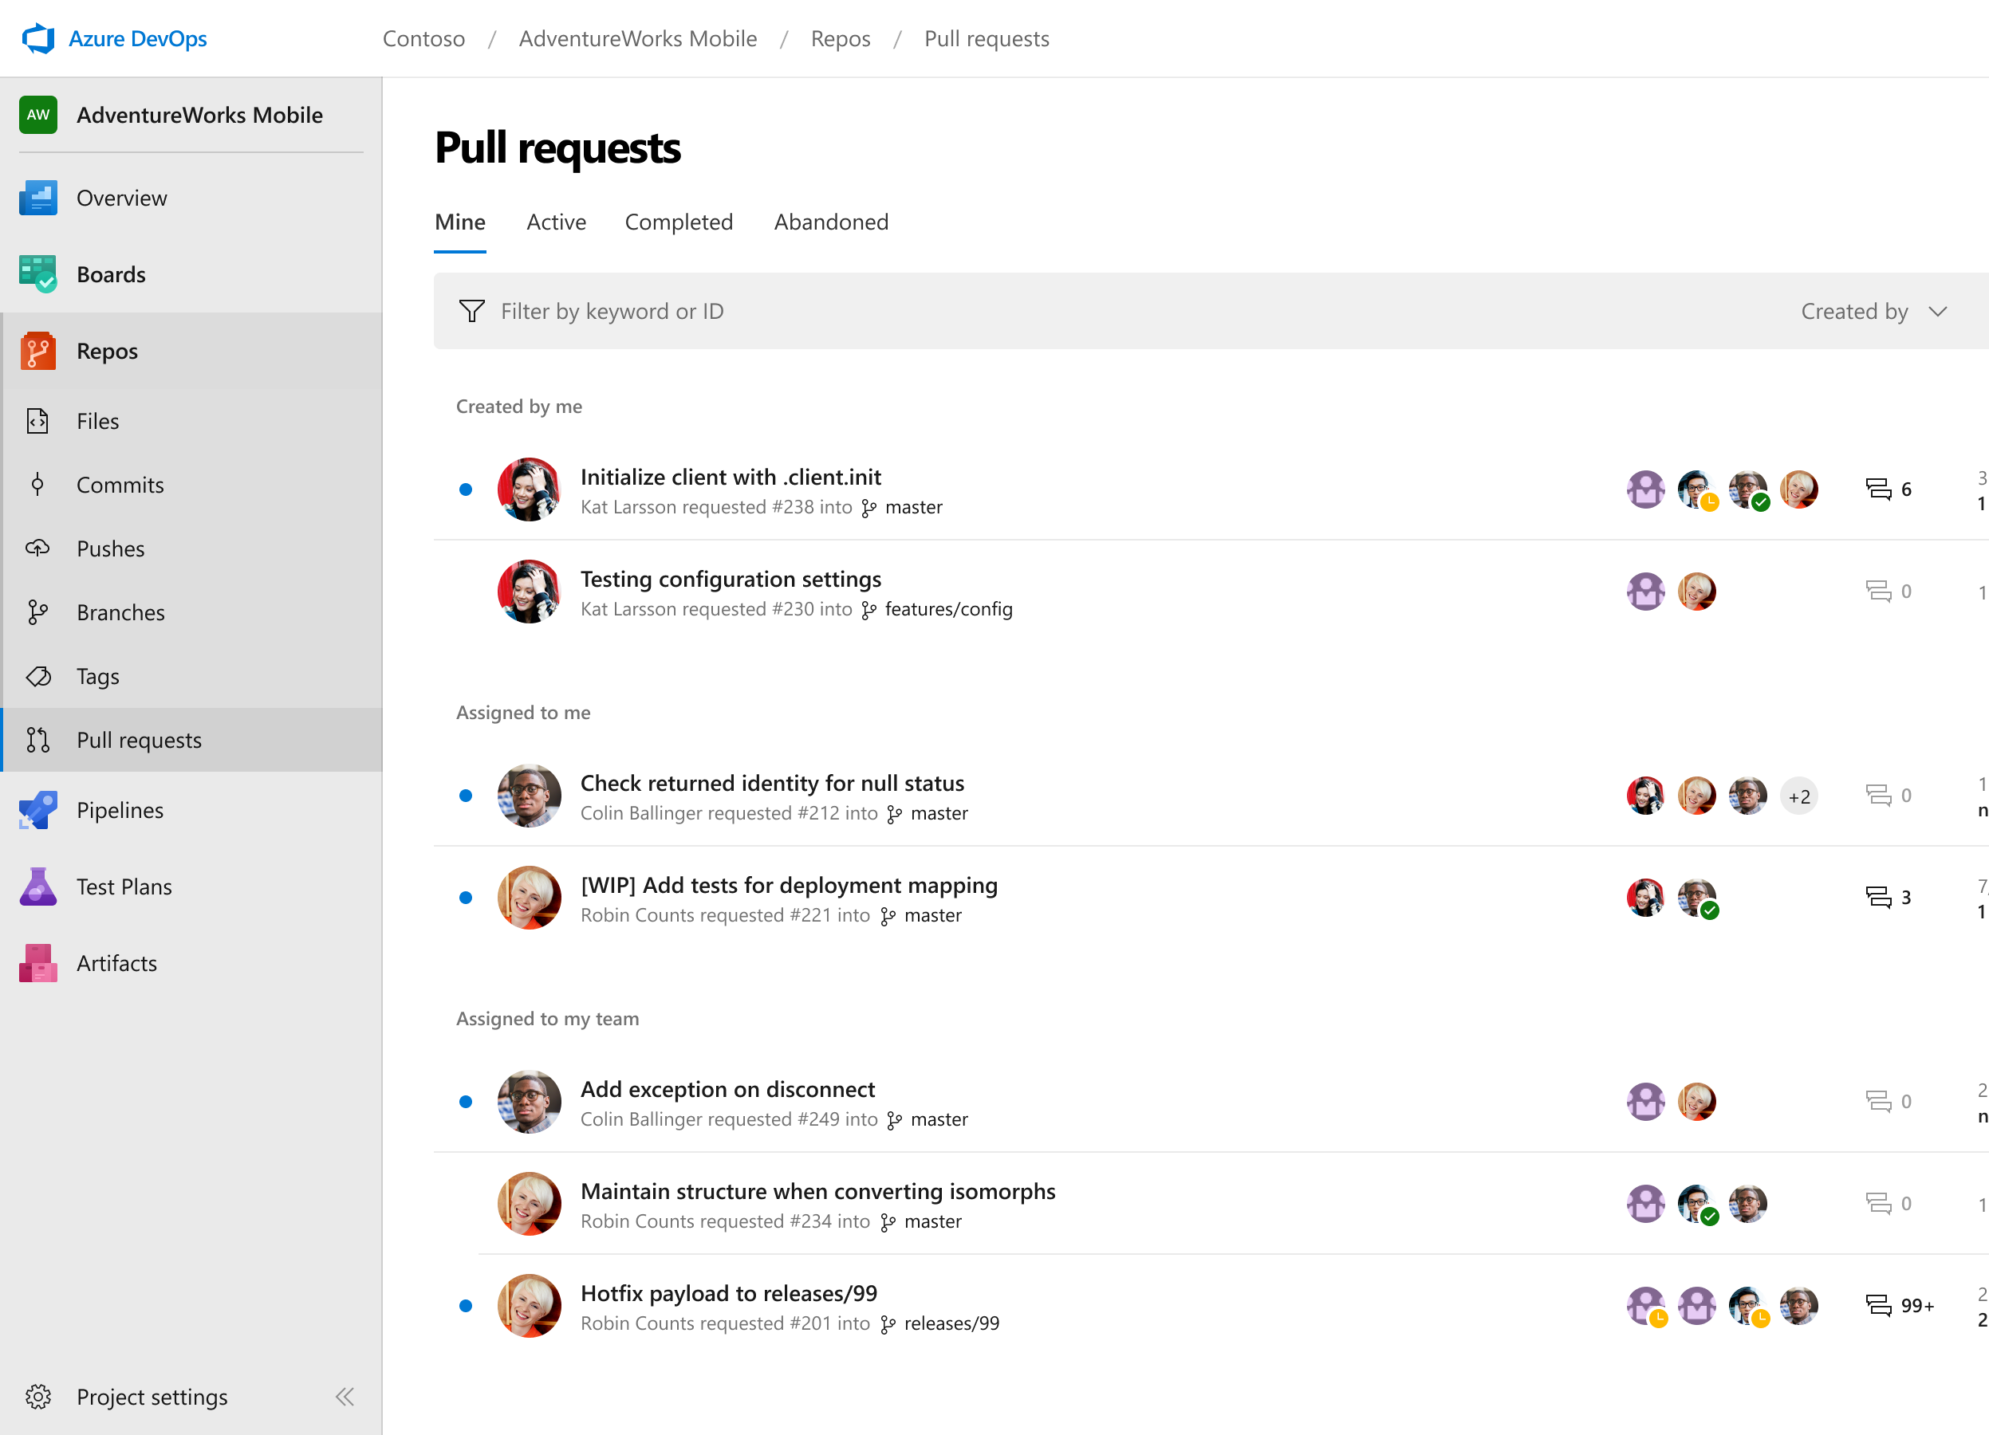
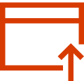
Azure Repos
Unlimited private Git repo hosting and support for TFVC that scales from a hobby project to the world’s largest Git repositories
Works with your Git client
Securely connect with and push code into your Git repos from any IDE, editor, or Git client.
Web hooks and API integration
Add validations and extensions from the marketplace or build your own using web hooks and REST APIs.
Semantic code search
Quickly find what you’re looking for with code-aware search that understands classes and variables.
➔
https://azure.com/devops
Notes:
Collaborate on code changes with threaded discussion and continuous integration for each change. Use forks to promote collaboration with Inner Source workflows.

Slide 14
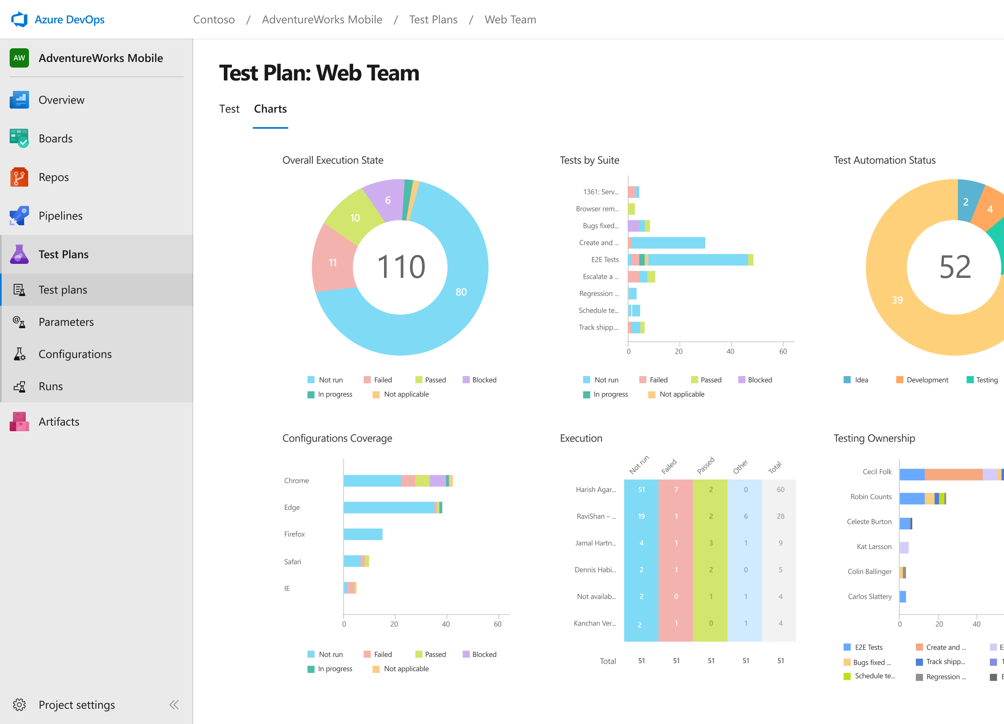
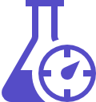
Azure Test Plans
Get end-to-end traceability. Run tests and log defects from your browser. Track and assess quality throughout your testing lifecycle.
Capture rich data
Capture rich scenario data as you execute tests to make discovered defects actionable. Explore user stories without test cases or test steps. You can create test cases directly from your exploratory test sessions.
Test across web and desktop
Test your application where it lives. Complete scripted tests across desktop or web scenarios. Test on-premises application from the cloud and vice-versa.
Get end-to-end traceability
Leverage the same test tools across your engineers and user acceptance testing stakeholders. Pay for the tools only when you need them.
➔
https://azure.com/devops
Notes:
Collaborate on code changes with threaded discussion and continuous integration for each change. Use forks to promote collaboration with Inner Source workflows.

Slide 15
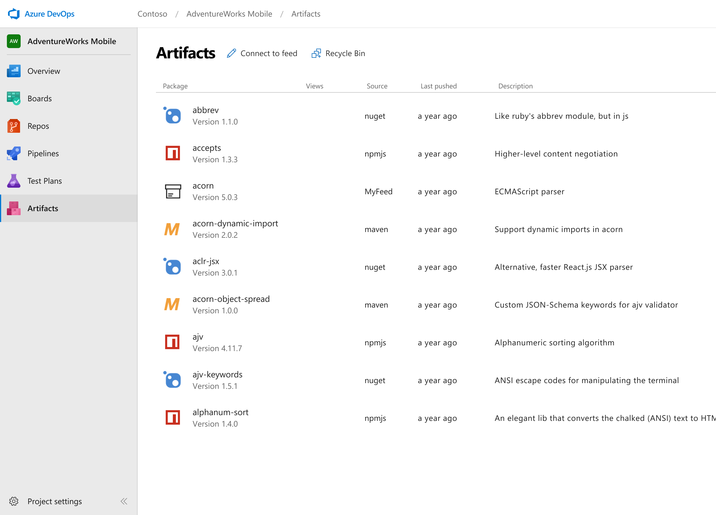
Azure Artifacts
Create and share Maven, npm, and NuGet package feeds from public and private sources – fully integrated into CI/CD pipelines
Manage all package types
Get universal artifact management for Maven, npm, and NuGet.
Add packages to any pipeline
Share packages, and use built-in CI/CD, versioning, and testing.
Share code efficiently
Easily share code across small teams and large enterprises.
➔
https://azure.com/devops
Notes:
Collaborate on code changes with threaded discussion and continuous integration for each change. Use forks to promote collaboration with Inner Source workflows.

Slide 16
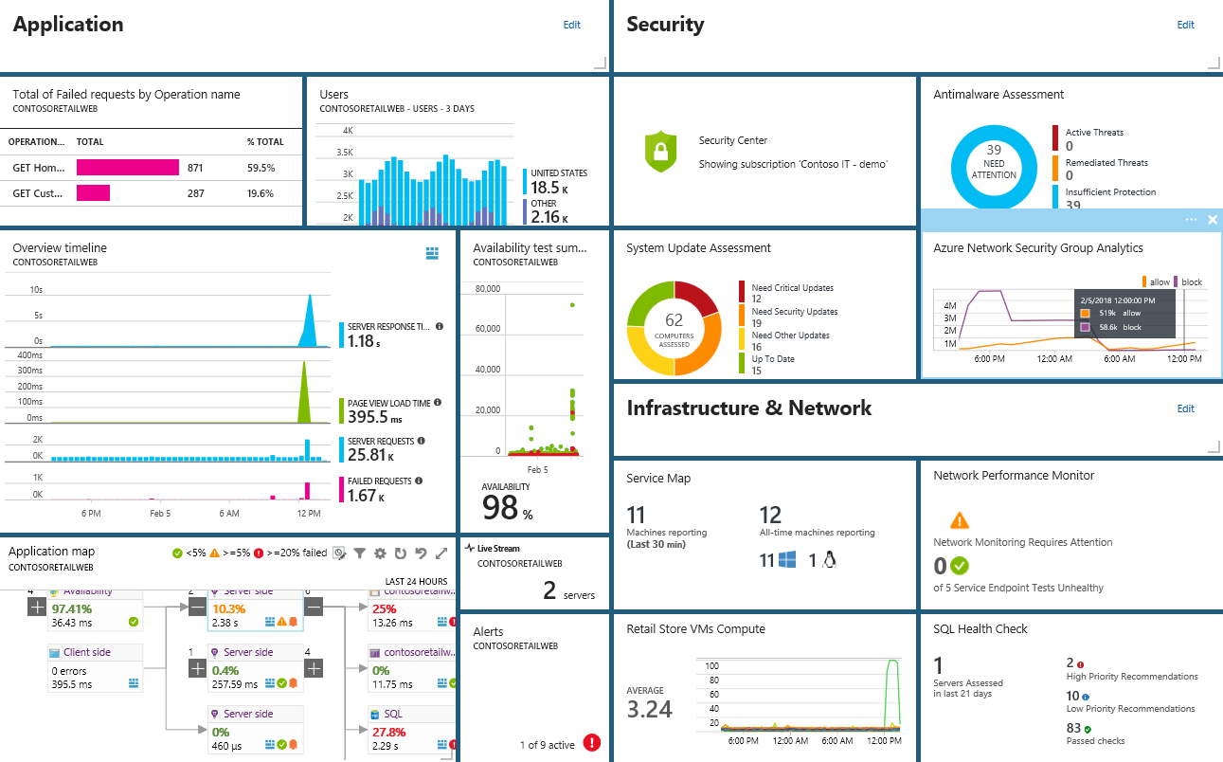
Smarter Insights, Faster
Azure Monitor, Application Insights & Log Analytics
Pre-defined solutions with smart thresholds
Visualize data in intuitive and customizable dashboards
Separate the signal from the noise and accelerate root-cause analysis
Integrate your existing processes & tools like Service Now
Notes:
Azure’s monitoring solutions provide pre-defined solutions with smart thresholds and intuitive dashboards so you can start getting insights straight away
Azure Monitor provides metrics for all Azure infrastructure, building upon that you can leverage both Log Analytics and Application Insights to gain greater insights into your Infrastructure and Applications respectively – leveraging Azure to simplify this into standardized dashboards for both your Developer and your Operations teams
Spend less time separating the signal from the noise and accelerate you root cause analysis
You can also automate and integrate into your existing service desk platforms such as Service Now
------ (additional product context) ------
Monitor your cloud health with Log Analytics
Collect and store your data from any source
Easily collect, store, and analyze your systems and operational data from any source, both on-premises and in the cloud.
Collect data from a wide range of sources including virtual machines, storage accounts, activity logs, Windows, Linux Servers, Java, .NET, legacy and modern apps.
Centrally store activity logs, network logs, infrastructure metrics, app data points, diagnostics logs and alerts.
Gain deep operational insights
Understand CPU disk and memory utilization for your virtual machines.
Get a comprehensive view of applications and network dependencies across multiple virtual machines to perform root-cause analysis more quickly.
Track configuration changes, system updates, and malware status to improve security & compliance.
Visualize data in intuitive and customizable dashboards.
Find the information you need quickly using interactive queries and full-text search.
Detect, diagnose and fix issues quickly
Get notifications and alerts with rich diagnostic information so you can always stay on top of the issues.
Separate the signal from the noise and accelerate root-cause analysis across platforms using advanced analytics including machine learning algorithms.
Automate the implementation of recommended fixes so you can address issues quickly.
Integrate with customer service systems such as your ticketing tool to speed up implementation of fixes.

Slide 17
Demo
Enough slides, let’s code.

Slide 18
Please use EventsXD to fill out a session evaluation.
Thank you!

