Slide 1
Blazor
A new framework for browser-based .NET apps
Ryan Nowak
Developer & Architect, ASP.NET Core
@aVerySpicyBoi
Demos and presentations
Notes:
Greet audience and intro self
ASP.Net Core team
Working on Blazor for over a year
Part of Blazor experiment
Excited to finally ship something that we can slap a “supported” label on

Slide 2
Blazor
Build client-side web UI with .NET instead of JavaScript
Write reusable web UI components with C# and Razor
Share .NET code with both the client and the server
Call into JavaScript libraries & browser APIs as needed
C#
Notes:
What is Blazor?
- Blazor is a new UI framework that’s simple and fun to use
- Blazor is component-based, influence by JS frameworks, takes the parts that we think work well in C#
- Blazor is the next step for Razor and adds new powerful capabilities
- Gives you real .NET – use netstandard libraries

Slide 3
Demo: Build client web UI with Blazor
Notes:
[Start 2M]
Show navigation without a refresh
Create a new project and show the counter page
Counter proves that we can handle events without a refresh
Add increment count, show that we can write code
Leave demo running and come back

Slide 4
.NET
Notes:
[Start 3M]
Where Blazor began… WebAssembly means any language can run in the browser
No plugins are requires
Driven by web standards
Supported in all modern browsers included mobile
Low level instruction language like .NET’s Common Instruction Language
What’s common today: compiling C/C++ or Rust to wasm
How does .NET Plug in to this? (next slide)

Slide 5
How client-side Blazor works
https://...
Razor Components
DOM
.NET
WebAssembly
Notes:
To make .NET work in the browser, we compile the Mono runtime to webassembly. This makes sense because Mono has been built with a lot of flexibility, it supports a variety of different execution environments.
This means that your application dlls (for right now) don’t compile directly to web assembly, they are .NET IL.
Go back to browser and show .NET dlls in the network tab.
So what’s good about this?
Well for starters, the fact that we’re running real .NET dlls means that we have a real .NET runtime. Features like reflection *just work*.
However, we also have some limitations, and I want to convince you that’s a *good thing*.
WebAssembly (and Blazor) runs in the browser’s security sandbox
- No access to local filesystem, no ability to break the users computer
- Your application has to get its data from remote services over HTTP

Slide 6
Demo: Server Side Blazor
Notes:
[Start 8M]
Open the app and show how quickly it loads, point out that we don’t have “loading…”.
Show the network tab and show how there are no dlls. Add a counter component and show the web socket traffic

Slide 7
One Framework – two hosting models
Client-side
Server-side
https://...
https...
ASP.NET Core
Razor Components
DOM
SignalR
DOM
.NET
WebAssembly
Razor Components
.NET
.NET 5!!!
.NET Core 3.0
Notes:
[start 12M]
We’re building a programming model where the same components can run on the server or in web assembly.
You might prefer one model or the other depending on your requirements
Client-side Blazor has a slower loading time because it has to download the app, but once its downloaded it executes fully in the browser and can run offline
Server-side Blazor has a faster loading time but requires a connection
Client-side Blazor will ship in .NET 5
Server-side Blazor will ship in .NET Core 3.0 because CoreCLR is already great

Slide 8
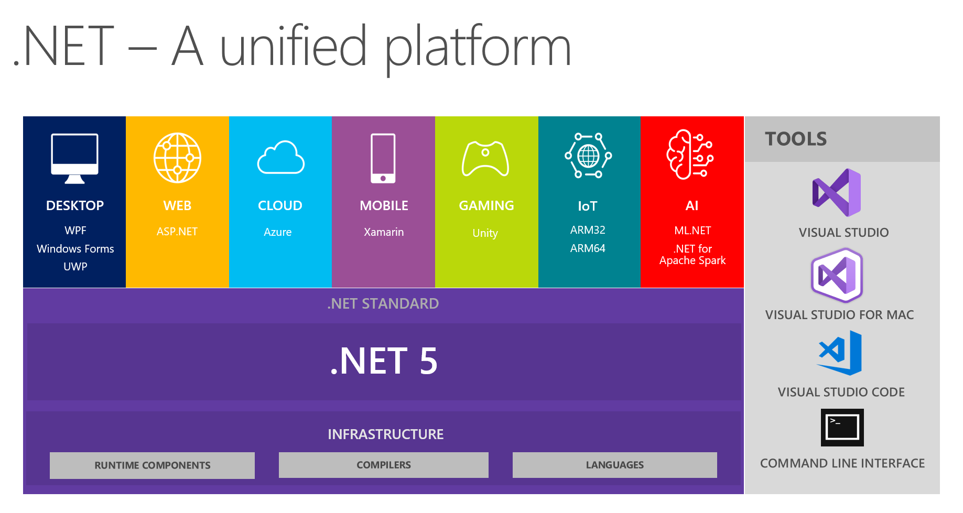
.NET 5
https://devblogs.microsoft.com/dotnet/introducing-net-5/
Notes:
.NET 5 includes a grand unification of the best parts of Mono and

Slide 9
Blazor
Build client-side web UI with .NET instead of JavaScript
Write reusable web UI components with C# and Razor
Share .NET code with both the client and the server
Call into JavaScript libraries & browser APIs as needed
Blazor for WebAssembly now in official preview!
C#

Slide 10
Demo: Let’s learn some Blazor
Notes:
[start 17M]
Now we’re going to do some coding. That’s what you’re all here for right? I’m also going to lean on some new features that are being adding in 3.0 preview 6.
Demo: create mat design TODO list with EF
[start 17m] Checkpoint 1: Let’s write the UI for a simple TODO list on a single page with input and bind and a ul
[start 23m] Checkpoint 2: Now that we have this, it might be good to refactor so we can clean up the UI.
[start 27m] Checkpoint 3: So we refactored the code into components, let’s add some material design pizzazz. Explain the static files stuff
[start 34m] Checkpoint 4: Now the UI looks great, let’s add a database. Now this is a normal SQL server database with EF core. Because we’re doing Blazor server-side we can *just* do that.
[start 39m] Checkpoint 5: What’s not great about this is that we could see delays where the UI doesn’t update. Let’s dig into the material design components and add a progress bar.
Break for now.

Slide 11
Pages & Views with Components
ASP.NET Core
Request
https...
Page / View
HttpContext
SignalR
Component
UI events / DOM updates
DOM
State
Response
Notes:
[start 43m]

Slide 12
Demo: Pages & Views with Components
Notes:
[start 45M] Checkpoint 6: Now who out there has existing apps. Wouldn’t it be great if you could enhance your existing apps with new components features. Here we have a Razor Page that’s displaying the list of TODO items as a static page. The UI is pretty ho-hum, it would be nice if we could reuse something that we already created.
[start 50M] Checkpoint 7: Let’s add authorization

Slide 13
One Framework – two hosting models
Client-side
Server-side
https://...
https...
ASP.NET Core
Razor Components
DOM
SignalR
DOM
.NET
WebAssembly
Razor Components
.NET
.NET 5!!!
.NET Core 3.0
Notes:
[start 53M]

Slide 14
Schedule
.NET Core 3.0
Preview 5 - Now available!
Preview 6 - *soon*
Preview 7 (go-live) - July
(more previews go here)
GA - Sept
Blazor for WebAssembly
Updates with .NET Core 3.0, but will GA sometime later
Notes:
[start 53M]

Slide 15
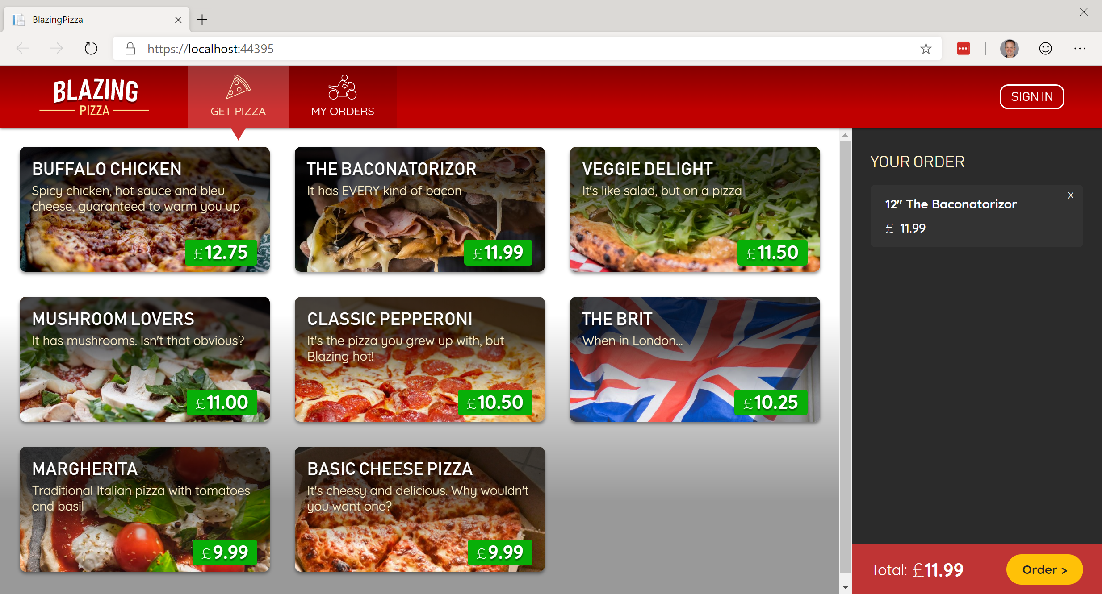
Build your own pizza store UI with Blazor
https://aka.ms/blazorworkshop
Notes:
If you want to learn more, the team have built a Blazor workshop – available through this link
- Developed in the open over a period of 1+ years
- Great community participation and feedback
- Works with latest .NET Core Preview and Visual Studio Preview
- Visual Studio Previews are side-by-side, easy to install and easy to remove
- Show how many VS installs I have

Slide 16
What’s coming in Preview 6
Authentication & authorization
@namespace
@code
Directive attributes
Embeded static content
New `key` intrinsic for component/element preservation in lists

Slide 17
Try Blazor today!
Blazor: https://blazor.net
Docs: https://blazor.net/docs
.NET Core 3.0: https://dot.net/get-core3
Visual Studio: https://visualstudio.com/preview
Workshop: https://aka.ms/blazorworkshop

