Slide 1
COGNITIVE SERVICES MACHINE LEARNING FOR DEVELOPERS
Chris Noring
@chris_noring

Slide 2
Machine Learning
Machine Learning finds patterns in data and uses those patterns to predict the future
@chris_noring

Slide 3
What can we use it for?
What Football team is going to win the league?
Detecting credit card fraud
Determining whether a customer is likely to switch to a competitor
Determine when to do preventive maintenance on a robot
@chris_noring

Slide 4
Why is ML popular?
Takes lots of data, the more data, the better our predictions
Takes lots of compute power
We have effective machine learning algorithms
Do you know what takes a lot of computing power?
@chris_noring

Slide 5
Who Benefits?
Business leaders, wants solutions to problems
Software developers, wants to create better applications
Data Scientists, wants powerful, easy-to-use tools
@chris_noring

Slide 6
Machine Learning – NN and Math
$$W^{T}x+b$$
$$Q\left(w\right)=\frac{1}{n}\sum_{i=1}^{n}{Q_{i}(w)}$$
$$σ\left(z\right)=\frac{1}{1+e^{−z}}$$
$$f_{i}(\vec{x}) =\frac{e^{x_{i}^{ }}}{\sum_{j=1}^{J}{e^{x_{j}}}}$$
@chris_noring

Slide 7
Programming
Algorithm
Answers
Data
@chris_noring

Slide 8
Machine Learning
Answers
Algorithm
Data
@chris_noring

Slide 9
Machine Learning
Answers
Model
Data
@chris_noring

Slide 10
Machine Learning
Answers
Data
Model
Predictions
Data
@chris_noring

Slide 11
Artificial Intelligence
Use an existing model
Customize a pre-trained model
Train a new model from scratch
Easy
Medium
Hard
A pre existing
Service like a box
around someones face
It can recognize face
But we need specific
faces
Lot’s of time and
effort needed
@chris_noring

Slide 12
Microsoft AI Platform
Azure AI Services
Tools
PRE-BUILT AI
CONVERSATIONAL AI
CUSTOM AI
CODING & MANAGEMENT TOOLS
Cognitive Services
Bot Service
Azure Machine Learning
VS Tools for AI
Azure ML Studio
Azure ML Workbench
Azure Infrastructure
Others (PyCharm, Jupyter Notebooks…)
DEEP LEARNING FRAMEWORKS
AI ON DATA
AI COMPUTE
3rd Party
Cosmos DB
SQL
DB
SQL
DW
Data Lake
Spark ADB
DSVM
Batch AI
ACS
IoT Edge
Cognitive Toolkit
TensorFlow
Caffe
CPU, FPGA, GPU
Others (Scikit-learn, MXNet, Keras, Chainer, Gluon…)
@chris_noring

Slide 13
Microsoft AI Platform
Azure AI Services
Tools
PRE-BUILT AI
CONVERSATIONAL AI
CUSTOM AI
CODING & MANAGEMENT TOOLS
Cognitive Services
Bot Service
Azure Machine Learning
VS Tools for AI
Azure ML Studio
Azure ML Workbench
Azure Infrastructure
Others (PyCharm, Jupyter Notebooks…)
DEEP LEARNING FRAMEWORKS
AI ON DATA
AI COMPUTE
3rd Party
Cosmos DB
SQL
DB
SQL
DW
Data Lake
Spark ADB
DSVM
Batch AI
ACS
IoT Edge
Cognitive Toolkit
TensorFlow
Caffe
CPU, FPGA, GPU
Others (Scikit-learn, MXNet, Keras, Chainer, Gluon…)
@chris_noring

Slide 14
Azure Cognitive Services
A set of simple APIs that harness Machine Learning
so you can add AI (without needing a deep understanding of AI)
Easy
Medium
Hard
@chris_noring

Slide 15
Azure Cognitive Services
Vision
Speech
Language
Knowledge
Search
Image Tagging, Thumbnails
OCR, Handwriting recognition
Speech to text (Speech Transcription)
Contextual language understanding – customized intent analysis
Customized decision making with reinforcement learning
Visual Search with object detection
Customized speech Transcription (complex word, noisy environment)
Comprehensive news, image, and video results
Sentiment analysis, key phrase detection
Q&A service and bot training with personality
Customized image recognition
Custom Search
Face detection
Text to speech
text translation up to 60+ languages
Tailored and customized search experiences
Emotion recognition
Speaker ID and authentication
Text Moderation
Video insights - people detection, visual search, keyframe detection, object recognition
Real-time speech translation
Spell checking
Automatic search suggestions
Entity information augmentation
Image and video moderation
@chris_noring

Slide 16
How to use?
Header
Ocp-Apim-Subscription-Key
Base URL
https://westeurope.api.cognitive.microsoft.com
Specific API URL
text/analytics/v2.1/languages
@chris_noring

Slide 17
Sending/receiving
{
"documents": [{
"id": "1",
"detectedLanguages": [{
"name": "English",
"iso6391Name": "en",
"score": 1
}]
},
{
"id": "2",
"detectedLanguages": [{
"name": "Spanish",
"iso6391Name": "es",
"score": 1
}]
}],
"errors": []
}
let documents = {
'documents': [{
'id': '1’,
'text': 'This is a document written in English.’
},
{
'id': '2',
'text': 'Este es un document escrito en Español.’
}
]
};
module.exports = documents;
@chris_noring

Slide 18
Let’s focus on Language APIs
Language detection
Sentiment analysis (bad or good)
Key phrase detection
Translation
and more…
@chris_noring

Slide 19
DEMO text, keyphrase, sentiment
@chris_noring

Slide 20
Sentiment analysis This is about determining whether something is good or bad
GOOD: I really enjoy the new XBox One S. It has a clean look, it has 4K/HDR resolution and it is affordable.
BAD: Este ha sido un dia terrible, llegué tarde al trabajo debido a un accidente automobilistico.
@chris_noring

Slide 21
Let’s focus on Vision APIs
Thumbnails
OCR with handwriting
Customized image recognition
Face detection
Emotion recognition
@chris_noring

Slide 22
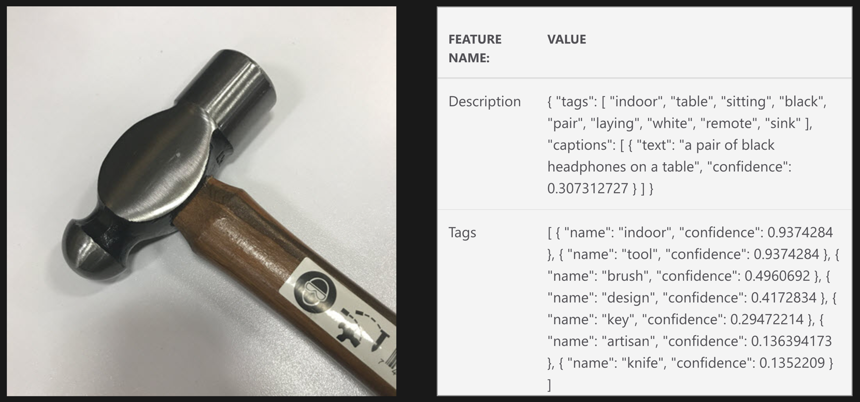
Sometimes the Cognitive service is not good enough

Slide 23
When you need a better Model
Sometimes the services are not enough
The Model is not specific enough
Then you can train the Model yourself
@chris_noring

Slide 24
Azure Custom Cognitive Services
Vision
Speech
Language
Knowledge
Search
Image Tagging, Thumbnails
OCR, Handwriting recognition
Speech to text (Speech Transcription)
Contextual language understanding – customized intent analysis
Customized decision making with reinforcement learning
Visual Search with object detection
Customized speech Transcription (complex word, noisy environment)
Comprehensive news, image, and video results
Sentiment analysis, key phrase detection
Q&A service and bot training with personality
Customized image recognition
Custom Search
Face detection
Text to speech
text translation up to 60+ languages
Tailored and customized search experiences
Emotion recognition
Speaker ID and authentication
Text Moderation
Video insights - people detection, visual search, keyframe detection, object recognition
Real-time speech translation
Spell checking
Automatic search suggestions
Entity information augmentation
Image and video moderation
@chris_noring

Slide 25
Custom Vision API When the vision API model isn’t good enough
When you want to detect a specific person
When you want to identify a specific tool over “tools”
https://www.customvision.ai/
Add tags
Train with images
Choose iteration and use API
@chris_noring

Slide 26
Train an existing model
Select
Select a model in the right domain
Create
Create all the tags you need
Upload
Upload an image and assign a tag
Train
Train = produce iteration
Call
Call API

Slide 27
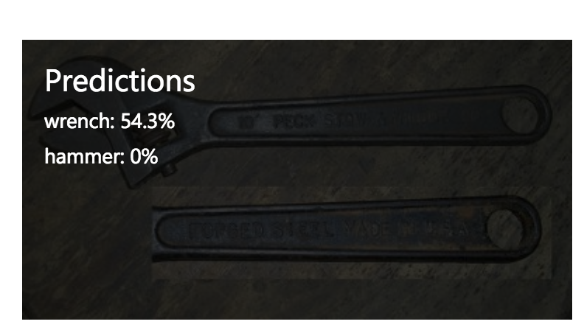
Press train
Produces an
iteration
Each image was assigned
a score that says
how certain it is
that the image is a certain tag

Slide 28
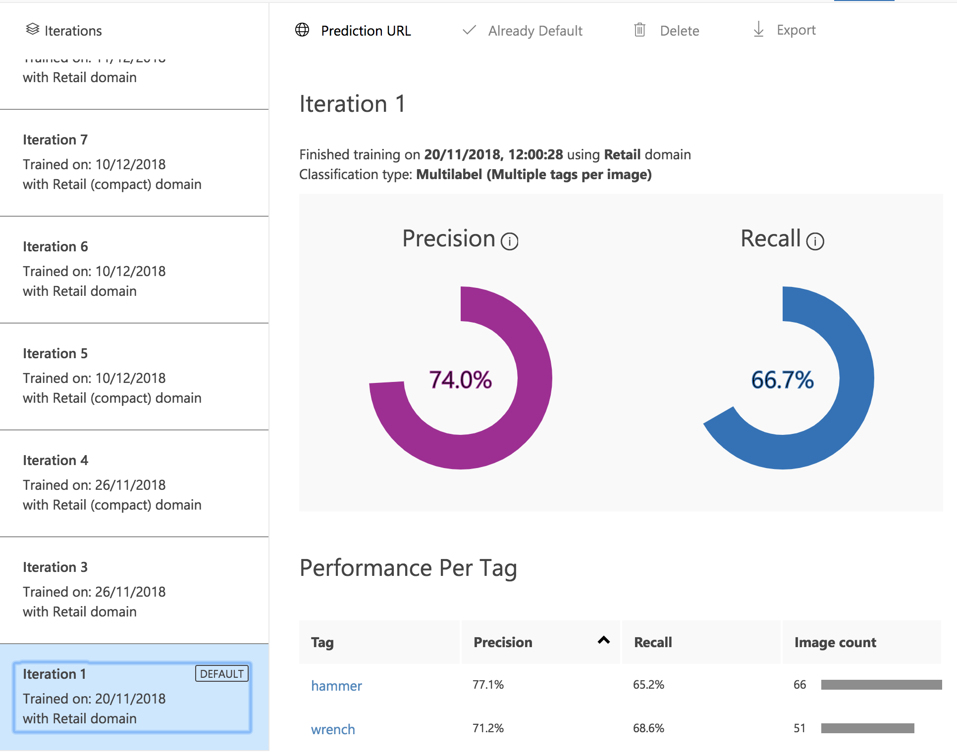
Precision, if a tag is predicted
by your model,
how likely is it to be correct
Recall, out of the tags which
Should be predicted,
what percentage did your
model correctly find

Slide 29
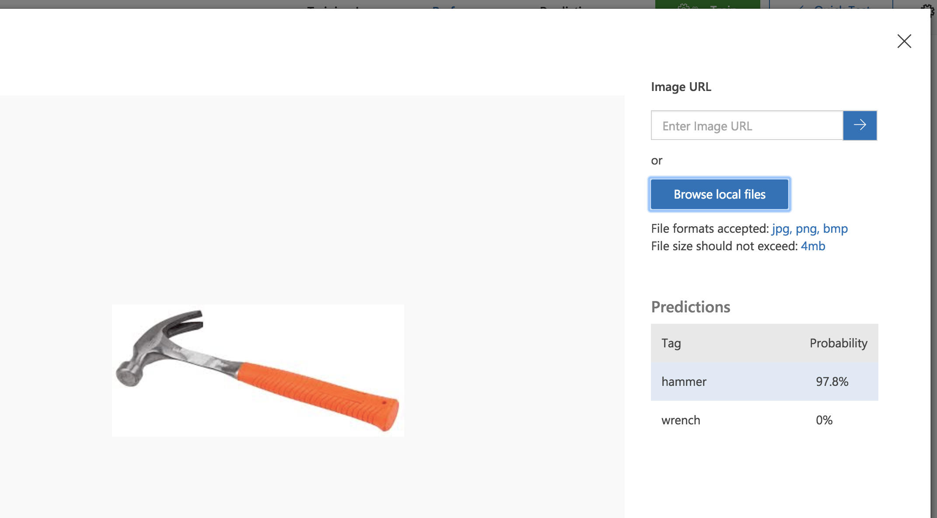
Quick test – see how our model performs

Slide 30
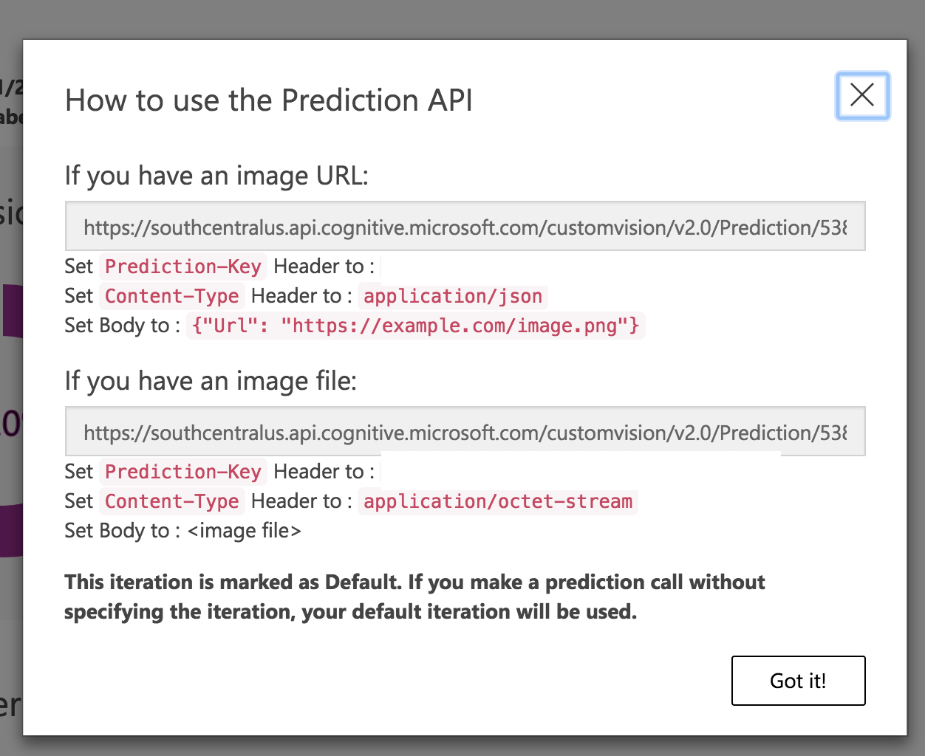
Test out our model with an API call
Image URL
The image itself

Slide 31
DEMO Custom Vision, upload file
@chris_noring

Slide 32
Summary
Cognitive Services is ML for Developers
There are tons of REST APIs, you just need a key
Send JSON and get JSON
Major areas: Vision, Speech, Language, Knowledge, Search
You can make models better by training them with images in customvision.ai, any service marked as custom, can be trained
@chris_noring

Slide 33
Thank you
aka.ms/azure-signup-cogservices
customvision.ai
aka.ms/azure-textapis
aka.ms/azure-cogservices-overview
@chris_noring

