Slide 1
ML.NET Machine Learning the .NET Way
Bri Achtman
Program Manager, Microsoft
@briacht

Slide 2
What is Machine Learning?

Slide 3
Machine Learning “Programming the Unprogrammable”
{
{
Is this a dog?
Price of shirt?
f(x)
f(x)
“It has exquisite buttons … with long sleeves …works for casual as well as business settings”

Slide 4
Machine Learning “Programming the Unprogrammable”
{
Machine Learning creates a
Dog
Dog
f(x) Model
Not a dog
Not a dog
using this data

Slide 5
What is ML.NET?

Slide 6
ML.NET 1.0 @Build 2019
Notes:
Goal: To make .NET great for machine learning and offer .NET developers a choice when going about their ML journey.

Slide 7
ML.NET is…
Cross-platform (Windows, Linux, MacOS)
Free
Open Source
Supported on .NET Core and .NET Framework
Supported for C# and F#
Supported on x64 and x86 processers
Supported for most .NET app types, including:
Web apps and services
Microservices/Containers
Desktop apps (WPF and WinForms)
Azure Functions & any Azure server-side app type
Console apps

Slide 8
Pre-built vs. Custom Machine Learning Models
Pre-built ML models have been pre-trained and are not customizable – some limitations
Ex: Azure Cognitive Services
Great for some scenarios…
“This is a great vacuum cleaner.”
Not great for others…
“This vacuum cleaner sucks so much dirt.”
Sentiment:
positive
Sentiment:
negative
Use ML.NET to create custom models trained on your data

Slide 9
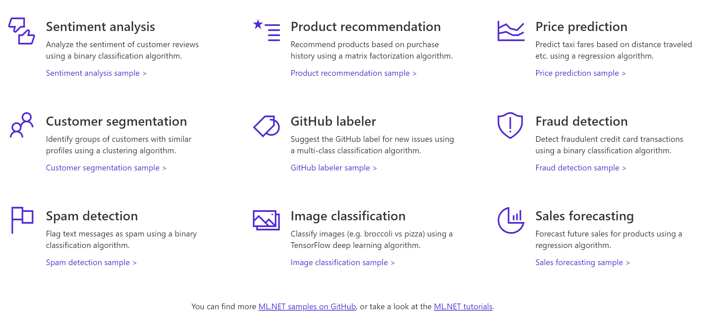
Some things you can do with ML.NET
http://dot.net/ml

Slide 10
Sentiment Analysis ML.NET
Is this a positive comment?
Yes or no
(Binary Classification)
Notes:
https://blazormlnetsentimentanalysis.azurewebsites.net/

Slide 11
ML.NET Step-by-Step
Create ML.NET Context
Load data
Transform data
Add algorithm
Train model
Evaluate model
Deploy model

Slide 12
1
2
3
4
5
6
7
MLContext
Load data
Transform data
Add algorithm
Train model
Evaluate model
Deploy model
MLContext = starting point for all ML.NET operations
Initializing MLContext creates a new ML.NET environment that can be shared across the model creation workflow objects
Notes:
Model creation workflow objects = (e.g. data loading and saving, transforms, and trainers)
Similar conceptually to DBContext in Entity Framework

Slide 13
1
2
3
4
5
6
7
MLContext
Load data
Transform data
Add algorithm
Train model
Evaluate model
Deploy model
Features = inputs for ML
Attributes used to make predictions
Label = output of ML
What you want to predict
Notes:
ML uses known data (e.g. training data) to find patterns in order to make predictions on new, unknown data
In a sentiment analysis, where you want to predict if a comment is positive or negative, the actual comment text column is the Feature column, while the sentiment (negative or positive) is the Label column, since sentiment is the value that you want to predict:

Slide 14
1
2
3
4
5
6
7
MLContext
Load data
Transform data
Add algorithm
Train model
Evaluate model
Deploy model
Data in ML.NET represented as IDataView
Can load data from:
Files (e.g. TSV, CSV)
Real-time streaming sources (e.g. SQL, CosmosDB)
Other data sources (e.g. Enumerables, JSON, XML)
Notes:
IDataView - a flexible, efficient way of describing tabular data (e.g. rows and columns). IDataView objects can contain numbers, text, booleans, vectors, and more.

Slide 15
1
2
3
4
5
6
7
MLContext
Load data
Transform data
Add algorithm
Train model
Evaluate model
Deploy model
Data you have available usually isn't suitable to be used directly to train an ML model
Raw data needs to be pre-processed using data transformations
Transformers take data, do some work on it, and return new, transformed data
Notes:
Since text is not an acceptable format, the text in the sentiment analysis example must be transformed into numeric vectors, which the ML algorithm can understand
Transformers take data, do some work on it, and return new transformed data.
One example of a transformer we will need in our example is a Text Featurizer, which takes the text in the issue text and converts it to numbers (numeric vector) that the ML algorithms can understand.
Another example of a transformer is a model, which turns the input features into output predictions.

Slide 16
1
2
3
4
5
6
7
MLContext
Load data
Transform data
Add algorithm
Train model
Evaluate model
Deploy model
ML.NET provides built-in set of data transforms
Featurizing Text
Replacing missing values
Normalizing values
Notes:
So that you can get your data into the correct format needed for processing

Slide 17
1
2
3
4
5
6
7
MLContext
Load data
Transform data
Add algorithm
Train model
Evaluate model
Deploy model
When using machine learning and ML.NET, you must choose an ML task that goes along with your scenario
Binary classification (e.g. sentiment analysis)
Multi-class classification (e.g. topic categorization)
Regression (e.g. price prediction)
Clustering (e.g. customer segmentation)
Anomaly Detection (e.g. sales spike detection)
Recommendation (e.g. movie recommender)
Ranking (e.g. search results)
AveragedPerceptronTrainer, SdcaLogisticRegressionBinaryTrainer
LightGbmMulticlassTrainer, OneVersusAllTrainer
LbfgsPoissonRegressionTrainer, FastTreeRegressionTrainer
KMeansTrainer
RandomizedPcaTrainer
MatrixFactorizationTrainer
LightGbmRankingTrainer, FastTreeRankingTrainer
Notes:
ML.NET offers over 30 algorithms (or trainers) for a variety of ML tasks

Slide 18
1
2
3
4
5
6
7
MLContext
Load data
Transform data
Add algorithm
Train model
Evaluate model
Deploy model
Data transformations & algorithms are not executed until Fit() method is called (lazy loading)
An estimator takes in data, learns from the data, and creates a transformer
Notes:
This is when model training happens - In the case of model training, the training data is the input, and the trained model is the output; the trained model is thus a transformer that turns the input Features from new data into output predictions.
An estimator learns from data to create a transformer. For instance, estimators take our example data, learn from the data, and produce a model.
Now a model, which turns the input features into output predictions, is a transformer.
For the sentiment analysis example, an estimator takes in your comment text and corresponding sentiments, learns from the data, and produces a machine learning model, which can then be used as a transformer to take in new sentiment text data and return the predicted sentiments

Slide 19
1
2
3
4
5
6
7
MLContext
Load data
Transform data
Add algorithm
Train model
Evaluate model
Deploy model
ML.NET offers evaluators that assess the performance of your model on a variety of metrics e.g.
Accuracy
Area under the curve (AUC)
R-Squared
Root Mean Squared Error (RMSE)

Slide 20
1
2
3
4
5
6
7
MLContext
Load data
Transform data
Add algorithm
Train model
Evaluate model
Deploy model
Save your trained model as a binary file
Load model into your other .NET applications

Slide 21
1
2
3
4
5
6
7
MLContext
Load data
Transform data
Add algorithm
Train model
Evaluate model
Deploy model
Consume the loaded model using
Prediction Engine, a convenience API used for making single predictions, or
Transform method, which is used for making batch predictions

Slide 22
Sentiment Analysis with the ML.NET API Demo

Slide 23
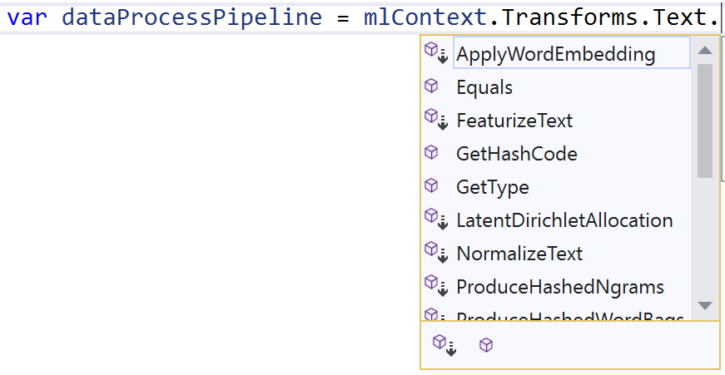
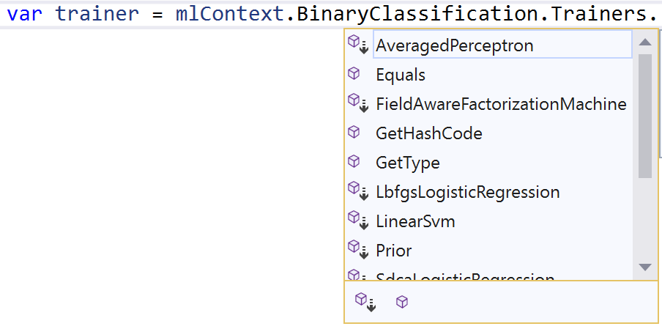
Which transformations are best for my data?
Which algorithm is best for my scenario?
What are the right options for my algorithm?
var options = new LbfgsLogisticRegressionBinaryTrainer.Options()
{
LabelColumnName = "Label",
FeatureColumnName = "Features",
MaximumNumberOfIterations = 100,
OptimizationTolerance = 1e-8f,
L2Regularization = 0.01f
};

Slide 24
ML.NET with AutoML

Slide 25
Automate Machine Learning (AutoML)
PREVIEW
Automatically builds models with the best performing algorithms and settings
Runs locally and currently supports three ML tasks (regression, binary classification, & multi-classification)
Available in three form factors:
ML.NET CLI
ML.NET Model Builder
ML.NET AutoML API
Notes:
AutoML-- model composition is easier since you don’t have to worry about featurization or model selection

Slide 26
Sentiment Analysis with ML.NET CLI Demo
PREVIEW

Slide 27
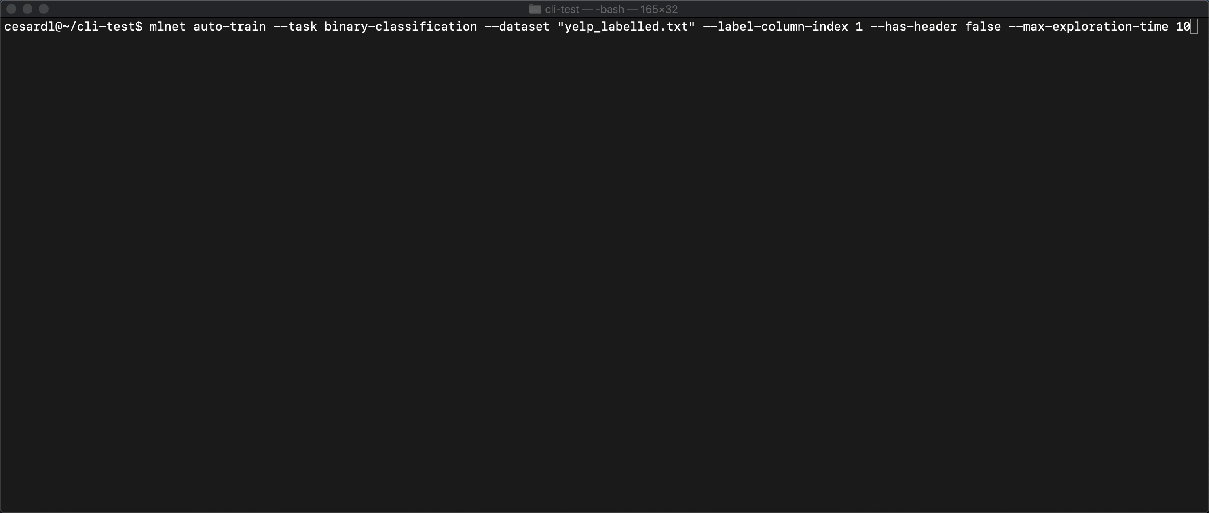
ML.NET CLI
Notes:
Cross-platform (Windows, macOS, Linux)
Generate code for training & consumption

Slide 28
Sentiment Analysis with ML.NET Model Builder Demo
PREVIEW
Notes:
Simple UI tool for developers that generates code for training & consumption

Slide 29
Deep Learning with ML.NET

Slide 30
Integrate trained deep learning models
PREVIEW
Use pre-trained deep learning models to add intelligence to your .NET app
Enables computer vision, speech recognition, and more
Currently supports TensorFlow and ONNX models
Image (input)
Dog
Not a dog
Dog
Not a dog
Notes:
Tensorflow: an open source library for ML used for deep neural networks
ONNX: an open format to represent deep learning models and make them portable

Slide 31
Object Detection with ML.NET and ONNX Demo

Slide 32
Who uses ML.NET?

Slide 33
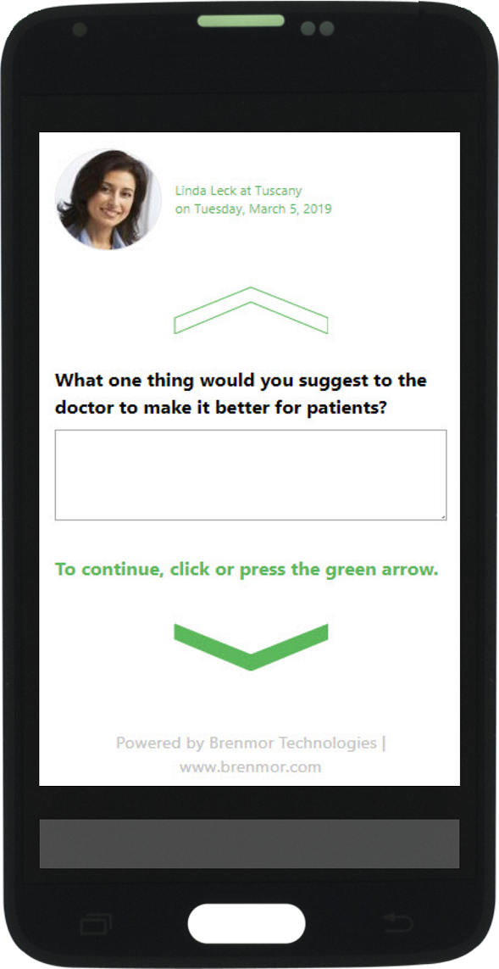
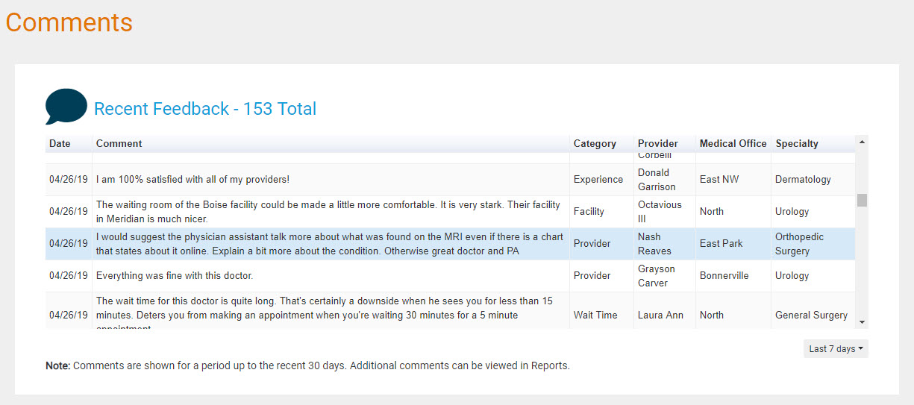
uses ML.NET to classify free-form comments from patient surveys.
“Because of the intelligence that AutoML provides, Microsoft has essentially provided a shrink-wrapped Data Scientist to users of ML.NET. This has resulted in a significant increase in the speed and accuracy of categorizing complex, free-form, patient text responses. Our clients are thrilled.”

Slide 34
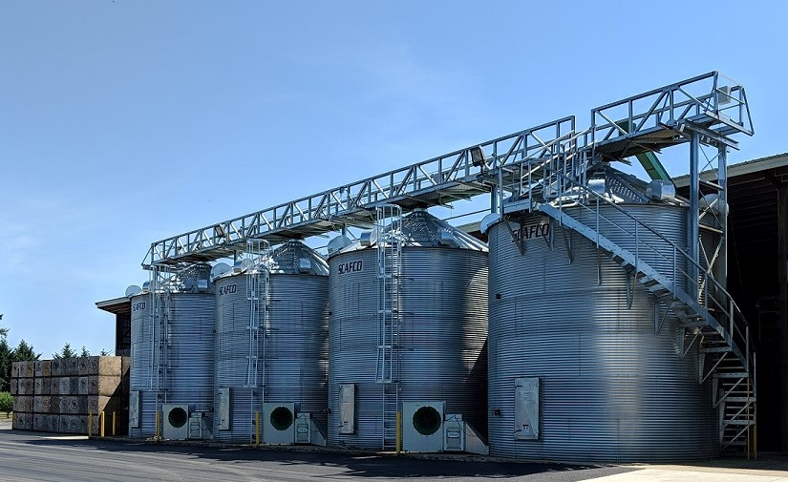
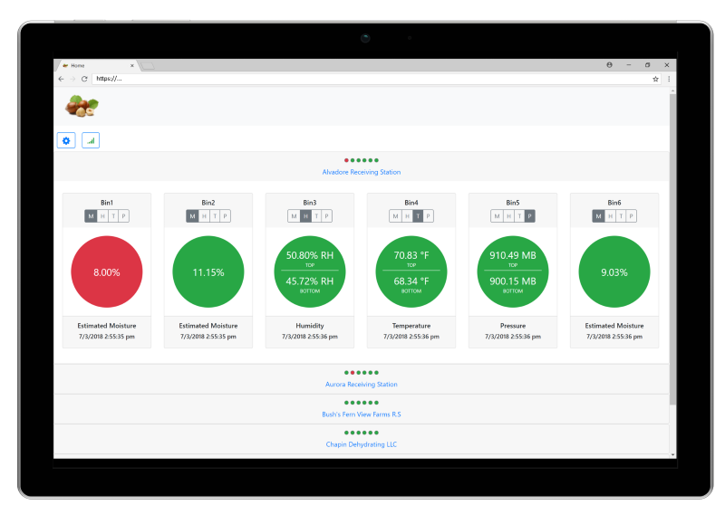
uses ML.NET to predict hazelnut moisture levels.
“ML.NET made it straightforward to leverage our existing .NET and C# skills and software assets to add machine learning capabilities into the application… deployed on Azure, the integration of machine learning models was easy.”

Slide 35
The Road Ahead
ML.NET 1.1 announced this week
Added Time Series for Forecasting
Added more Anomaly Detection algorithms
Upcoming
Improved AutoML experience for all ML scenarios
Additional Deep Learning training support scenarios
Connectors for data sources (e.g. SQL Server, Cosmos DB etc.)
Scale-out on Azure for training and consumption
Improve tooling in Visual Studio and .NET (Model Builder & CLI)
ARM support
Additional ML tasks

Slide 36
Get started with ML.NET at: http://dot.net/ml

Slide 37
Appendix

Slide 38
ML.NET: Key concepts

Slide 39
Machine Learning Workflow
Load & Transform
Your Data
Build & Train Model
Use Model
Notes:
The high level process for building your own models will involve “Preparing your data” -> “Build and training your model” and then deploying it your app.

Slide 40
1. Data
Data
Example
Comment Text | Sentiment
Wow... Loved this place. | 1
Crust is not good. | 0
Not tasty and the texture was just nasty. | 0
The selection on the menu was great. | 1
Features
(input)
Label
(output)
Yelp review dataset

Slide 41
2. Transformers
Data
Data
Transformer
Data
Example
Text
Wow... Loved this place.
Crust is not good.
Not tasty and the texture was just nasty.
The selection on the menu was great.
Featurized Text
[0.76, 0.65, 0.44, …]
[0.98, 0.43, 0.54, …]
[0.35, 0.73, 0.46, …]
[0.39, 0, 0.75, …]
Text Featurizer
Notes:
Transformers take data, do some work on it, and return new transformed data.
One example of a transformer we will need in our example is a Text Featurizer, which takes the text in the issue text and converts it to numbers (numeric vector) that the ML algorithms can understand.
Another example of a transformer is a model, which turns the input features into output predictions.

Slide 42
3. Estimators
Data
Data
Transformer
Data
Data
Estimator
Transformer
Example
Comment | Sentiment
Wow... Loved this place. | 1
Crust is not good. | 0
Not tasty and the texture was just nasty. | 0
The selection on the menu was great. | 0
Estimator
Model (Transformer)
Notes:
An estimator learns from data to create a transformer. For instance, estimators take our example data, learn from the data, and produce a model.
Now a model, which turns the input features into output predictions, is a transformer.

Slide 43
3. Estimators
Data
Data
Transformer
Data
Data
Estimator
Transformer
Example
Comment | Sentiment
Wow... Loved this place. | 1
Crust is not good. | 0
Not tasty and the texture was just nasty. | 0
The selection on the menu was great. | 0
Estimator
Model (Transformer)
Notes:
Prediction Engine

Slide 44
4. Prediction Engine
Data
Data
Transformer
Data
Data
Estimator
Transformer (e.g. model)
Data (single row)
Prediction Function
Data (single row)
Example
Prediction Engine
Comment
Love the atmosphere here
Predicted Label – Toxic? (Sentiment)
1

Slide 45
ML.NET 1.0 components
Developer friendly API for Machine Learning
Training & Consumption
Data
Transforms
Trainers for
Misc.
IDataView
Text
Binary Classification
Train/Test Validation
Text IDV/TSV Readers
Categorical
Multi-class Classification
Cross-Validation
IEnumerable reader
Missing values
Regression
Quality Metrics
IDV file reader
Feature engineering
Anomaly detection
Calibrators
(Preview)
Schema
Normalization
Ranking
TensorFlow & ONNX
(Preview)
Vector column
User custom transforms
Clustering
Extension for ASP.NET Core
(30 transforms)
(40 trainers/algorithms)

