Slide 1
DevOps for Desktop Apps
Ricardo Minguez (aka Rido)
@ridomin

Slide 2
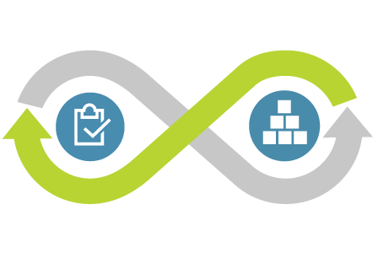
High Performance DevOps Companies Achieve…
46x Deployment
Frequency
2,555x Faster Lead
Time For Changes
Faster
Time to Market
$
Increased
Revenue
DevOps
7x Lower Change
Failure Rate
2,604x Faster Mean
Time to Recover
Source: 2018 Accelerate: State of DevOps: Strategies for a New Economy." N. Forsgren, J. Humble, G. Kim.
DevOps Research and Assessment (DORA)

Slide 3
Desktop DevOps Demo
https://aka.ms/devops4clientapps

Slide 4
DevOps for Desktop
Branches
Builds
Testing
Telemetry
Signing
Packaging
Distribution

Slide 5
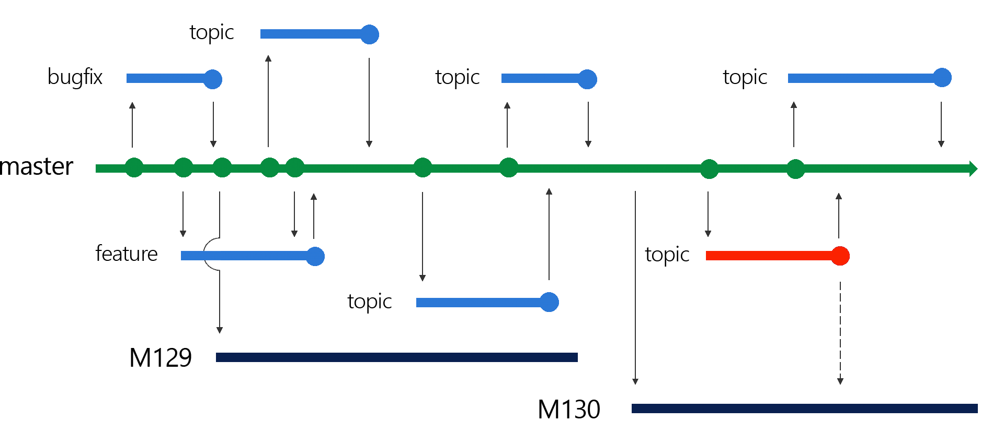
Branches and Release Flow
Release Flow
Contributions made in small branches off master
PR to master
Release branch at sprint milestone
Version calculated
File seed + Git height
NerdBank.GitVersioning
Environment promotion with Release Pipelines
Branches can be released to a test environment

Slide 6
Packaging with MSIX
MSIX is the package format to deploy ANY Windows application
MFC, Win32, UWP, .NET Framework, .NET Core 3… or any other EXE
Publishing Anywhere
Managed: Store, Intune, SCCM
Unmanaged: Custom locations (Web, UNC)
with App Installer app and .appinstaller file
Support .NET Core 3 deployment modes
Self Contained, Framework Dependent

Slide 7
Create MSIX with Visual Studio
Visual Studio Application Packaging Project (.wapproj)
Manifest Editor
Debugging
Packages Wizard
MSBuild based
Customize build/package with MSBuild properties
Available in the UWP Workload

Slide 8
Configuring automatic updates with the .appinstaller
<AppInstaller xmlns="http://schemas.microsoft.com/appx/appinstaller/2018"
Uri="{AppInstallerUri}"
Version="{Version}"> <MainBundle Name="{Name}"
Version="{Version}"
Publisher="{Publisher}"
Uri="{MainPackageUri}"/> <UpdateSettings>
<OnLaunch HoursBetweenUpdateChecks="0"
ShowPrompt="true"
UpdateBlocksActivation="true" />
<AutomaticBackgroundTask/>
<ForceUpdateFromAnyVersion>true</ForceUpdateFromAnyVersion>
</UpdateSettings> </AppInstaller>

Slide 9
Windows Application Packaging Project
https://aka.ms/wapproj

Slide 10
Builds
Hosted Build Agent
Include all VS features
Can be extended with new SDKs
Run automated tests
Clean images for each build
Private Build Agent
Access local resources (UNC shares)
Speed up build times
Custom SDKs installed in advance
Security with public PRs
One YAML file to rule them all

Slide 11
azure-pipelines.yaml
https://aka.ms/yaml

Slide 12
Signing
CA issued certificates
Public CA’s enable wide distribution
Private CA’s enable enterprise distribution
Self Signed certificates
Development/testing purposes only
Not for wide distribution
NOTE: Manifest Publisher MUST match the certificate subject name
NOTE: Local/F5 debugging does not require signed packages

Slide 13
Azure DevOps secure files

Slide 14
Distribution
Store
Consumer apps
Store handles signing
Flights
Auto updates based on Store client
Non-Store
Non-Store Distribution (UNC and Web)
Requires trusted certificate
You are in control of update policy
Great for enterprises
PRO TIP: Modify Package Identity to support Side by Side installations (e.g. Nightly Builds)

Slide 15
Deploying to Azure

Slide 16
Testing
UI Tests is an integration-style
WinAppDriver enables automation for Win10 applications
Supports every type of Win10 app (inc. UWP, WPF, WinForms, Win32)
Built on an open-standard (WebDriver)
Integrates with the Appium/Selenium ecosystem
Web
Selenium
Mobile
Appium
Desktop
WinAppDriver
2004
2011
2017
https://github.com/Microsoft/WinAppDriver

Slide 17
Automated UI Testing

Slide 18
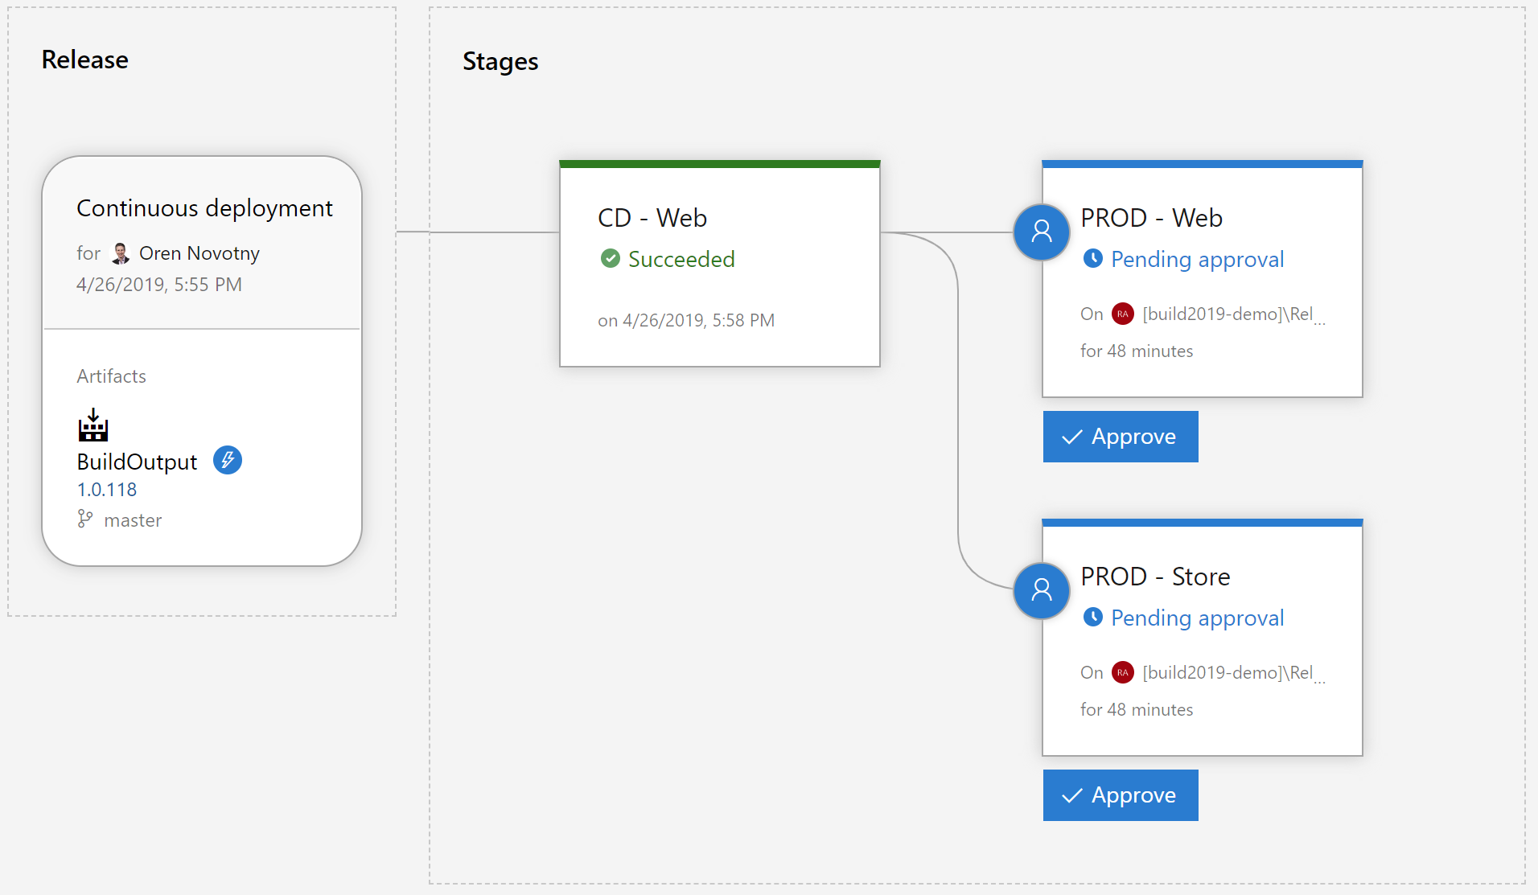
Release Pipelines
Releases deploy artifacts to environments
Client apps should be signed at release time
Promotion based on approval workflow

Slide 19
Environment Promotion

Slide 20
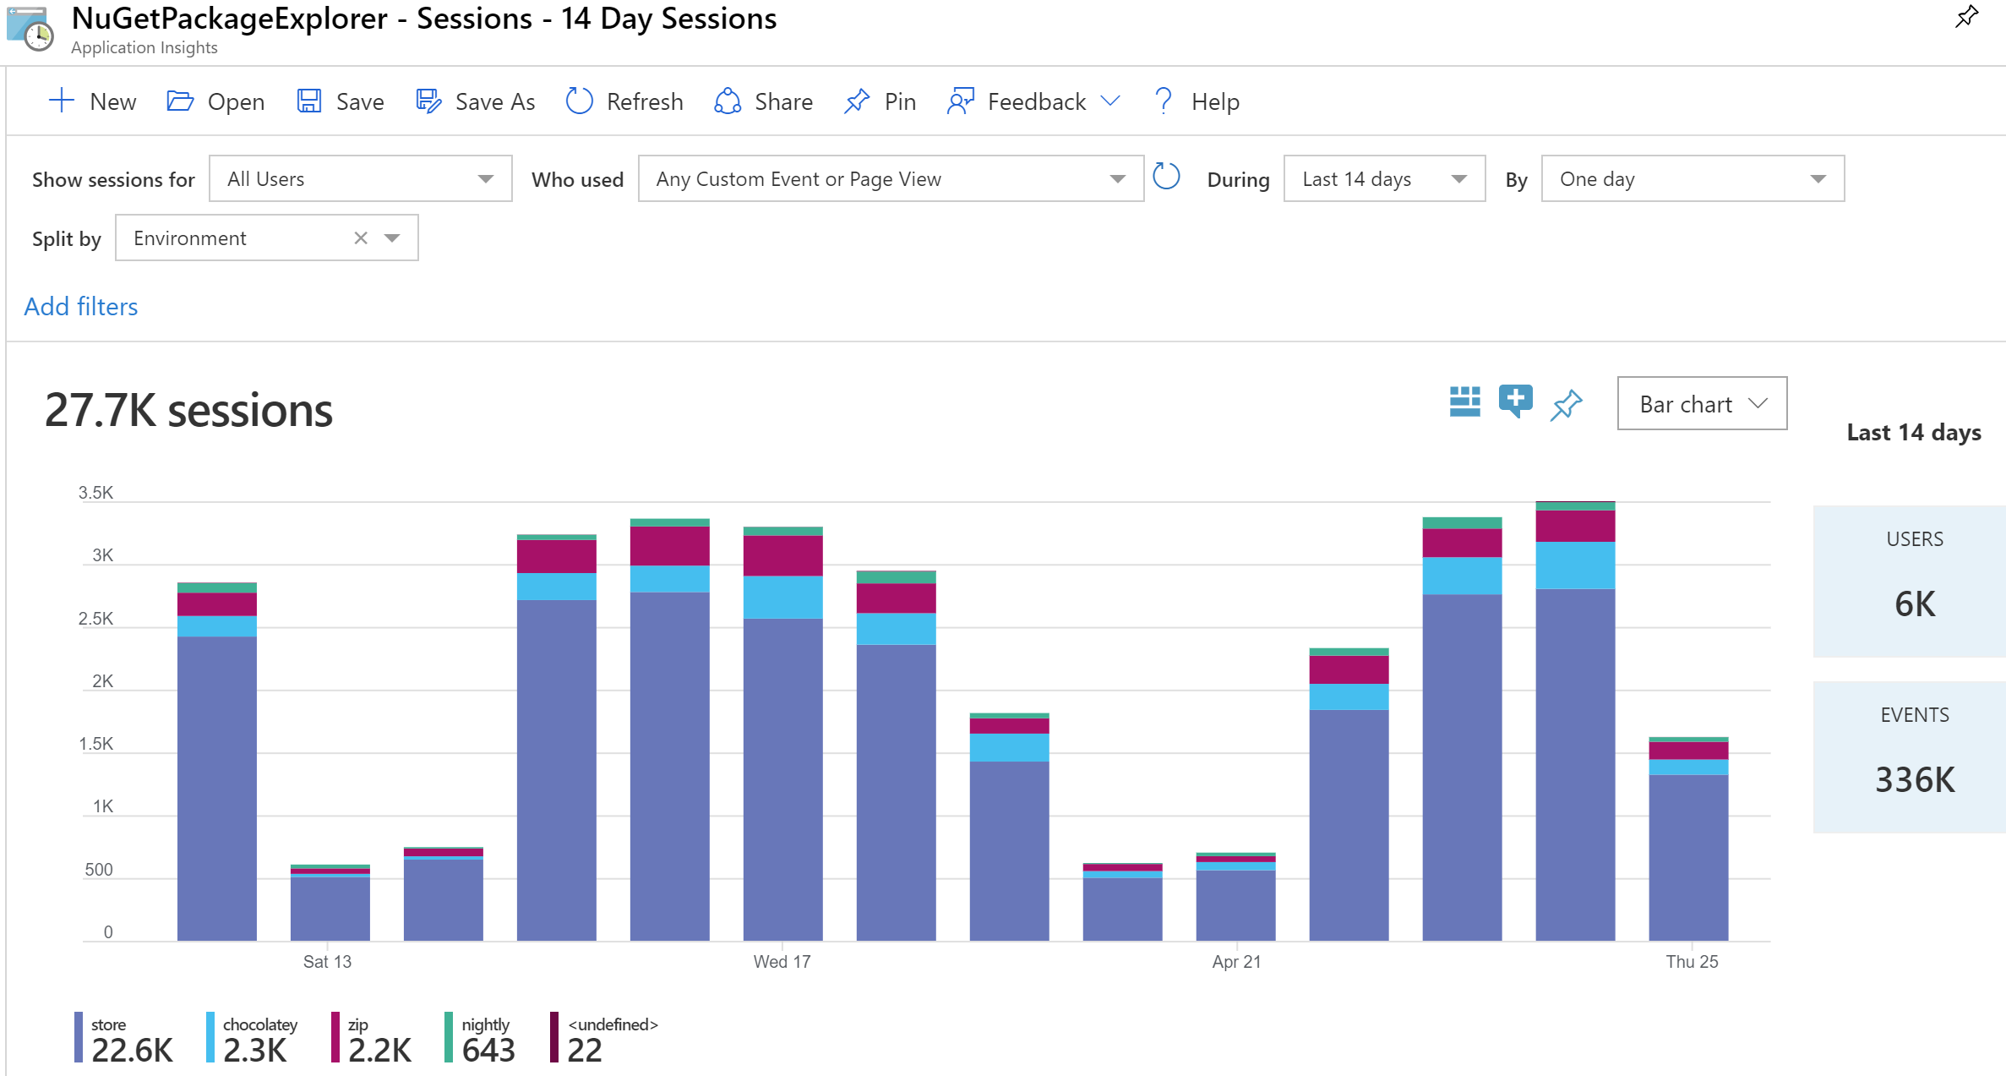
Telemetry

Slide 21
AppInsights

Slide 22
DevOps for Desktop
Branches
Builds
Testing
Telemetry
Signing
Packaging
Distribution

Slide 23
VS Roadmap
Visual Studio 2019 Update (Late Summer)
.NET Core 3.x tooling support for Framework Dependent Deployments
New certificate management in Visual Studio
Enable manifest updates from MSBuild
Add appinstaller templates

Slide 24
Call to action
Use Azure DevOps pipelines to configure your CI/CD
Use VS Packaging Project to produce MSIX packages for existing Desktop applications
Choose the distribution option(s) for your scenario
Automate your UI test with WinAppDriver
Instrument your application for telemetry

Slide 25
Resources
DevOps Demo https://github.com/microsoft/devops-for-windows-apps
Pipelines https://dev.azure.com/devops-for-client-apps/MyWPFApp
MSIX Docs https://docs.microsoft.com/en-us/windows/msix/
MSIX MIME types https://aka.ms/msix-mimetypes
Packaging Project Docs https://aka.ms/wapproj
Packaging Project Samples https://github.com/microsoft/Windows-Packaging-Samples
WinAppDriver https://github.com/microsoft/winappdriver
AppInsights for Desktop https://github.com/onovotny/AppInsights.WindowsDesktop

Slide 26
Please use EventsXD to fill out a session evaluation.
Thank you!

