Slide 1
Improve Your Testing with Visual Studio 2019
Kendra Havens
.NET & Visual Studio
@gotheap

Slide 2
Agenda
Performance Improvements
New Test Explorer UI in Visual Studio 2019 Preview
Why and how we test
Overview of testing tools in Visual Studio
    Generate unit tests
    Code coverage
    Intellitest
    Live Unit Testing
Need to know and Testing productivity tips

Slide 3
Performance!
Visual Studio 2019 start up 1.5x faster than 2017
Branch Switching 2x faster
Significant reduction in memory consumed by the Visual Studio process and faster test discovery for solutions which have a large number of tests.

Slide 4
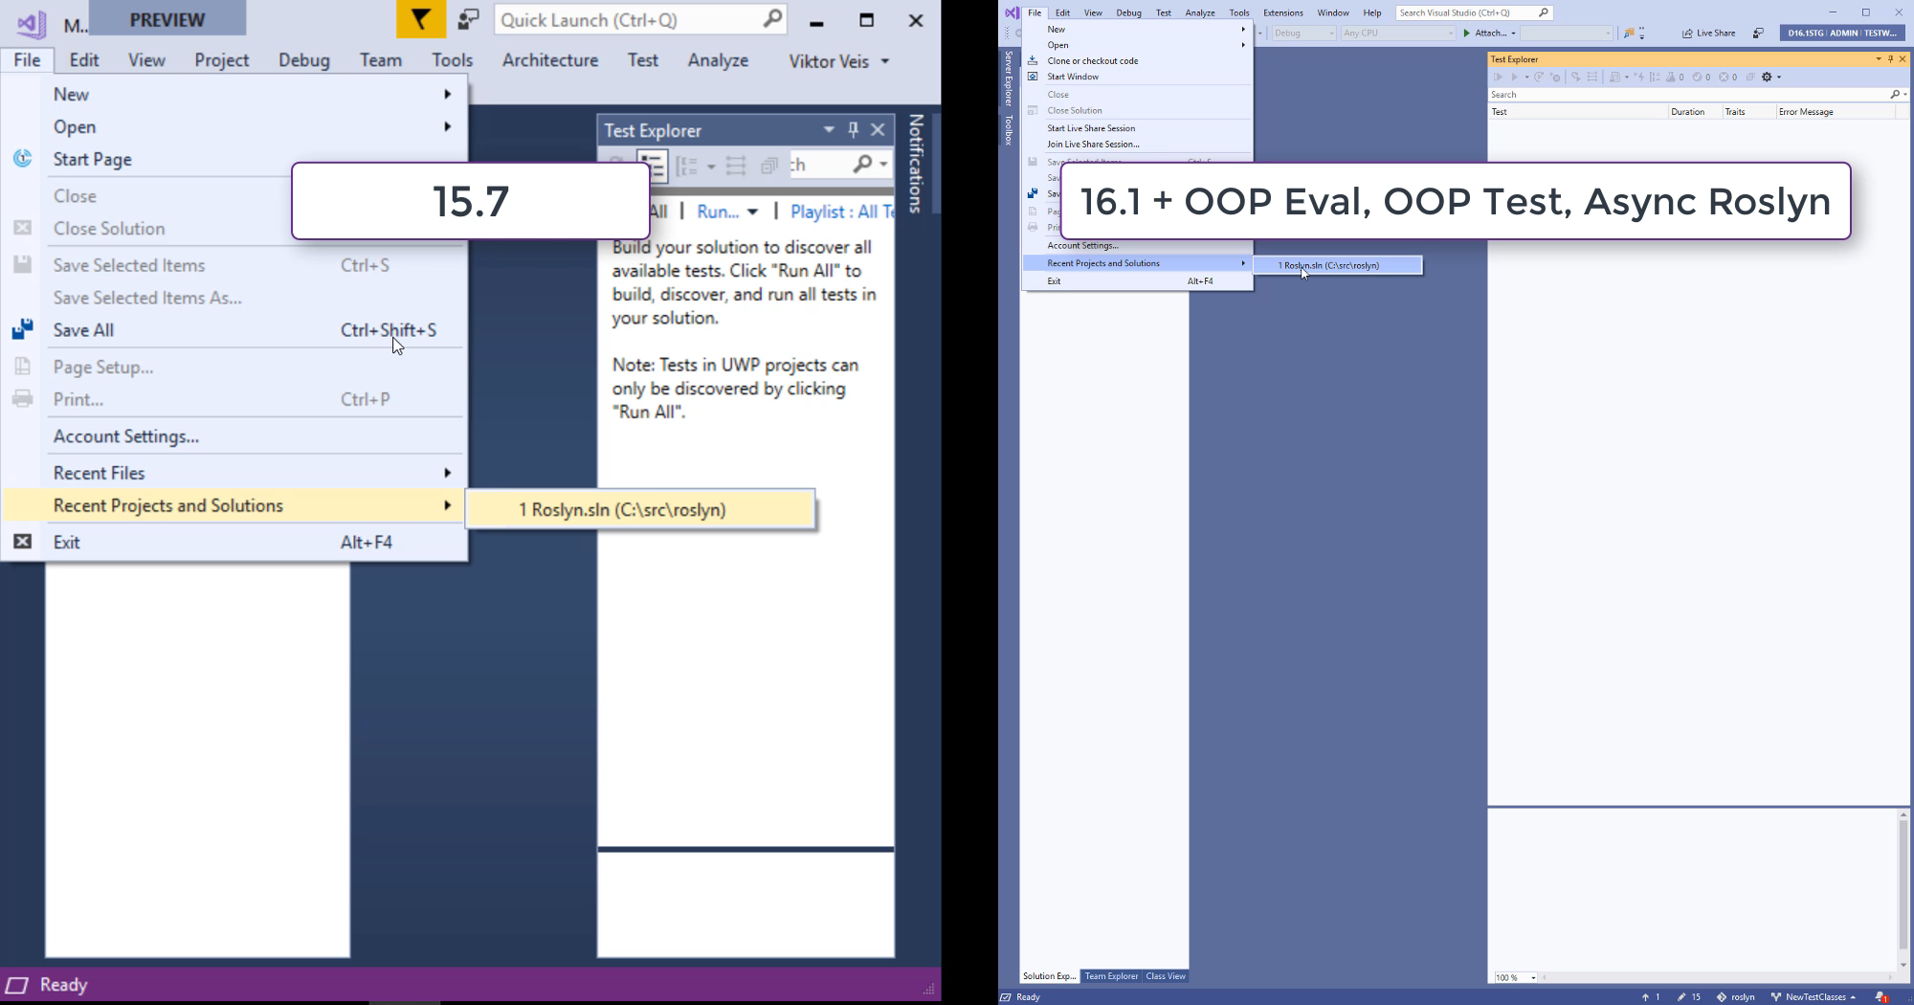

Slide 5
New Test Explorer UI
Now in Preview! (Visual Studio 2019 16.2 Preview 1)
  Significant memory improvements
  Persisted test explorer results between closing and opening Visual Studio
  Filter buttons
  Customizable hierarchy
  Customizable and filterable columns
  Additional ‘Run Failed’ and ‘Run Previous Test Run’ buttons
  Improved test status pane
  Playlists tabs
  Live Unit Testing tab
  Target framework column for viewing multi-targeted tests

Slide 6
Why we test
Validate code changes and quality
Roslyn – 50% OSS contributions, over 4 million lines of code, 100k tests

Slide 7
How we test
Types of tests

Slide 8
How we test
As code base/team grows
  When code needs better documentation
  When code needs better architecture
TDD
When a bug is found
Developer/Team’s preference
Combination of these and everything in between!

Slide 9
Testing tools in Visual Studio
Generate test method stubs (.NET Framework only)
Code coverage
    Enterprise only
    Integrates with Azure DevOps pipeline
Intellitest (.NET Framework and C# only)
    Enterprise only

Slide 10
Live Unit Testing
Only available in Enterprise
Run impacted test in the background as you code
Never forget to run tests before pushing to the server
Easily view and run what tests cover specific lines of code
Manage tests included and excluded from Live Unit Testing
  Skip category
  Include/Exclude entire test projects, namespace, or classes
  View in the Live Unit Testing tab
Task Center Notification – gives feedback on Live Unit Testing discovery, build, and execution

Slide 11
Public service announcements
MSTest and VSTest are open source!
  Docs, RFCs, and issues can be very informative for troubleshooting/debugging/reporting issues
  VSTest: https://github.com/Microsoft/vstest
  MSTest framework: https://github.com/Microsoft/testfx
Update your test adapters! Performance improvements in MSTest, NUnit, and xUnit.

Slide 12
Testing productivity tips
Solution filters
Apply different code styles to tests with Editorconfig
Sync namespace and folder name
Remapping test commands
  ReSharper keyboard profile built-in
  Assign new keyboard shortcuts to unassigned commands
Visual Studio Search (Ctrl +Q)
CodeLens now in Visual Studio community – including the test indicators!

Slide 13
Call to Action
Tomorrow 10 AM:
Increase Your .NET Productivity with Visual Studio 2019!
Learn more on testing tools
    https://docs.microsoft.com/en-us/visualstudio/test
Send us feedback:
    https://developercommunity.visualstudio.com/
    Tweet me @gotheap
    Email me: kehavens@microsoft.com

Slide 14
Please use EventsXD to fill out a session evaluation.
Thank you!

