Slide 1
What’s Happening with my App, Application Insights?
Joseph Guadagno
jguadagno@hotmail.com
@jguadagno
http://jjg.me/aboutJJG

Slide 2
About Joseph Guadagno
Directory, Technology at Quicken Loans
Organizer of Desert Code Camp
Microsoft “Developer Services” MVP
Father of 2, husband to 1
Notes:
Former President and Vice President of INETA North America (2007-2015)
Founder of the Southeast Valley .NET User Group (SEVDNUG) in Chandler, AZ (2007-2013)
Currently serving on my the City of Chandler‘s Parks and Recreation board (since 2010)
Telerik MVP (2010 to 2012)
Microsoft Visual Basic MVP (1996)

Slide 3
Agenda
Azure Monitor
Walk through Application Insights
Adding Application Insights
Enhancing Application Insights
Using the Application Insights Portal

Slide 4
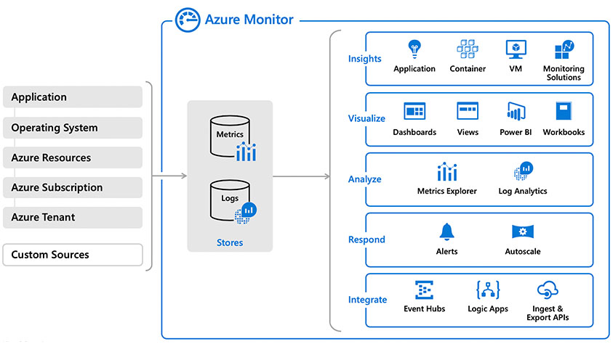
What is Azure Monitor?
Notes:
Azure Monitor collects monitoring telemetry from a variety of on-premises and Azure sources. Management tools, such as those in Azure Security Center and Azure Automation, also push log data to Azure Monitor. The service aggregates and stores this telemetry in a log data store that’s optimized for cost and performance. Analyze data, set up alerts, get end-to-end views of your applications, and use machine learning–driven insights to quickly identify and resolve problems.

Slide 5
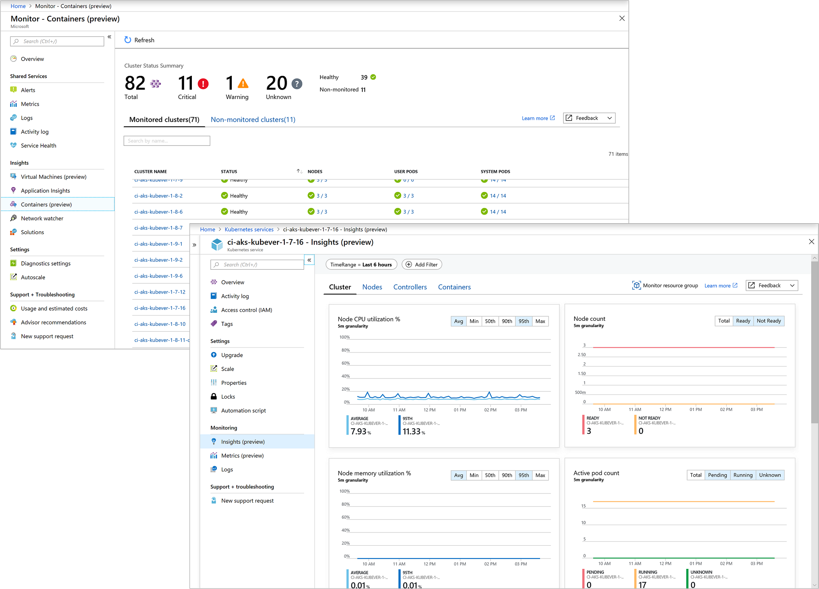
Azure Monitor for Containers
Notes:
Azure Monitor for containers monitors the performance of container workloads deployed to either Azure Container Instances or managed Kubernetes clusters hosted on Azure Kubernetes Service (AKS). Monitoring your containers is critical, especially when you're running a production cluster, at scale, with multiple applications.

Slide 6
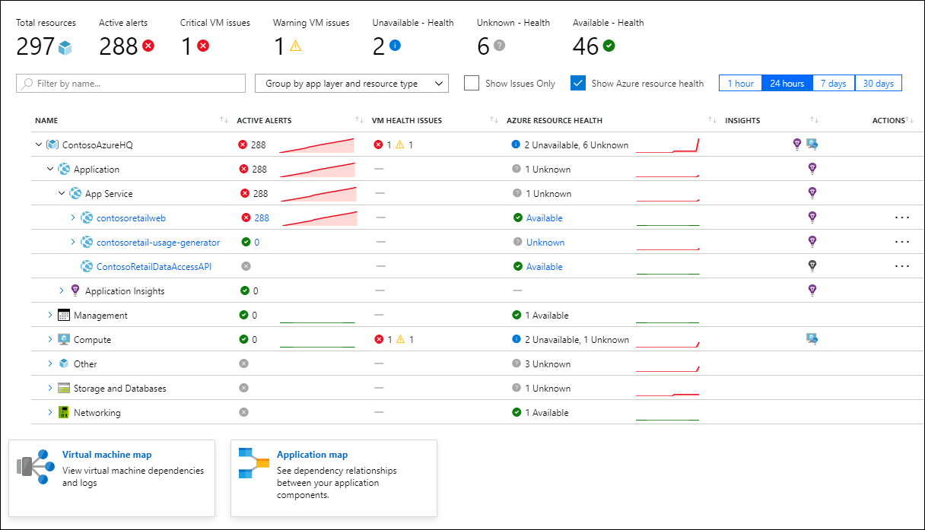
Azure Monitor for Resource Groups
Notes:
Azure Monitor for resource groups helps to triage and diagnose any problems your individual resources encounter, while offering context as to the health and performance of the resource group as a whole.

Slide 7
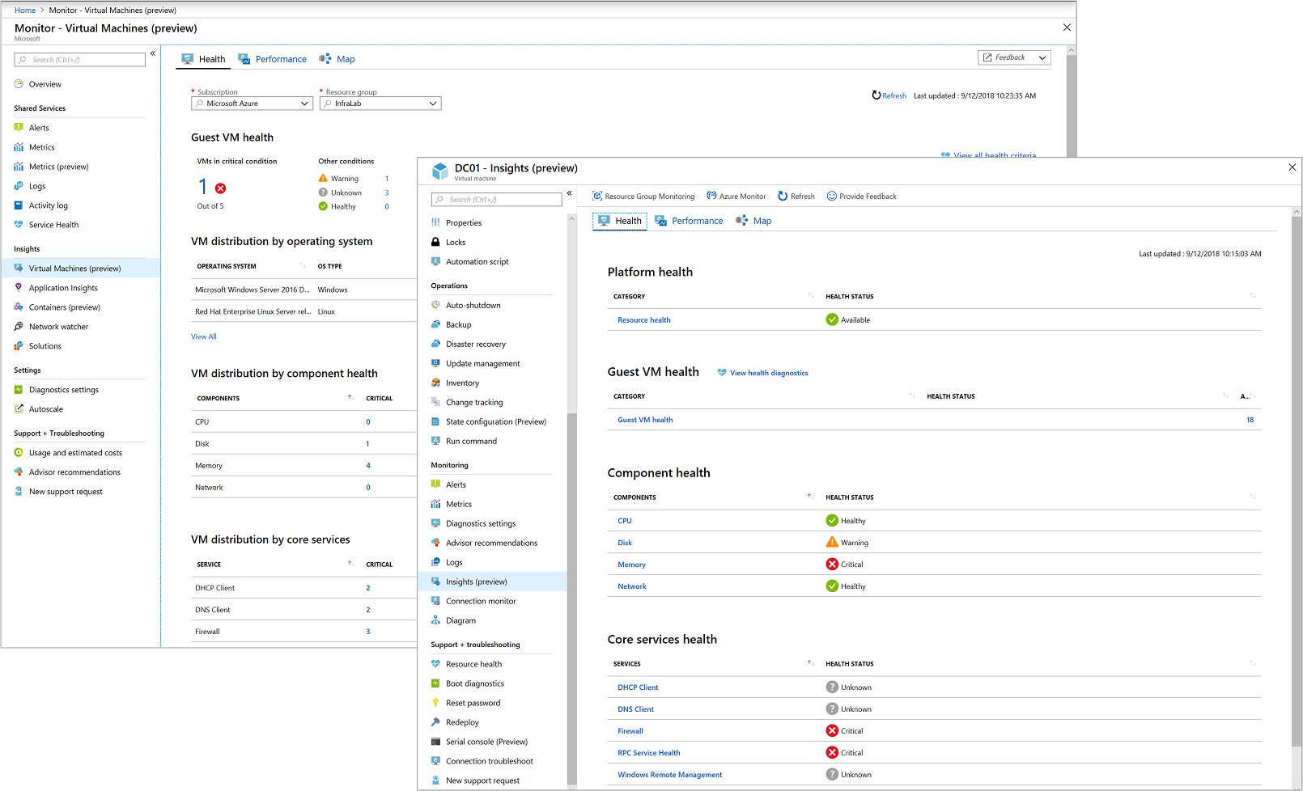
Azure Monitor for VMs
Notes:
Azure Monitor for VMs monitors your Azure virtual machines (VM) and virtual machine scale sets at scale. It analyzes the performance and health of your Windows and Linux VMs, and monitors their processes and dependencies on other resources and external processes.

Slide 8
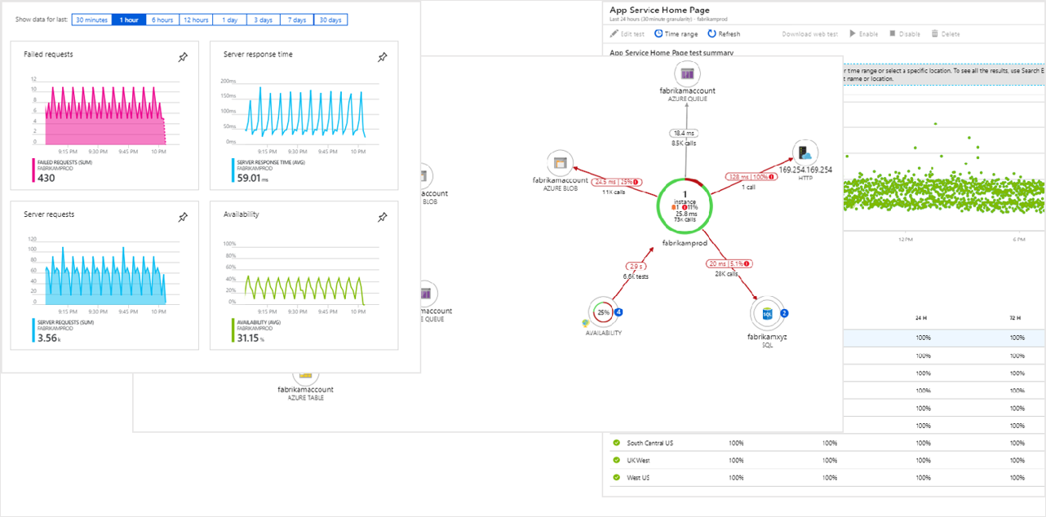
Application Insights
Notes:
Application Insights is an extensible Application Performance Management (APM) service for web developers on multiple platforms. Use it to monitor your live web application. It will automatically detect performance anomalies. It includes powerful analytics tools to help you diagnose issues and to understand what users actually do with your app. It's designed to help you continuously improve performance and usability. It works for apps on a wide variety of platforms including .NET, Node.js and J2EE, hosted on-premises or in the cloud. It integrates with your DevOps process, and has connection points to a variety of development tools. It can monitor and analyze telemetry from mobile apps by integrating with Visual Studio App Center and HockeyApp.

Slide 9
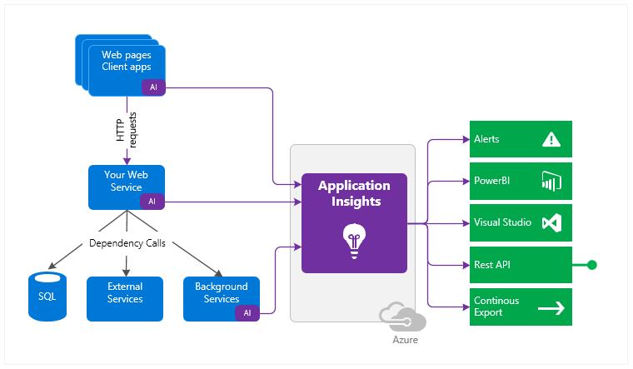
How Does Application Insights Work?
Notes:
Talk to you can use AI to * Monitor, Detect/Diagnose, and Build/Measure

Slide 10
What Does Application Insights Monitor?
Request rates, response times, and failure rates
Dependency rates, response times, and failure rates
Exceptions
Page views and load performance
AJAX calls
User and session counts.
Performance counters
Host diagnostics
Diagnostic trace logs from your Applications
Custom events and metrics
Notes:
Request rates, response times, and failure rates - Find out which pages are most popular, at what times of day, and where your users are. See which pages perform best. If your response times and failure rates go high when there are more requests, then perhaps you have a resourcing problem.
Dependency rates, response times, and failure rates - Find out whether external services are slowing you down.
Exceptions - Analyse the aggregated statistics, or pick specific instances and drill into the stack trace and related requests. Both server and browser exceptions are reported.
Page views and load performance - reported by your users' browsers.
AJAX calls from web pages - rates, response times, and failure rates.
User and session counts.
Performance counters from your Windows or Linux server machines, such as CPU, memory, and network usage.
Host diagnostics from Docker or Azure.
Diagnostic trace logs from your app - so that you can correlate trace events with requests.
Custom events and metrics that you write yourself in the client or server code, to track business events such as items sold or games won.

Slide 11
Supported Languages/Platforms
.NET
.NET Core
JavaScript
Node.js
Java
Mobile
Plugins
Notes:
Mobile (Android, IO, Universal Windows, React Native)

Slide 12
WordPress Plugins
Application Insights
http://jjg.me/ai_wpai
Header and Footer
http://jjg.me/ai_wphf

Slide 13
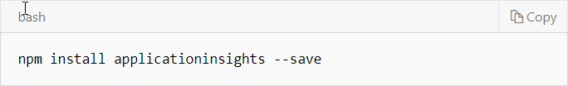
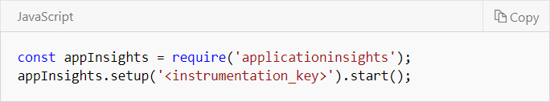
Node.js

Slide 14
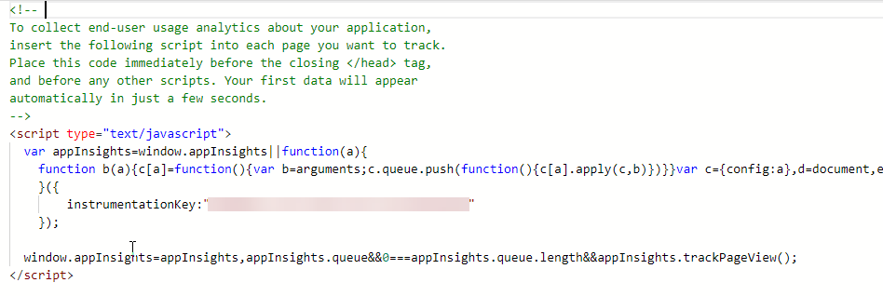
JavaScript

Slide 15
Application Insights
Create the Resource

Slide 16
Contoso (.NET) Example
https://jjg.me/ai-contoso

Slide 17
Logging Packages
Logger | Package
lLogger | Microsoft.Extensions.Logging.ApplicationInsights
NLog | Microsoft.ApplicationInsights.NLogTarget
Log4Net | Microsoft.ApplicationInsights.Log4NetAppender
System.Diagnostics | Microsoft.ApplicationInsights.TraceListener
 | Microsoft.ApplicationInsights.DiagnosticSourceListener
 | Microsoft.ApplicationInsights.EtwCollector
 | Microsoft.ApplicationInsights.EventSourceListener

Slide 18
Custom Events and Metrics
Method | Used for
TrackPageView | Pages, screens, blades or forms
TrackEvent | User actions and other events. Used to track user behavior or to monitor performance.
TrackMetric | Performance measurements such as queue lengths not related to specific events
TrackException | Log exceptions for diagnosis. Trace where they occur in relation to other events and examine stack traces.
TrackRequest | Log the frequency and duration of server requests for performance analysis.
TrackTrace | Diagnostic log messages. You can also capture 3rd-party logs.
TrackDependency | Log the duration and frequency of calls to external components on which your app depends.

Slide 19
References
What is Application Insights - http://jjg.me/ai_whatis
  Application Insights Documentation - http://jjg.me/ai_docs
  ASP.NET Setup - http://jjg.me/ai_aspnet
  Application Insights Status Monitor - http://jjg.me/ai_statusmon
  Status Blog - http://jjg.me/ai_service_status
  Monitor Web App Performance - http://jjg.me/ai_mon_webapp

