Slide 1
Your .NET App Won’t Scale
Glenn Condron
@condrong

Slide 2
What do we mean by “scale”?
Scale is a measure of user/request/connections per scale-unit (machine, container, etc)
“If you do nothing, you can scale it infinitely” – Scott Hanselman
Notes:
2

Slide 3
Types of scaling
Horizontal Scale (scaling out)
Add more units of scale (machines/VM/containers/etc.)
Vertical scale (scaling up)
Adding more capable resources to an existing scale unit (more CPU/memory/network bandwidth)
Notes:
Usually vertical scaling is easier. Move the slider and pay more.
Horizontal scaling is more challenging. Especially when you go from 1 to 2. As an example, session state can normally be persisted in-memory. However, when you go from 1 to 2, you now need a backing data store.
Talk about 12-factor app here
I. Codebase
One codebase tracked in revision control, many deploys
II. Dependencies
Explicitly declare and isolate dependencies
III. Config
Store config in the environment
IV. Backing services
Treat backing services as attached resources
V. Build, release, run
Strictly separate build and run stages
VI. Processes
Execute the app as one or more stateless processes
VII. Port binding
Export services via port binding
VIII. Concurrency
Scale out via the process model
IX. Disposability
Maximize robustness with fast startup and graceful shutdown
X. Dev/prod parity
Keep development, staging, and production as similar as possible
XI. Logs
Treat logs as event streams
XII. Admin processes
Run admin/management tasks as one-off processes

Slide 4
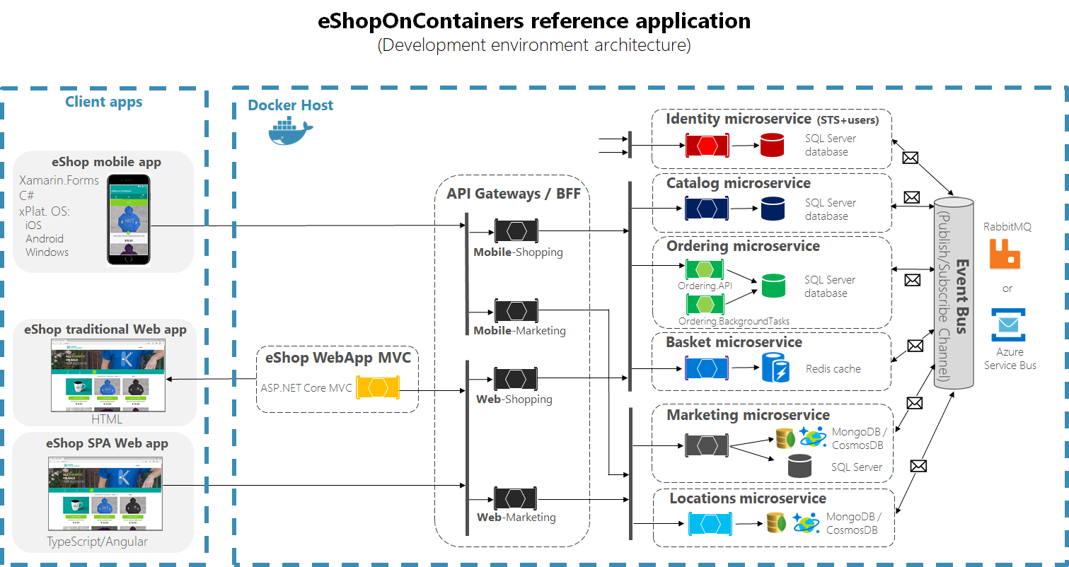
Notes:
Usually vertical scaling is easier. Move the slider and pay more.
Horizontal scaling is more challenging. Especially when you go from 1 to 2. As an example, session state can normally be persisted in-memory. However, when you go from 1 to 2, you now need a backing data store

Slide 5
What affects scale
CPU
Hot paths in your application
Contended locks
Memory
Memory leaks (work isn’t cleaning up properly when complete)
Inefficient memory usage (using more memory than expected for the work)
IO
Ephemeral port exhaustion
Running out of disk/storage space
Blocking IO
Bandwidth and latency

Slide 6
What affects scale (CLR)
GC
Too many GC pauses
ThreadPool
ThreadPool starvation
Timers
Too many timers
Exceptions
Locks
Highly contended locks
Synchronous IO
*Sometimes the use of these things isn’t in your app`
Notes:
11.25

Slide 7
DEMO
Logging can impact
Single Node:
GC
IO
Memory
Scale Out:
Log files and console are per-node
App Insights, ELK, LogStash, LogSpout, Seq

Slide 8
DEMO
Regex
CPU
Denial of Service
HTTPClient
IO

Slide 9
Async Programming
Doing async right can increase scalability
Doing async wrong can severely decrease scalability
.NET has lots of async traps
The number one rule is DON’T BLOCK
Notes:
11.40

Slide 10
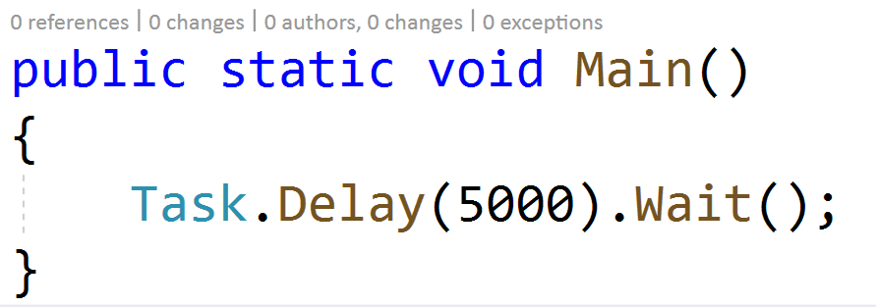
Sync over async
How many threads does this code sample use?

Slide 11
ThreadPool
Sync over async
APIs that masquerade as synchronous but are actually blocking async methods
Uses 2 threads to complete a single operation
Blocking APIs are BAD
Avoid Task.Wait, Task.Result, Thread.Sleep, GetAwaiter.GetResult()
Excessive blocking on thread pool threads can cause starvation
Thread injection rate beyond configured max is slow (2 per second)
1-2 MB per stack thread. Watch for memory limits

Slide 12
Thread Starvation
ASP.NET Core needs a thread pool thread to parse HTTP and run your app func
A thread pool thread is needed to run the result of work after an await
Timers need a thread pool thread to execute the code that fires
Work will be queued forever waiting for threads
See links for post on using PerfView to diagnose Thread Starvation.

Slide 13
Demo: Sync over Async

Slide 14
Timer Queue
There’s TimerQueue per CPU Core
Timers within a TimerQueue form a linked list
Timers are optimized for adding and removing
Timer callbacks are scheduled to the ThreadPool
Each TimerQueue is protected by a lock
Disposing the timer removes it from the queue
Notes:
11.55

Slide 15
Demo: Timer leak

Slide 16
Load testing
Scale issues usually show up when it’s too late
It’s important to figure out how much load your application can handle
For a fixed RPS, monitor CPU and memory usage
Understand how much each scale unit in your deployment can handle (e.g., each VM can handle 1000 rps)
Notes:
Measure early and keep measuring
Run load tests
Find bottlenecks
Fix issues
Repeat step 1

Slide 17
Scalability checklist: CPU
Machine resources
CPU usage
CLR resources
ThreadPool (work-items and worker threads)
GC (Gen 0/1/2 collections)
Locks
Application logic
Serialization
Chatty IO
Regex without timeouts

Slide 18
Scalability Checklist: Memory
Machine resources
Memory usage
Number of threads
CLR resources
Timers
GC (heap size for Gen 0/1/2)
Application logic
Strings
Reading everything into memory instead of using streaming data
Disk IO
Network IO
Disposable objects not being disposed

Slide 19
Scalability Checklist: IO
Machine resources
Number of open files/handles/sockets (check ulimit)
CLR resources
IO threads
Application logic
HttpClient
DbConnection/SqlConnection
FileStream
Inefficient buffering (lots of small read/write packets)

Slide 20
Links
Workshop Samples: https://github.com/shirhatti/ReadyWorkshop2019
Fowler Guidance: https://github.com/davidfowl/AspNetCoreDiagnosticScenarios/blob/master/AsyncGuidance.md
Diagnosing ThreadPool starvation in ASP.NET Core https://blogs.msdn.microsoft.com/vancem/2018/10/16/diagnosing-net-core-threadpool-starvation-with-perfview-why-my-service-is-not-saturating-all-cores-or-seems-to-stall/
High performance logging in ASP.NET Core: https://docs.microsoft.com/en-us/aspnet/core/fundamentals/logging/loggermessage?view=aspnetcore-2.2
High Performance ASP.NET Core: https://docs.microsoft.com/en-us/aspnet/core/performance/performance-best-practices?view=aspnetcore-2.2

